Slide 1
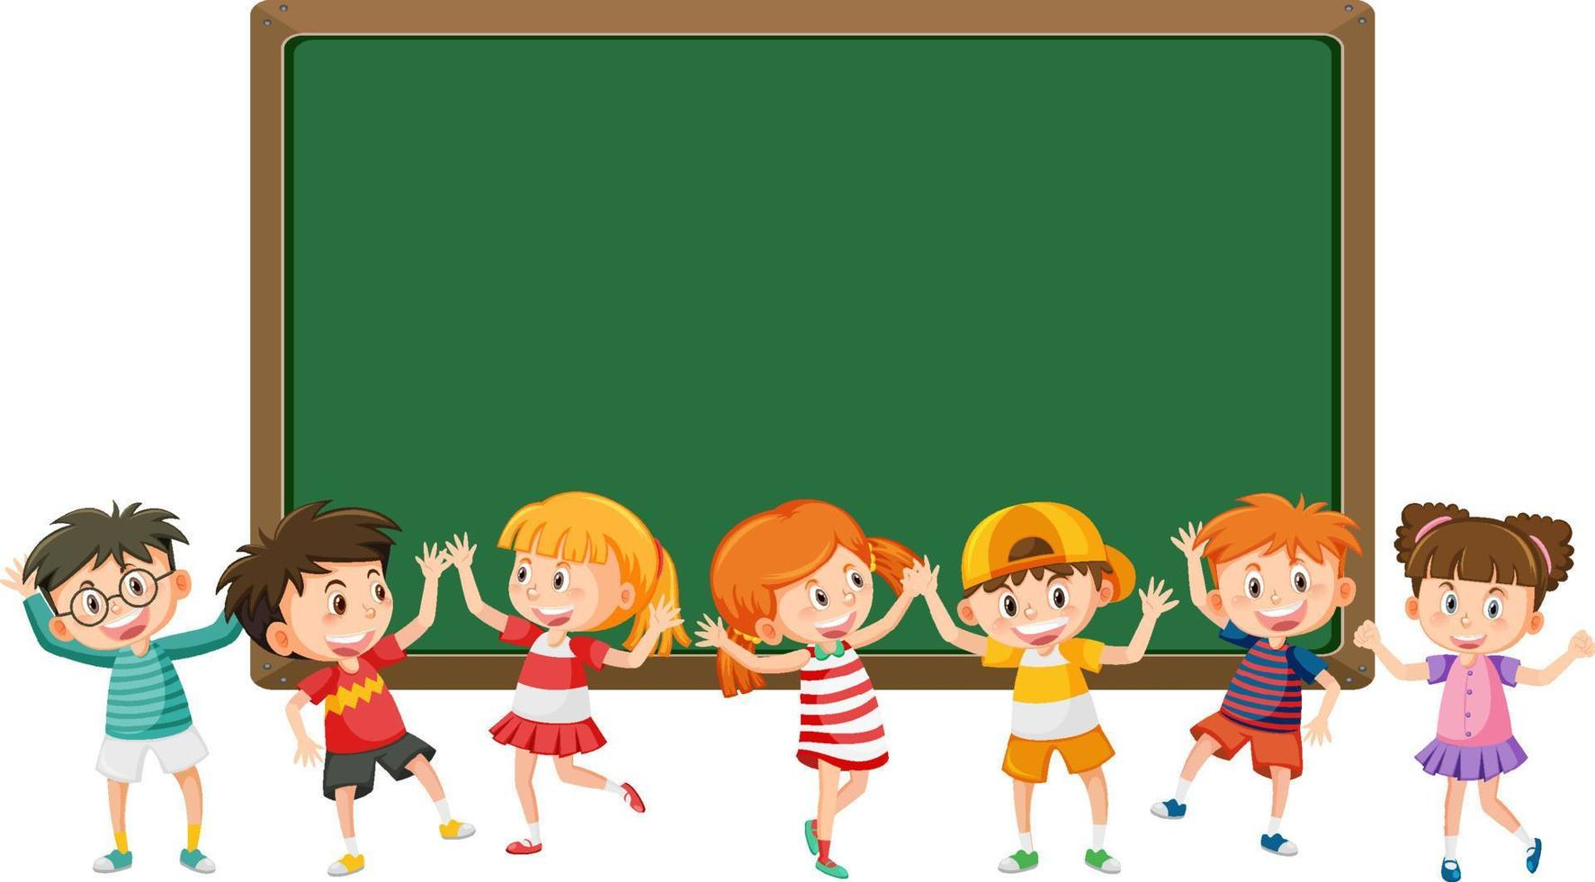
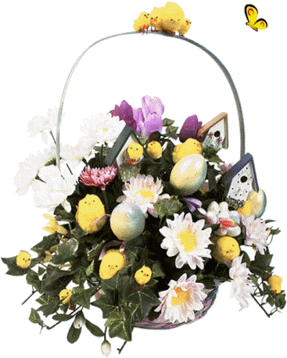
Warmly welcome teachers and students
to our English class!
Teacher: Phùng Thị Kim Sinh
Class: 7B

Slide 2


Slide 3



PERIOD 71: LESSON 6.8:
VOCABULARY IN ACTION
(SB page 68)

Slide 4

01. Review vocabulary about “school subjects and Class activities”
02. Pronounce the /ð/ and /θ/ sounds.

Slide 5

RING THE GOLDEN BELL
RING THE GOLDEN BELL
Let’s
Play!

Slide 6
Ring the golden bell.
How does it work?
- Team game/ individual work.
- You have 3 seconds to write your choice on the board.
- If you have correct answer, shake your board well.
-The team with more correct answers will get 1 star for each sentence.

Slide 7
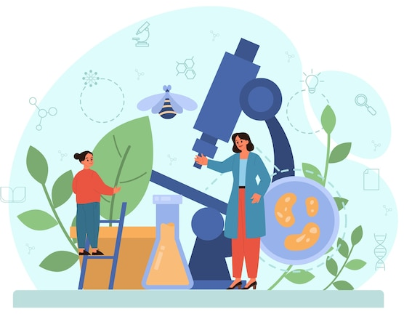
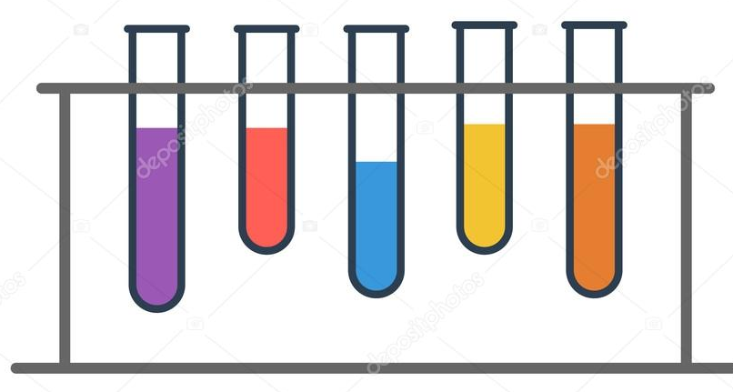
QUESTION 1
QUESTION 2
A. literature
A. homework
B. biology
B. microscope
C. physical education
C. test tube

Slide 8

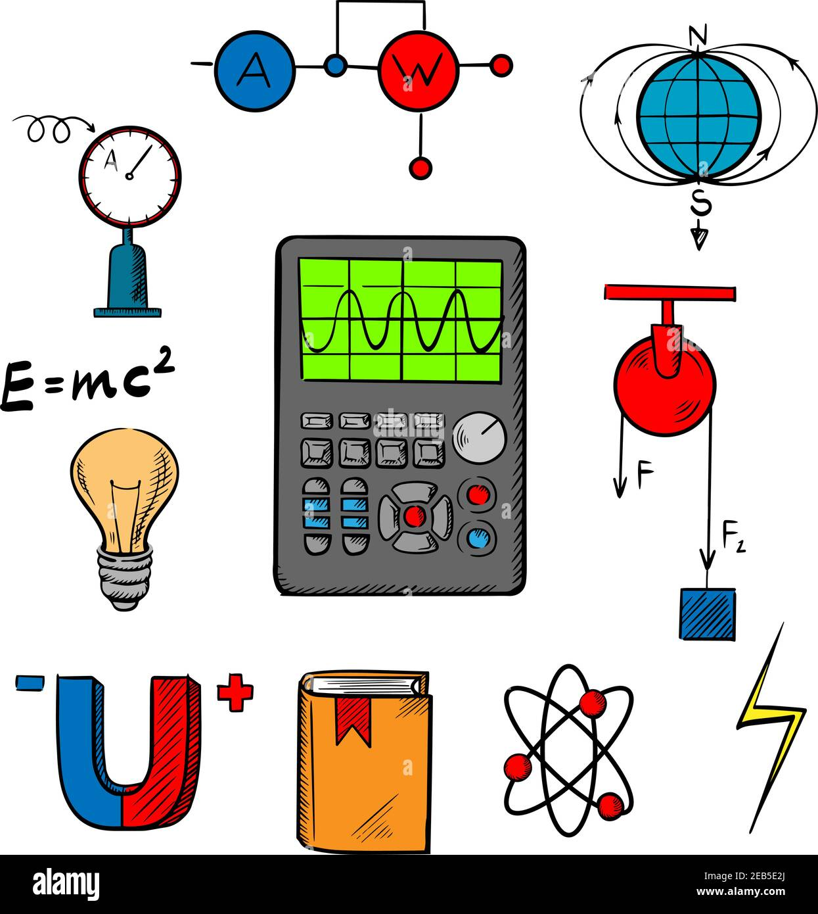
QUESTION 3
QUESTION 4
A. microscope
A. maths
B. heritage
B. physics
C. dissect
C. chemistry

Slide 9
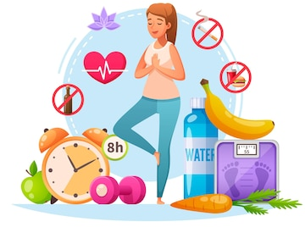

QUESTION 5
QUESTION 6
A. experiment
A. healthy
B. computer program
B. geographical
C. heritage
C. weak

Slide 10
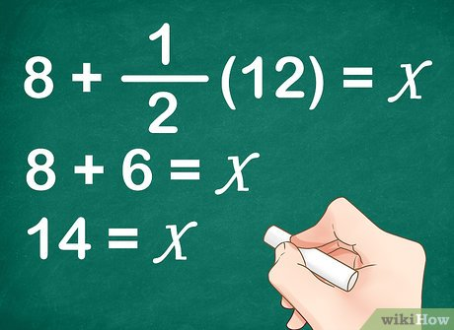
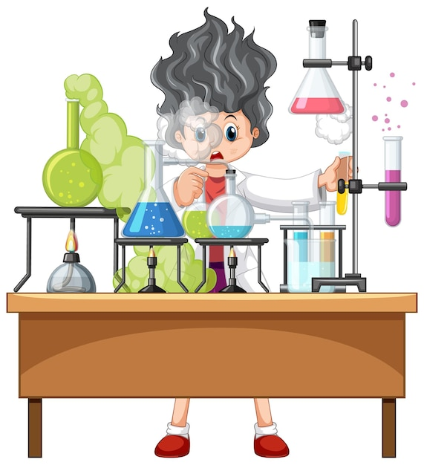
QUESTION 7
QUESTION 8
A. build a website
A. solve an equation
B. solve an equation
B. do an experiment
C. get an A
C. take a nap

Slide 11
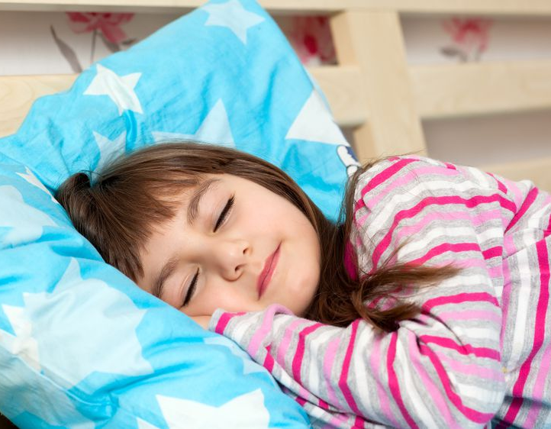
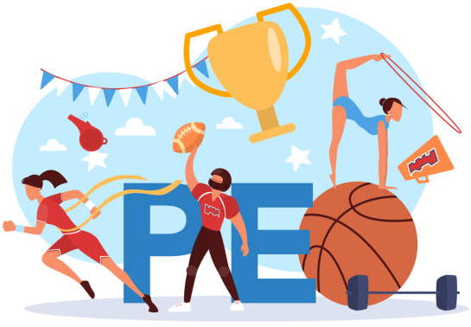
QUESTION 9
QUESTION 10
A. take a nap
A. solve an equation
B. prepare for exams
B. turn in homework
C. draw a map
C. compete in a game

Slide 12
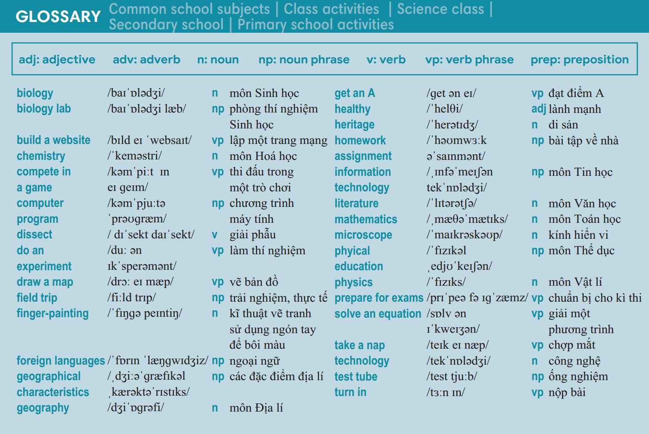

Slide 13
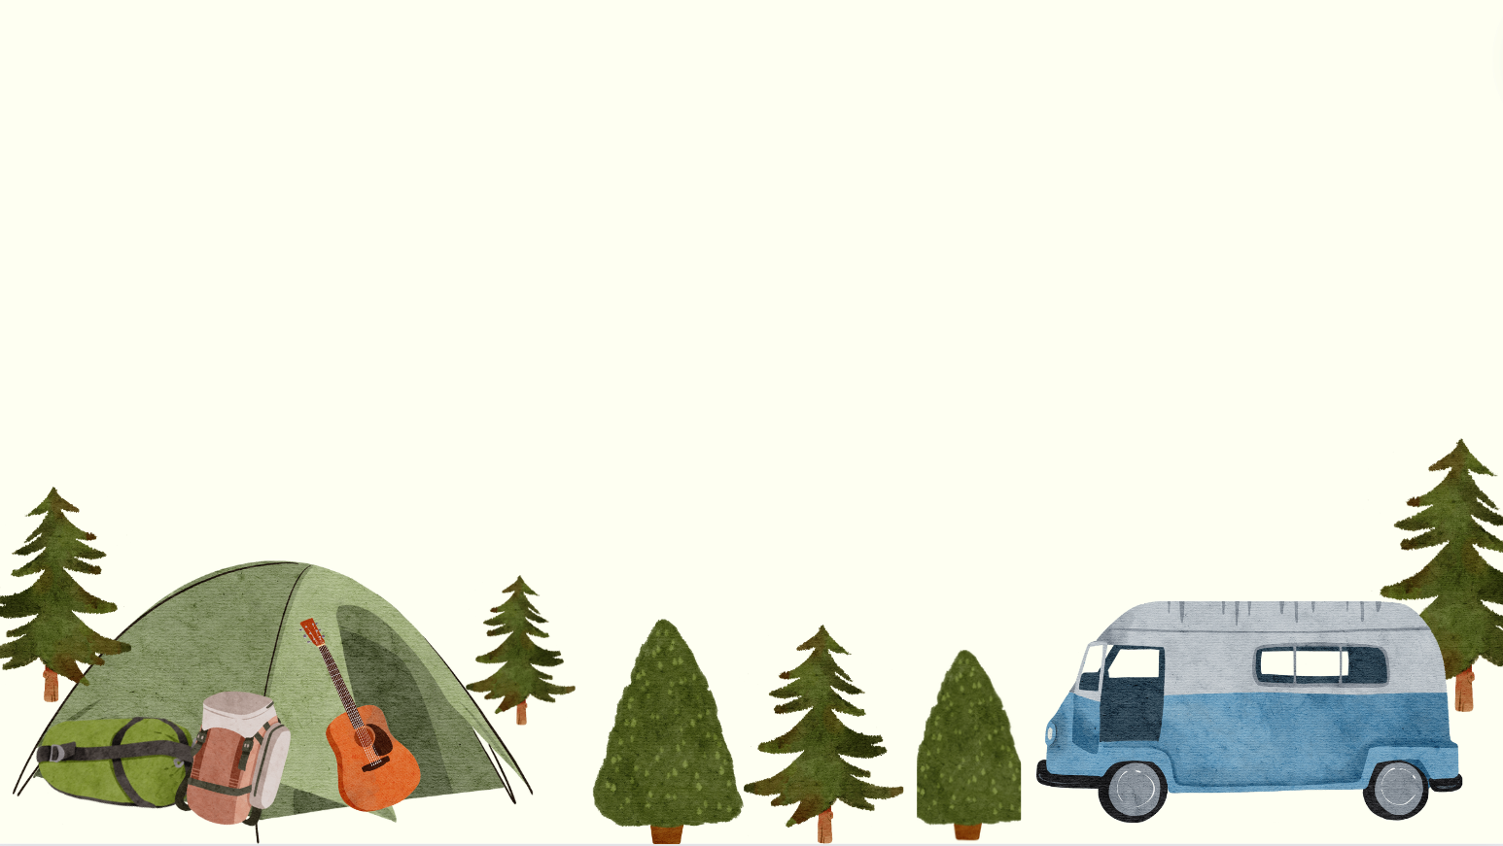

Exercise 1 (SB p.68)
Use the glossary to find:
7 words about science
4 words about primary school
5 school subjects
4 words about homework and exams

Slide 14

Exercise 1 (SB p.68)
Use the glossary to find:
7 words about science
4 words about primary school
biology
lab
chemistry
computer program
mathematics
homework
algebra
library
geometry
physics
information technology

Slide 15

Exercise 1 (SB p.68)
Use the glossary to find:
5 school subjects
4 words about homework and exams
biology
homework
chemistry
assignment
geography
Equation test
literature
Oral test
physics

Slide 16
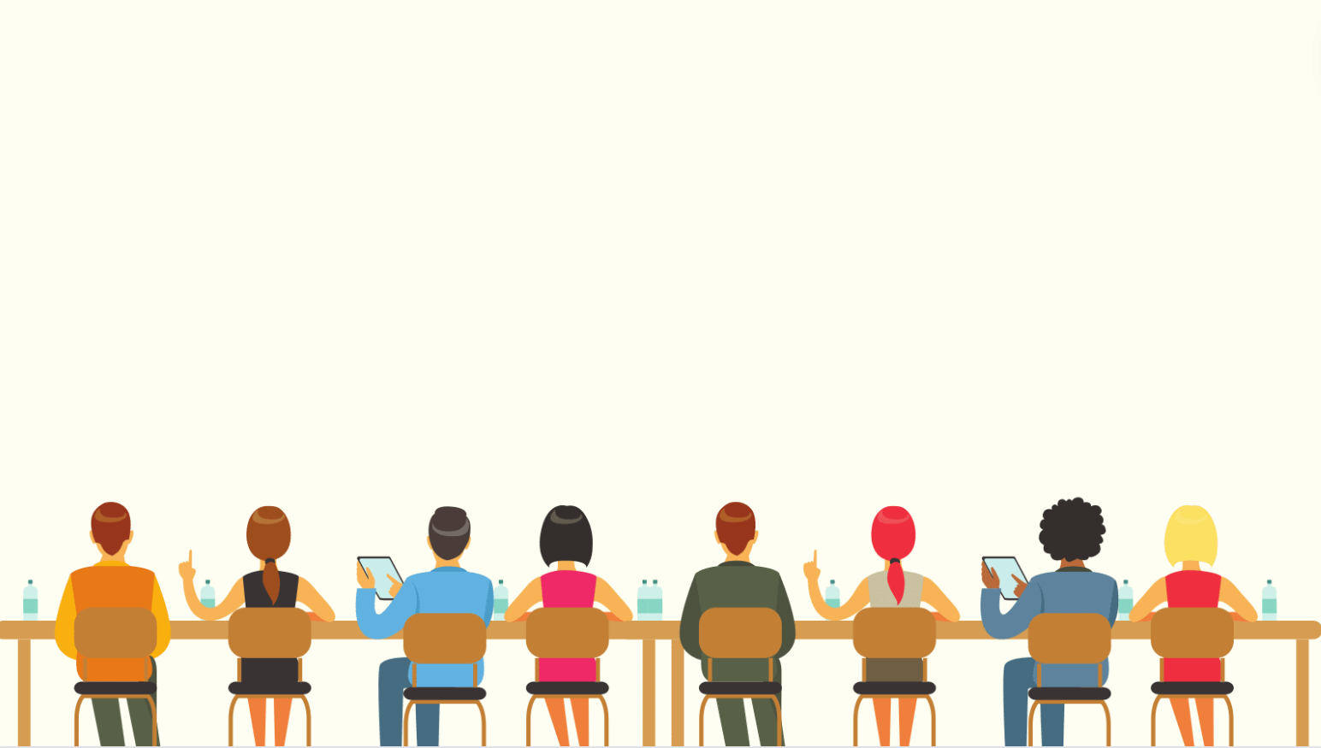
Exercise 2 (SB p.68) - Use the glossary to complete the sentences.
In pairs, say if statements are true for you.
1, I was never very good at sport, so I don’t like _______________________
very much.
2, I love music, but I cannot play any __________
3, Our science teacher lets us look at things under a _______________.
4, I don’t like _______________ . I don't like reading poems or stories.
I think it’s boring.
5, I exercise every day, because it is important to keep fit and ____________.

Slide 17
Exercise 2 (SB p.68) - Use the glossary to complete the sentences.
In pairs, say if statements are true for you.
GAME LUCKY NUMBER
Play!
Let’s

Slide 18
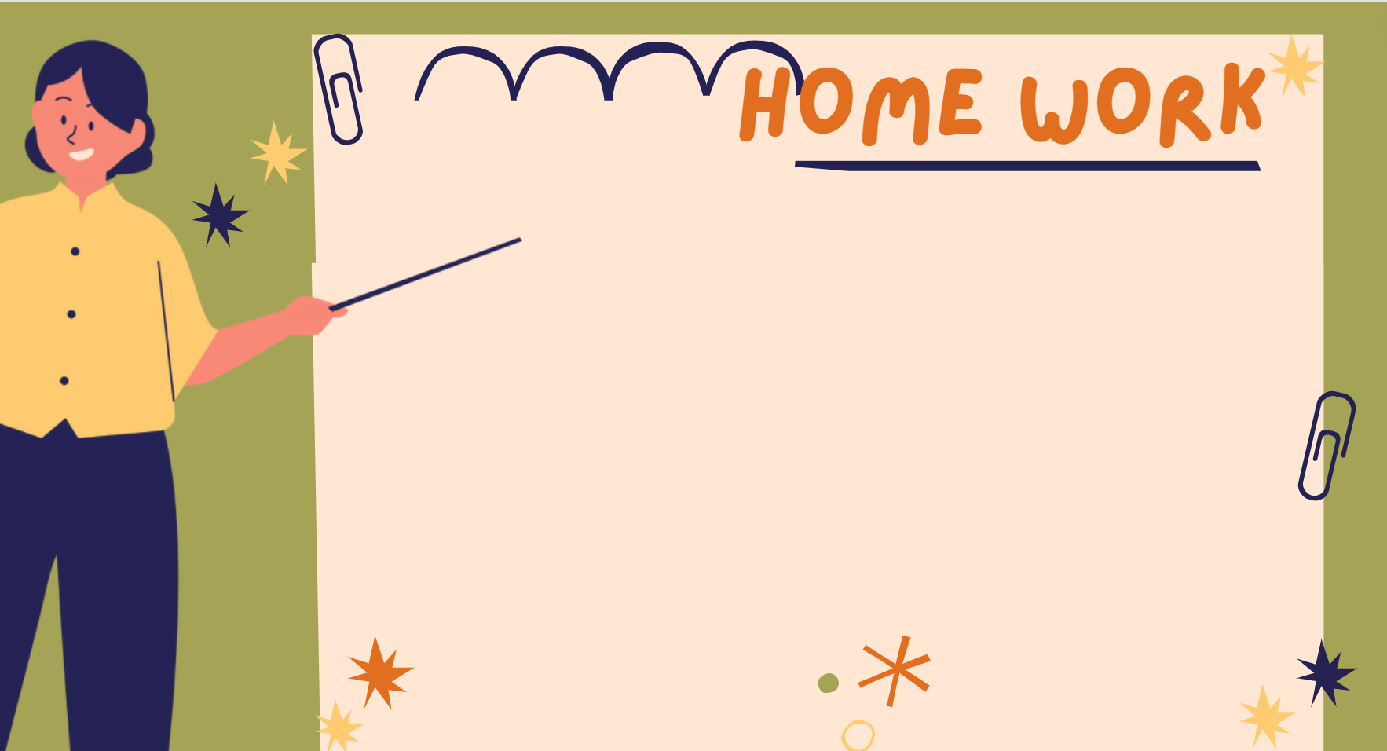
1
2
3
4
5
6

Slide 19
1, I was never very good at sport, so I don’t like ___________________
very much.
physical education

Slide 20
2, I love music, but I cannot play any ___________.
musical instruments

Slide 21
3, Our science teacher lets us look at things under a _______________.
microscope

Slide 22
4, I don’t like _______________ . I don't like reading poems or stories.
I think it’s boring.
literature

Slide 23
5, I exercise every day, because it is important to keep fit and ____________.
healthy

Slide 24
LUCKY NUMBER
Bạn nhận được một trang pháo tay khen thưởng

Slide 25

Exercise 3 (SB p.68)
In pairs, discuss the differences between the words below.
1 | biology | biology lab
2 | chemistry | physics
3 | English | foreign languages
4 | literature | history
5 | a test tube | a microscope

Slide 26
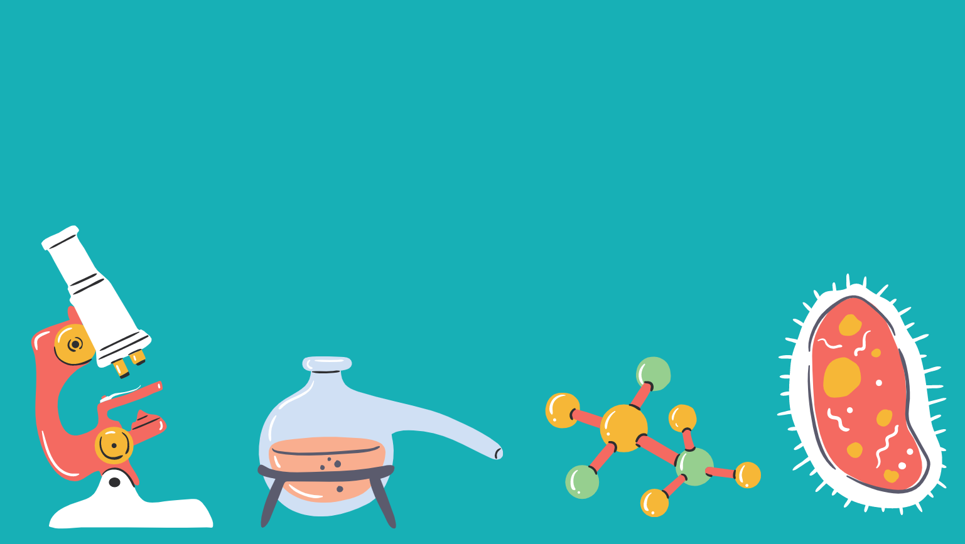
Exercise 3 (SB p.68)
In pairs, discuss the differences between the words below.
1
biology
biology lab
the study of the life, plants and animals
the place where you do the biological experiments

Slide 27

Exercise 3 (SB p.68)
In pairs, discuss the differences between the words below.
2
chemistry
physics
the study of how they react when combined or in contact with one another
the study of energy, heat,
light, sound, electricity

Slide 28

Exercise 3 (SB p.68)
In pairs, discuss the differences between the words below.
3
English
foreign languages
the language, originally of England, is spoken in many other countries around the world
is a language that is not an official language of your own country

Slide 29

Exercise 3 (SB p.68)
In pairs, discuss the differences between the words below.
4
literature
history
The subjects about writer, novel, poem, author ....
the subject of events, people in the past

Slide 30
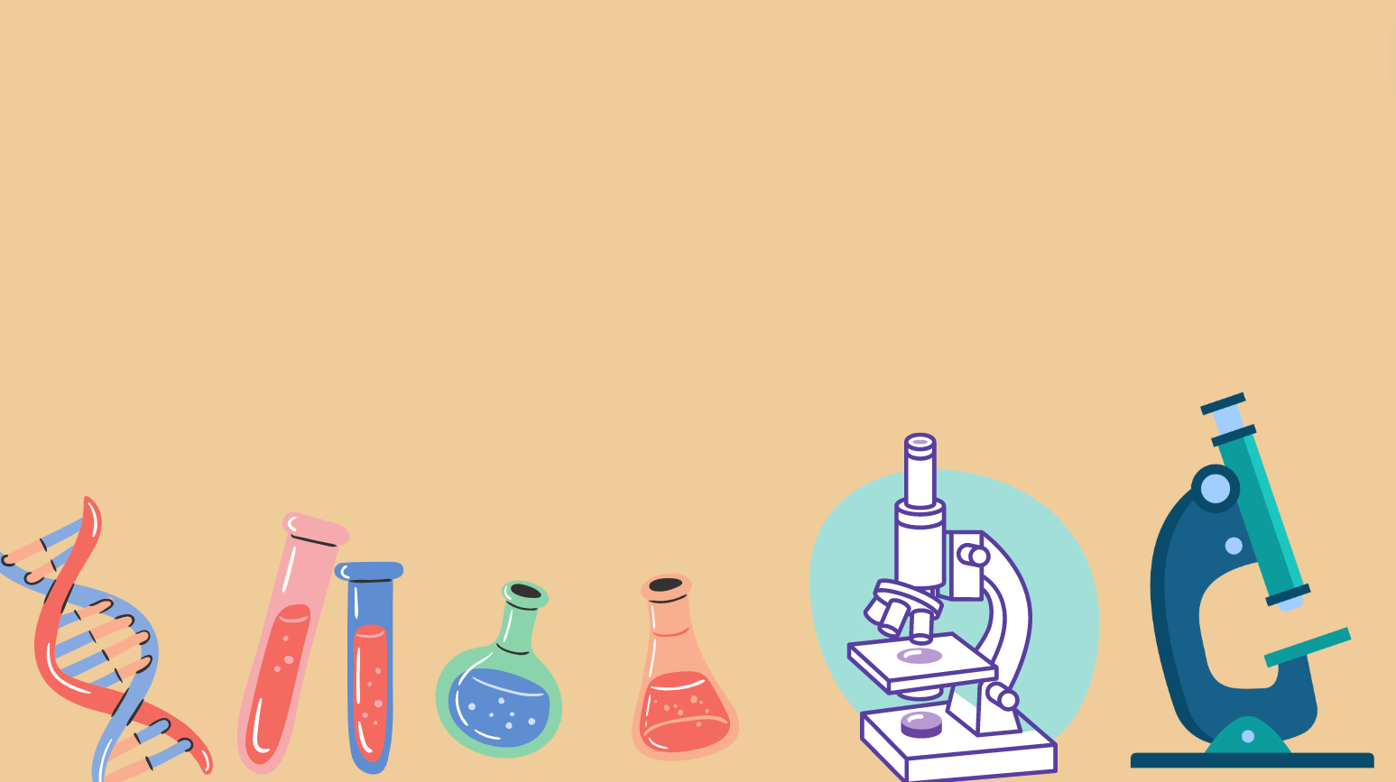
Exercise 3 (SB p.68)
In pairs, discuss the differences between the words below.
5
a test tube
a microscope
a small glass tube that
is used in experiments
A thing is used for making very small things look larger

Slide 31

Exercise 4 (SB p.68) – Listening 6.09 - Listen to how we pronounce
the /ð/ and /θ/ sounds. Listen and write the words in the blank.
another
healthy
thing
thought
anything
that
think
together
father
their
through
tooth
/ð/ | /θ/

Slide 32
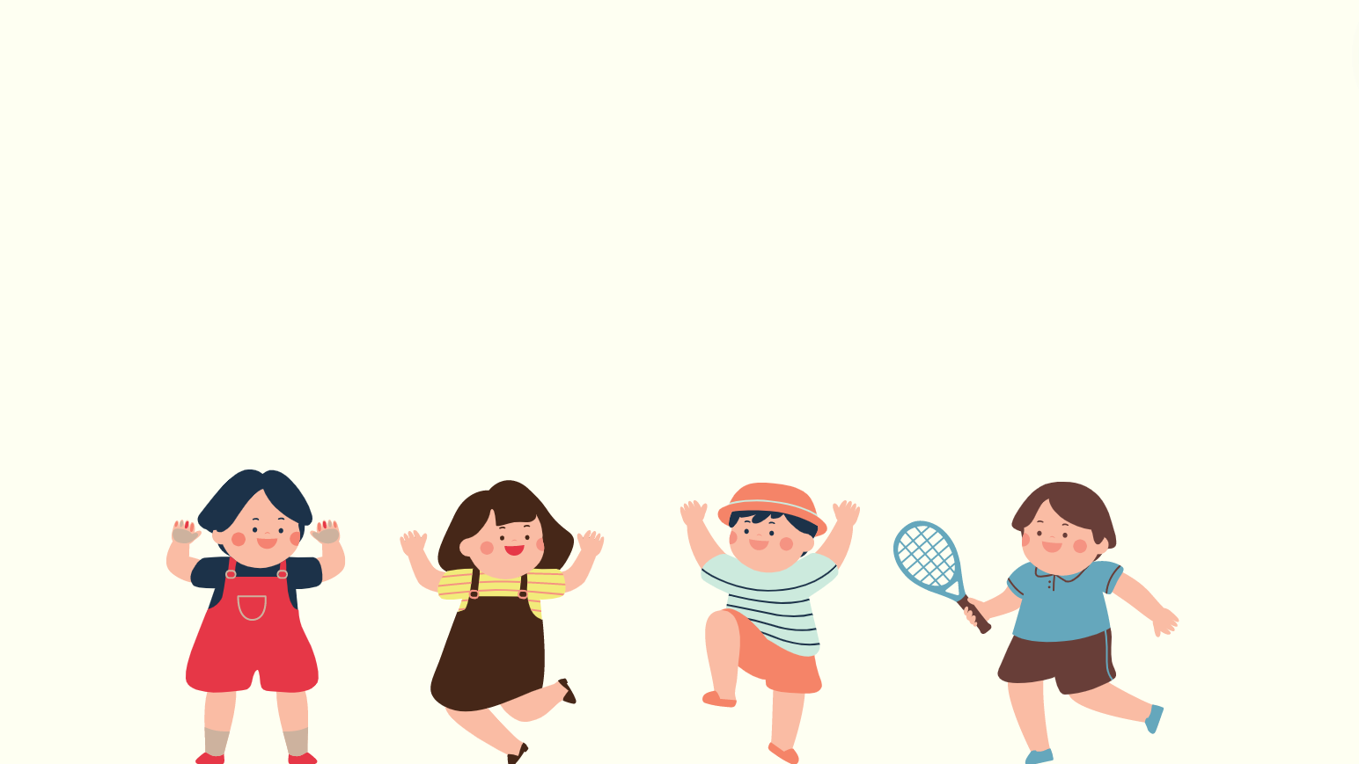
Exercise 5 (SB p.68) – Listening 6.10
In pairs, say the sentences. Listen, check and repeat.
1. Think it through before you do anything.
2. Their mother and father live together.
/θɪŋk/
/θruː/
/ˈeniθɪŋ/
/ðeər/
/ˈmʌðər/
/ˈfɑːðər/
/təˈɡeðər/

Slide 33

Consolidate what students
have learnt in the lesson

Slide 34

01. Review the Glossary and Rhyming words
02. Do the exercises (p59)in workbook
03. Prepare for Unit 6
Lesson 9 – Revision

Slide 35


