Slide 1


Slide 2



Unit 9: Future transport
LESSON 9.7: WRITNG
(SB page 97)

Slide 3

Use lexical items to write a paragraph about the advantages and disadvantages of a means of transport

Slide 4



QUICK FIRE GAME
Discussion on the advantages and disadvantages
How many advantages and disadvantages can your group have?

Slide 5


QUICK FIRE GAME
Cell-phones

Slide 6

QUICK FIRE GAME
School Uniform

Slide 7
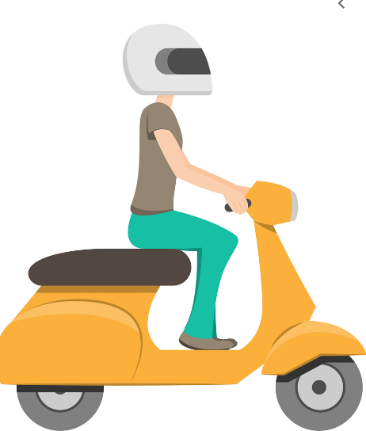
QUICK FIRE GAME
Riding a motorcycle

Slide 8
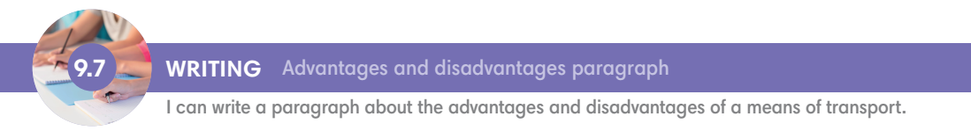
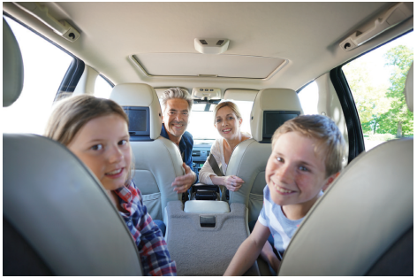

The advantages and disadvantages of travelling by car

Slide 9
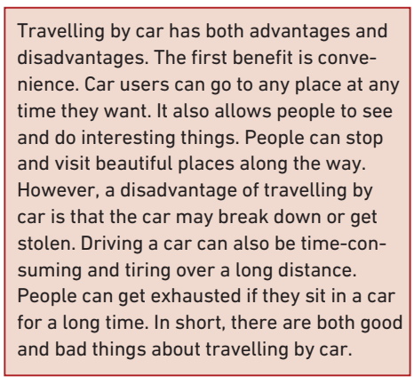





Exercise 1 (SB – p. 97)
Read the text about travelling by car. In pairs, answer the questions.
What are two advantages of travelling by car?
Why is travelling by car tiring?

Slide 10

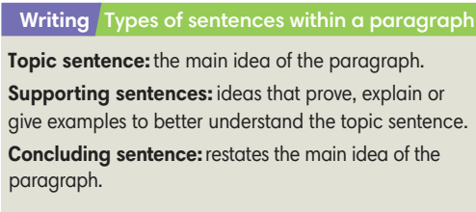
Exercise 3 (SB – p. 97)
Study the Writing box. In pairs, find the topic sentence, supporting sentences, and concluding sentence in the text in Exercise 1.

Slide 11










Topic sentence
Supporting sentences
Concluding sentence

Slide 12
Exercise 2 (SB – p. 97)
Look at the ideas below from the text. Label them as MI (main ideas) or SD (supporting details).
Traveling by car has advantages.
It is tiring to drive for many hours.
You can go to any place at any time.
Driving a car has some disadvantages.
It is cheaper to travel by car.
Your car may get stolen or break down.
It takes a long time to drive long distances.
You can see and do many things if you travel by car.

Slide 13

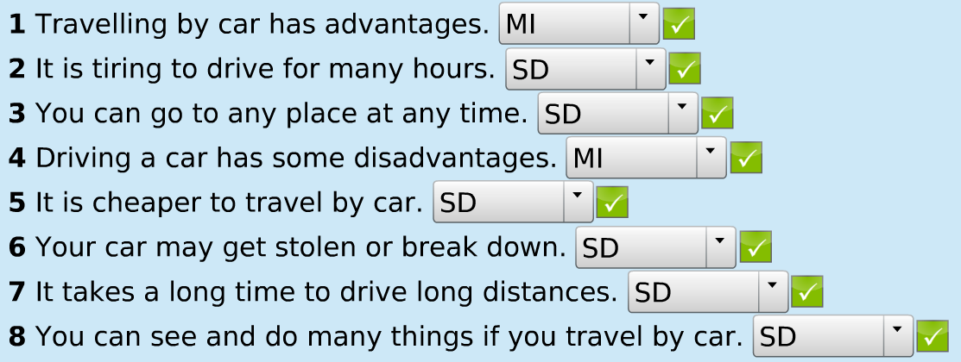
Exercise 2 (SB – p. 97)

Slide 14
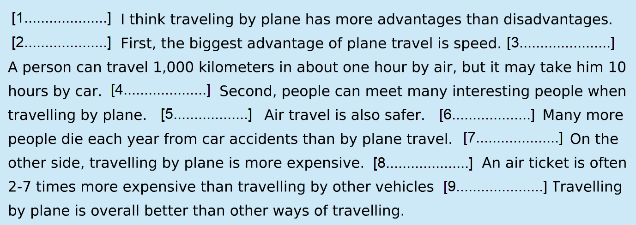
Exercise 4 (SB – p. 97)
Read the following paragraph and label the sentence types: topic sentence (TS), supporting sentences (SS) and concluding sentence (CS).

Slide 15
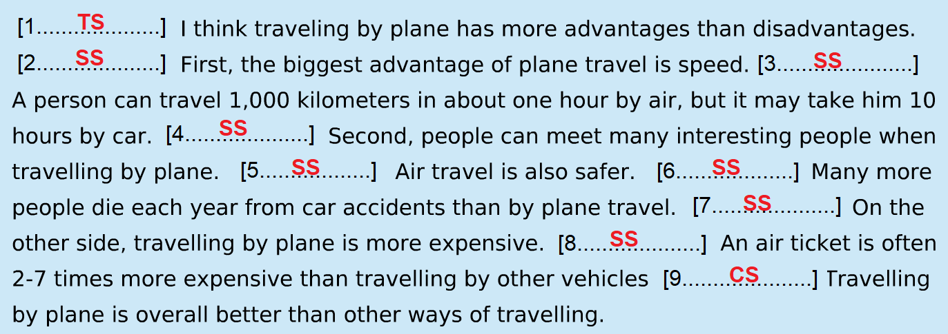
Exercise 4 (SB – p. 97)

Slide 16


‘Is that sentence correct?’
Game

Slide 17
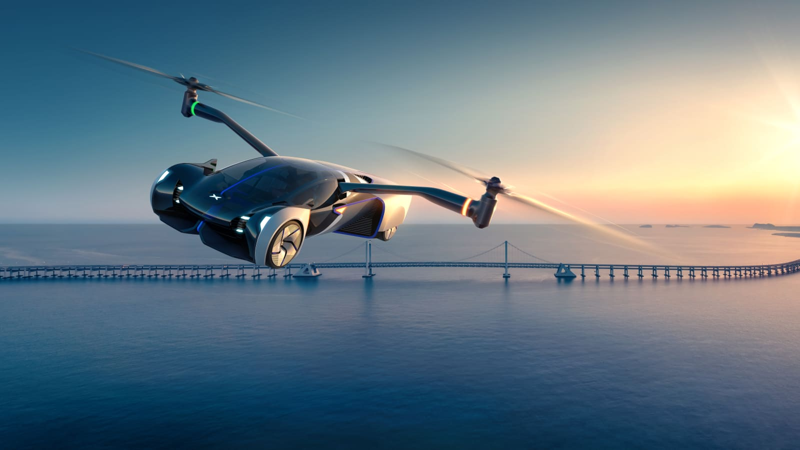
‘Is that sentence correct?’
Game
You can ride more quickly and convenient with a flying car.
conveniently

Slide 18
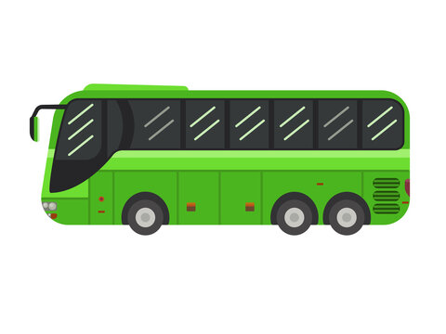
‘Is that sentence correct?’
Game
2. An electric bus is a public means of transport that uses gas power.
battery power.

Slide 19

‘Is that sentence correct?’
Game
3. I am going to the city center with my mum to make some shopping.
do

Slide 20

‘Is that sentence correct?’
Game
4. Most people in my country travel by motorbike because it’s cheaper.
more convenient.

Slide 21
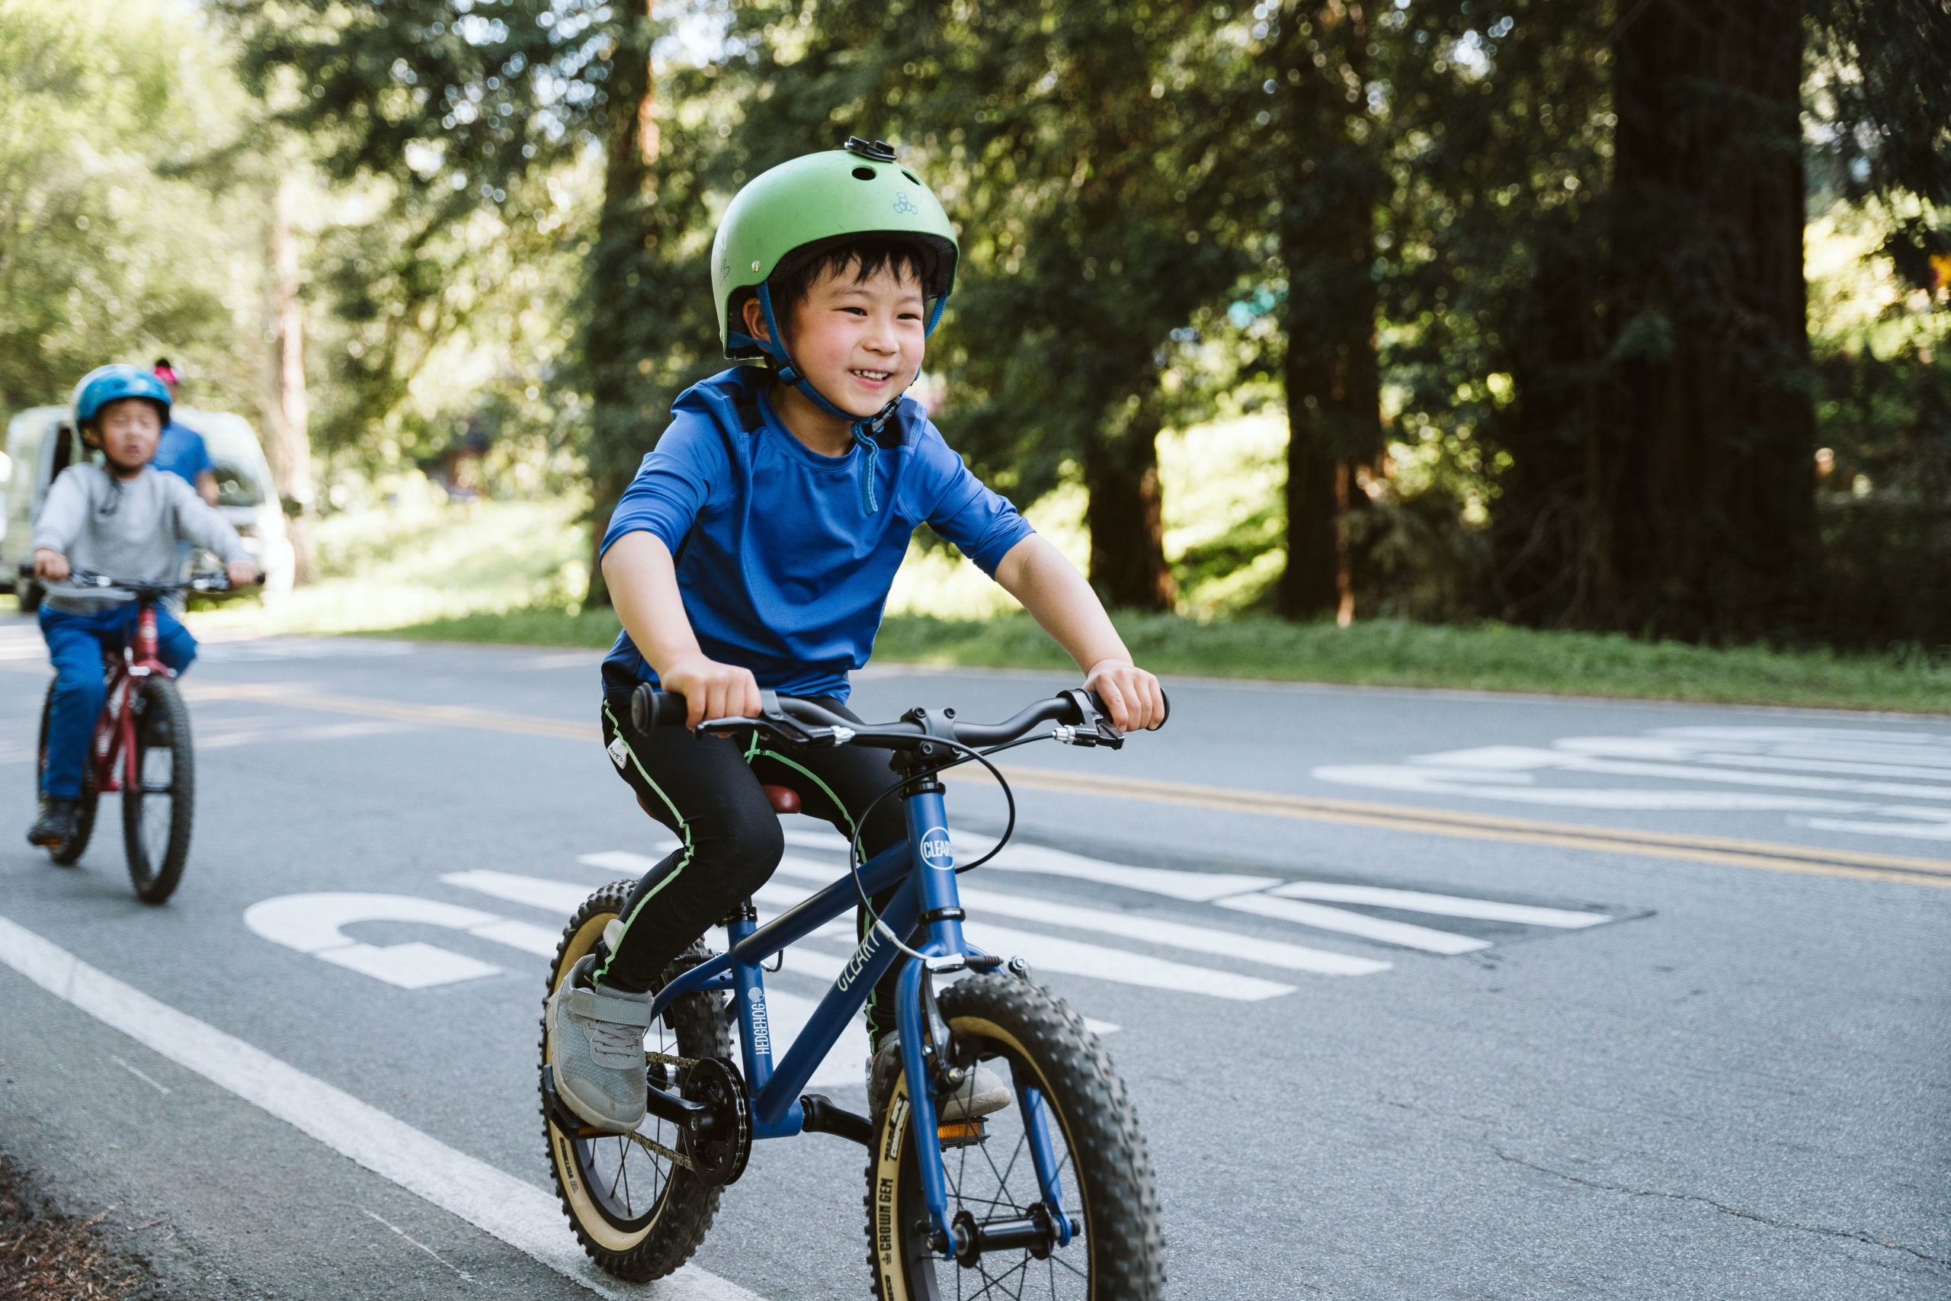
‘Is that sentence correct?’
Game
5. There are many reasons why I love riding a bike. Secondly, it’s not very convenient when it rains.
However,

Slide 22

‘Is that sentence correct?’
Game
6. If you want to go to the airport from the city center using private vehicles, you have to take two buses.
public transport

Slide 23
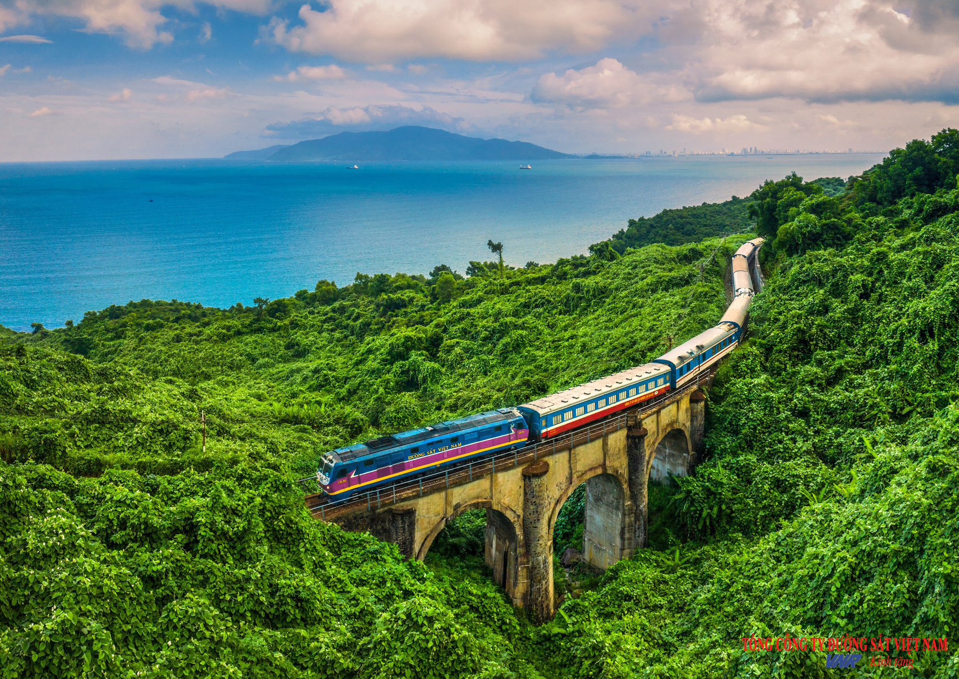
‘Is that sentence correct?’
Game
7. Travelling by train is much enjoy than travelling by plane.
enjoyable

Slide 24
‘Is that sentence correct?’
Game
8. Which do you prefer, going by train than going by car?
or

Slide 25

Exercise 5 (SB – p. 97)
Write a paragraph (60-80 words) about the advantages and disadvantages of a means of transport.

Slide 26

Consolidate what students
have learnt in the lesson

Slide 27
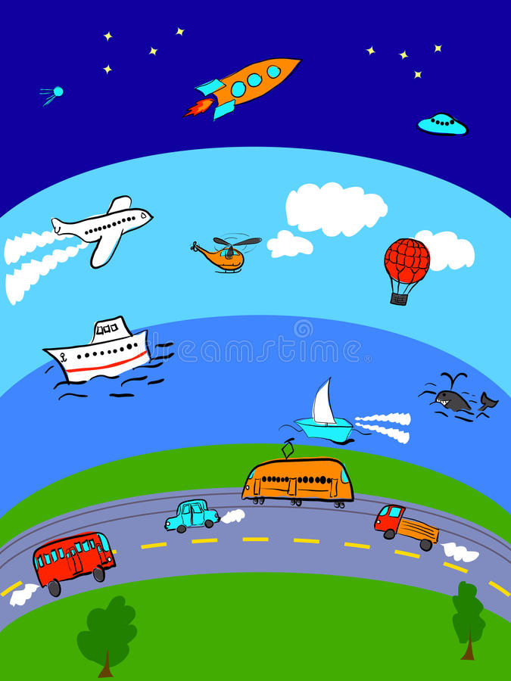

Understand three types of sentences in a paragraph
Write paragraphs about the advantages and disadvantages of a means of transport

Slide 28


01. Do the exercises in workbook
(p.84)
02. Prepare for Unit 9
Lesson 9.8 – Glossary and
Vocabulary in action

Slide 29


