Slide 1


Warmly welcome teachers and students
to our English class!
Teacher: Phùng Thị Kim Sinh
Class: 9

Slide 2


Slide 3












UNIT 9: ENGLISH IN THE WORLD
Period 72:
Lesson 4: Communication-P37

Slide 4










WARM UP

Slide 5

RING THE GOLDEN BELL
RING THE GOLDEN BELL
Let’s
Play!

Slide 6
Ring the golden bell.
How does it work?
- Team game/ individual work.
- You have 3 seconds to write your choice on the board.
- If you have correct answer, shake your board well.
-The team with more correct answers will get 1 star for each sentence.

Slide 7










1.
Which language is most spoken as a frist language in the word
A. English
B. Chinese
C. Vietnamese

Slide 8









2.
English has about ………… words and technical terms.
A. 500,000
B. 300,000
C. 800,000

Slide 9









3.
The……………of form makes English easy to learn.
A. simplicity
B. flexibility
C. Vietnamese

Slide 10







4.
One of the reasons why the vocabulary of English is open is that it has…………..
A. a lot of words
B. many varieties
C. borrowed many words

Slide 11









5.
Some English verbs are adjectives.
their nouns or…………….
A. very different from
B. the same as
C. changed according to

Slide 12






6.
Is English an international language?
A. Yes, it is
B. No, it is’nt
C. Yes. It done

Slide 13










7.
English today is the most ………… spoken language in the word
A. early
B. widely
C. large

Slide 14







8.
Do you know English is a /an …….subject in schools in Viet Nam now?
A. compulsory
B. alive
C. second

Slide 15
Work in groups to discuss the questions:
What do you think are the best ways to master English?
It is really hard to really master a language and learn all the cultural and social meanings in the conversation or messages. And every language has their own language pattern. I think most language learners can grasp the key structure and vocabulary but it takes time and a lot of effort to really master it.
2. What are the things that you like and don’t like about the English language?

Slide 16






1. Make notes about yourself:
ENGLISH LEARNER PROFILE | You | Your partner
1. How long have you been learning English?
2. What do you remember about your first English classes?
3. What exams have you taken in English?
4. Why are you interested in learning English now?
5. Which English-speaking countries would you like to visit?
6. What do you think is your level of English now?
7. How can you improve your English outside class?
8. For what purposes would you like to use English in the future?
9. What do you like about the English language?
10. What don’t you like about the English language?

Slide 17
1. How long have you been learning English?
--> I have been learning English for 7 years
2. What do you remember about your first English classes?
--> It was the first time I have studied English so I found it very joyful when I study English.
3. What exams have you taken in English?
--> Final exams
4. Why are you interested in learning English now?
--> Because I can read my favorite books in English.
5. Which English-speaking countries would you like to visit?
--> I would like to go to USA

Slide 18
6. What do you think is your level of English now?
--> I think I reach to medium level.
7. How can you improve your English outside class?
--> I listen to English music everyday
8. For what purposes would you like to use English in the future?
--> I use English to travel and find a suitable job.
9. What do you like about the English language?
--> It is easy than other languages
10. What don’t you like about the English language?
--> It has a lot of grammars that I find they are hard to remember.

Slide 19
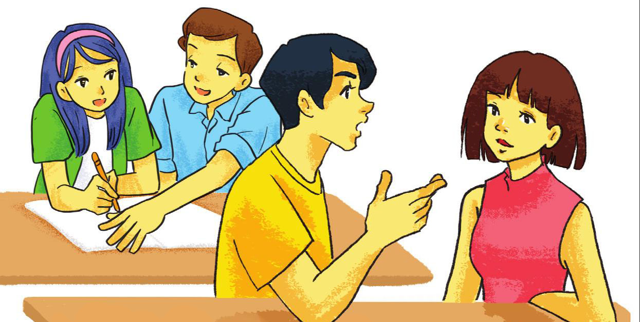
2. Work in pairs. Take turns to ask and answer the questions in 1. Make notes about your partner. How many things do you have in common?

Slide 20
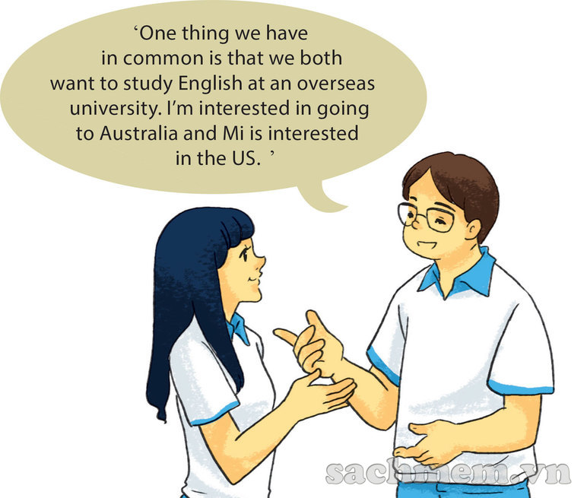
3. Work in groups. Tell your group the things that you and your partner have in common.

Slide 21
6
Home work
Do ex in workbook
Prepare Skills 1

Slide 22


Thank You

Slide 23








Nhạc nền
Notes:
Thầy cô có thể bật/tắt nhạc nền bằng cách nhấp vào biểu tượng Nốt nhạc.
Thầy cô nhấp vào BẮT ĐẦU hoặc nhấp trái chuột để vào phần câu hỏi.

Slide 24











If she ___________ (send) the letter now, they will receive it tomorrow.
01
Âm thanh
khi chọn Đúng
Sends
Send
Âm thanh
khi chọn Sai
Is sending
Would send
Notes:
HD chỉnh sửa: Thầy cô nhập câu hỏi và các đáp án vào các ô (Căn chỉnh size chữ cho phù hợp với độ dài câu hỏi)
Thầy cô nhấp chuột phải hoặc phím -> để hiện câu hỏi và các đáp án
Sau khi HS chọn đáp án, thầy cô nhấp vào PHẦN ĐẤT chứa đáp án đó.
Sau khi ở phần kiểm tra đúng sai, thầy cô nhấp < để trở về câu hỏi.
Sau khi hoàn thành xong câu hỏi, thầy cô nhấp hình > hoặc chuột trái, phím -> để chuyển sang câu hỏi tiếp theo.

Slide 25


Fred __________ (to answer) the phone if his wife has a bath.
02
Âm thanh
khi chọn Đúng
Answers
Will answer
Âm thanh
khi chọn Sai
Answered
Would answered

Slide 26

If I (were/was/would be) ____ rich, I (will try/would try/tried) ____ to help the poor.
03
Was/will try
Would be/tried
Were/would try
Were/will try

Slide 27

If the weather is beautiful tomorrow, we____________(drive) to the beach.
04
Drive
Would have drived
Drove
Will drive

Slide 28
What (would you do/will you do/did you do) ____ if you (see/would see/saw) ____ a huge spider in your shoe?
05
Will you do/see
Will you do/saw
Would you do/saw
Did you do/see

Slide 29
If I (have/had/will have/would have) ____ millions of dollars, I (am not/will not be/would not be) ____ mean.
06
Had/would not be
Would have/will not be
Have/am not
Have/am not

Slide 30
I (help/will help/would help) ____ the poor if I (become/became/had become) ____ a millionaire.
07
Will help/become
Will help/became
Help/had become
Would help/became

Slide 31
My brother (buy) ____ a sports car if he (have) ____ the money.
09
Buys/has
Will buy/had
Would buy/had
Will buy/has

Slide 32
If the weather (get) ____ colder, I (buy) ____a new coat.
10
Get/buy
Got/would buy
Got/will buy
Gets/would buy

