Slide 1
UNIT 4 – love to learn
Lesson 4.7 Speaking
(SB page 47)

Slide 2
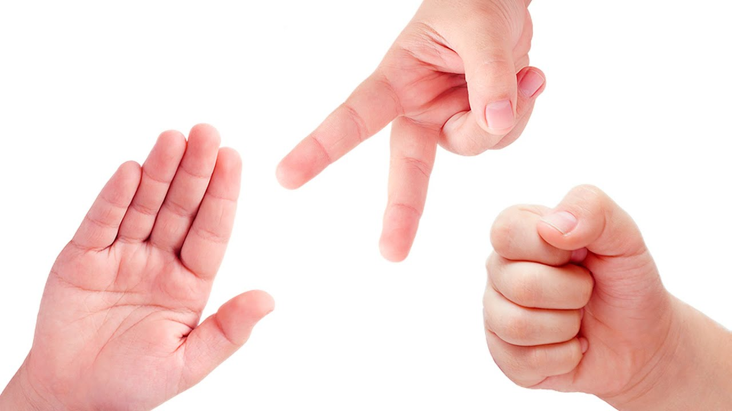
Rock – Paper – Scissors
Describe the people doing in pairs.
Play rock-paper-scissors.
The winner gets one point.
My turns. Tom and James are playing cards.
It’s correct. Rick is listening to music.

Slide 3
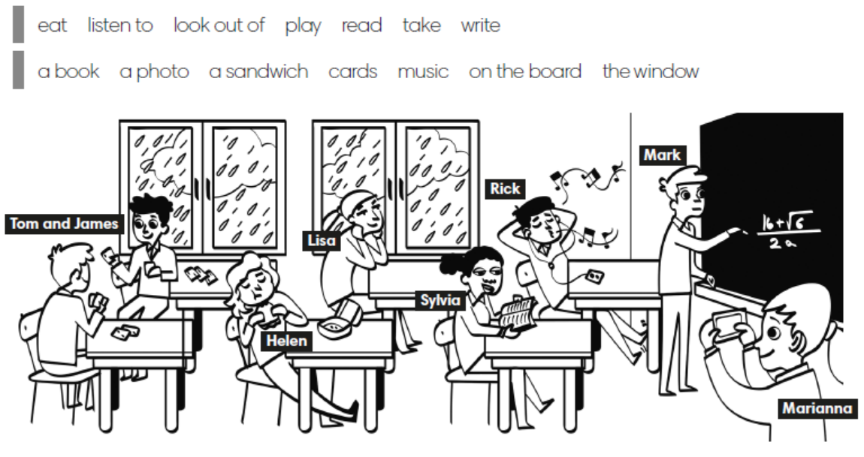

Slide 4

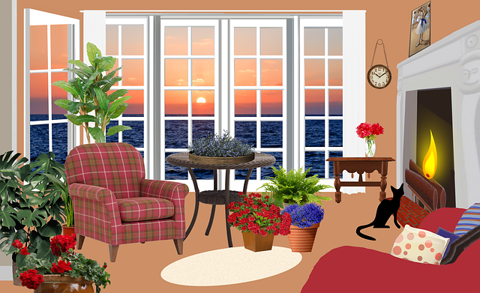
Objective
I can use prepositions of place to describe position.

Slide 5
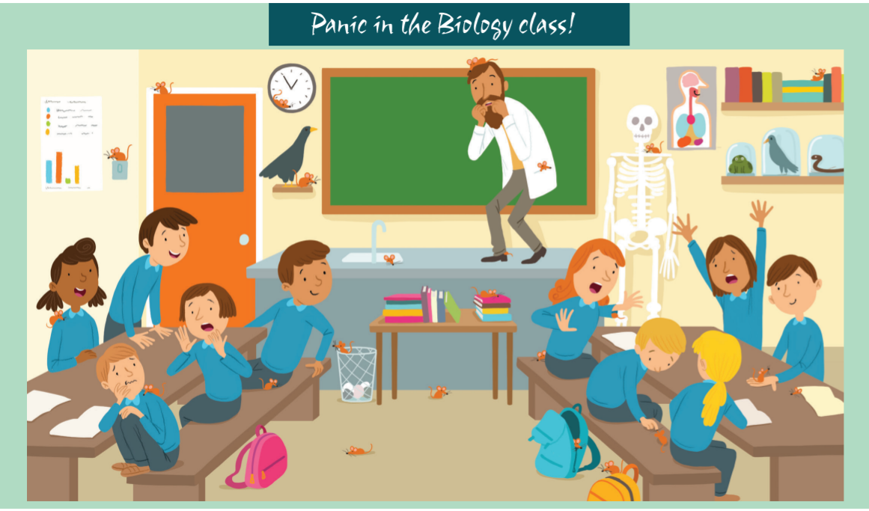

Exercise 1 (SB page 47)
Look and answer.
What can you see?
Sol
Max
What subject are they
learning? Why do you know?

Slide 6
Exercise 1 (SB page 47)
Look and answer.
Why are they scared?
 Because the mice are
running around the class.
Sol
Max
How many mice are there?
 There are 19 mice.
Where is the mouse?
 It’s on the boy’s shoulder.

Slide 7
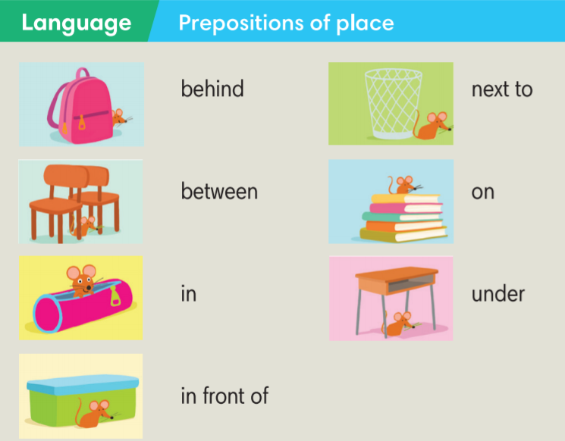

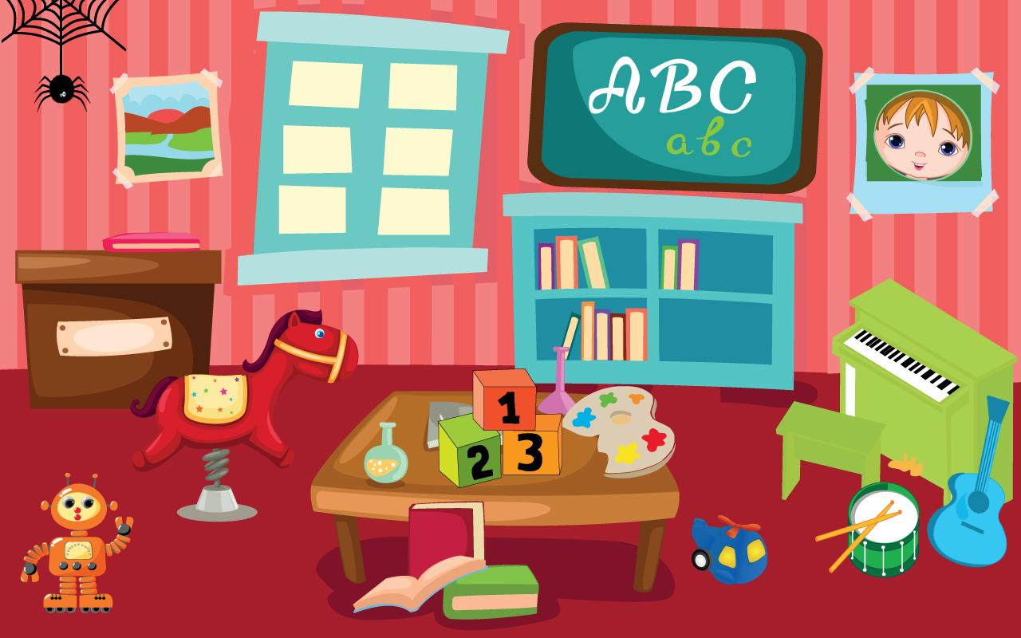
Exercise 2 (SB page 47)
Read, look and say.
This Photo by Unknown Author is licensed under CC BY-SA-NC

Slide 8
Exercise 3 (SB page 47)
Work in pairs. Look and write.
There’s a mouse under the table.
There’s a mouse on the teacher’s head.

Slide 9

WATERFFALL QUIZ
Read the sentences carefully.
Choose the correct answer.
Get 1 point for a correct answer.
START
Exercise 4 (SB page 47)

Slide 10
A. under
B. on
C. next to
1. In Maths lessons I always sit __________ to my best friend.
C. next to

Slide 11
A. under
C. between
B. on
2. There’s a nice park _________ my house and my friend’s house.
C. between

Slide 12
A. on
B. In behind
C. at
3. I always have a lot of papers _______ my desk.
A. on

Slide 13
A. under
B. on
C. in front of
4. Our teacher always stands ______ the class.
C. in front of

Slide 14
A. between
C. in
B. under
5. There’s a bin _______ my desk at home.
B. under

Slide 15
B. between
C. in front of
A. in
6. I always have an extra pencil ______ my pencil case.
A. in

Slide 16

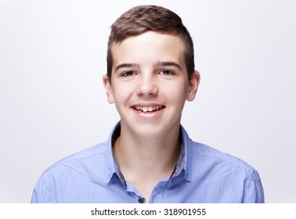
Exercise 4 (SB page 47)
Read and play the game True or False.
In my Maths lesson, I always sit next to my best friend.
Is that true for you?
Yes, it’s true for me.

Slide 17
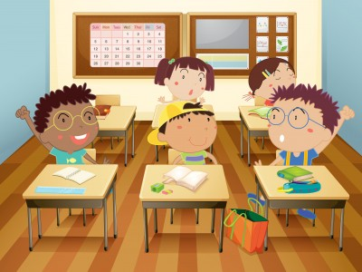
Exercise 5 (SB page 47)
Work in groups. Write sentences to describe your classroom.
There’s a blue ruler on the table.

Slide 18


