Slide 1

Unit 8: Festivals around the World
Review
Pages 104 & 105

Slide 2






LESSON OUTLINE
Consolidation

Slide 3

By the end of this lesson, students will be able to…
- review vocabularies and grammar points in Unit 8.
- practice listening, reading and speaking.

Slide 4
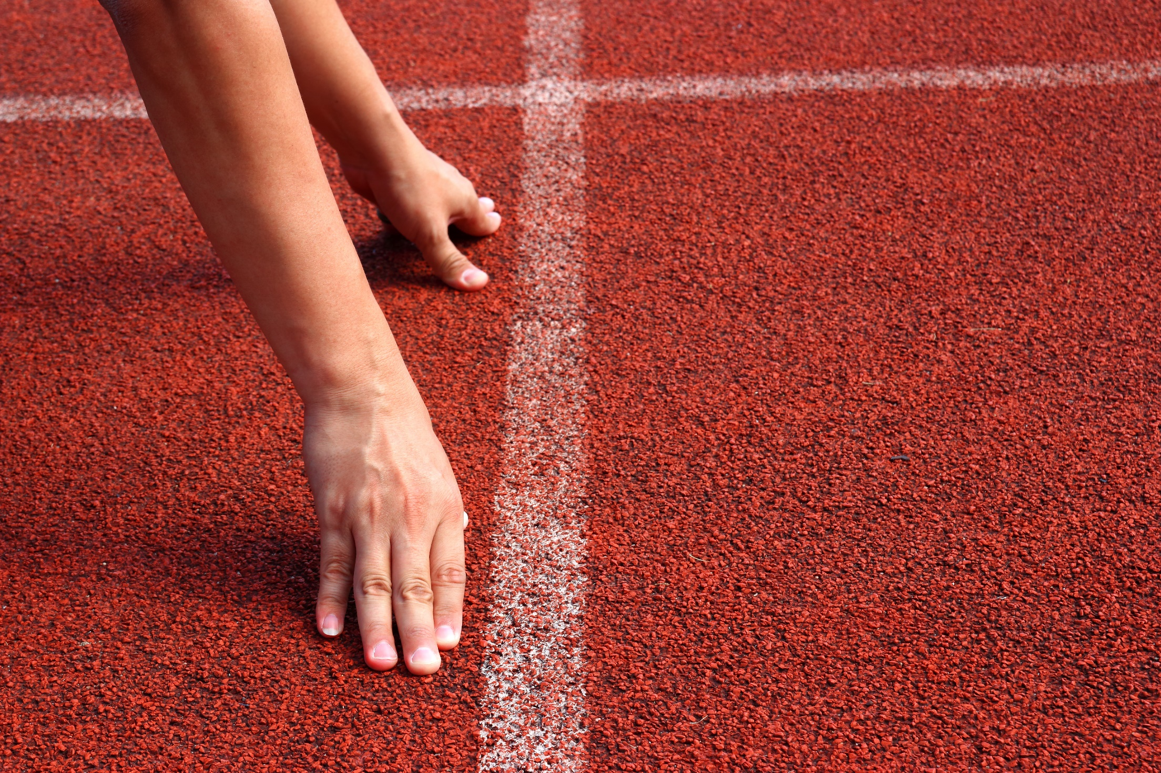
WARM UP

Slide 5
Pair work
What do people in your country do to prepare for the Lunar New Year?

Slide 6
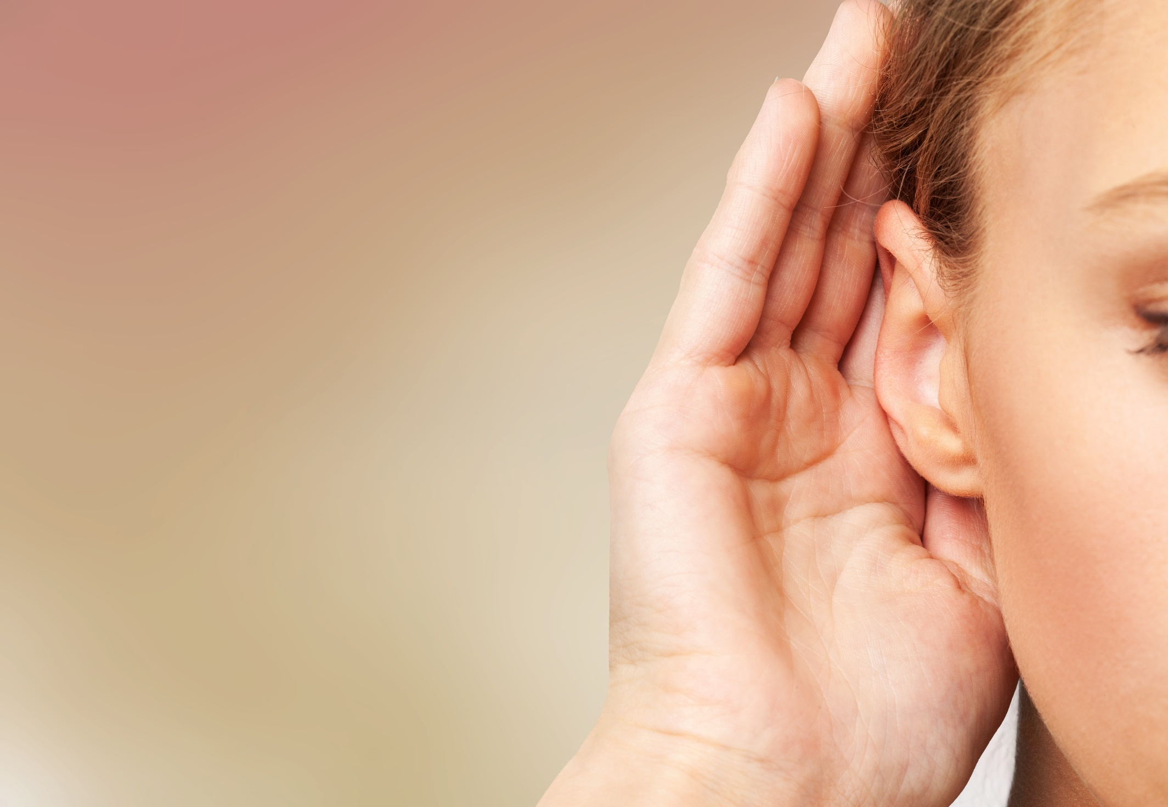
LISTENING

Slide 7



Example:
0. You will hear two friends talking about
their day. Which festival did they go to?
A. a food festival
B. a music festival
C. a sports festival
1. You will hear a girl, Mary, talking about a festival. What does she want to do?
A. see a concert
B. take part in everything
C. do arts and crafts

Slide 8
2. You will hear a boy, Harry, talking about Halloween in the US. What was the most different from Halloween in the UK?
A. the candies
B. trick-or-treating
C. the decorations
3. You will hear a boy, Bob, talking to his friend. What holiday is coming?
A. New Year's Eve
B. Christmas
C. Halloween
4. You will hear a teacher talking about a festival. What do people do there?
A. throw paint at each other
B. have water fights
C. have food fights
5. You will hear a girl, Alice, talking about Water Fire. What does she want to do most?
A. see the bonfires
B. have dinner with her mom
C. see the water show

Slide 9
Audio Scripts
1. Narrator: You will hear a girl, Mary, talking about a festival. What does she want to do?
John: What are you reading, Mary?
Mary: The Deer Shed Festival program. There are so many things to do.
John: Like what?
Mary: Well, you can see a concert, make your own jewellery and puppets, and go on rides.
John: That sounds fun. I love concerts.
Mary: I prefer making things. I'm going to make a necklace for my mom.
Narrator: Now, listen again.
Narrator: You will hear five short conversations. You will hear each conversations twice. There is
one question for each conversation. For each
question, choose the correct answer (A, B, or C).
You will hear two friends talking about their day. Which festival did they go to?
Fred: That was fun, wasn't it?
Max: Yes. I tried so many new things and they were all very good. The music was great, too.
Fred: Yeah. The competition looks interesting. I think we should take part next year!
Max: Well, we should start practicing eating more now if you want to do that.
Fred: Right.
Narrator: The answer is "a food festival," so there is a tick in Box A. Now, we are ready to start. Look at question one.

Slide 10
3. Narrator: You will hear a boy, Bob, talking to his friend. What holiday is coming?
Mandy: What did you do last night, Bob?
Bob: I went to the market. Lots of people also went out to celebrate and did last-minute shopping for the holiday.
Mandy: What did you buy?
Bob: I bought a gift for my sister and some
decorations. We already decorated our tree in the first week of December, but I want to put up some decorations in my room, like what I did on Halloween.
Mandy: Cool.
Narrator: Now, listen again.
2. Narrator: You will hear a boy, Harry,
talking about Halloween in the US. What was the most different from Halloween in the UK?
Hannah: Did you get lots of candies?
Harry: Yes, I did! It was more fun than in
the UK.
Hannah: Really?
Harry: Yeah, trick-or-treating isn't as popular. And the decorations! It was like another Christmas. All the houses in my neighborhood put up very big and scary displays. You won't see that in the UK.
Hannah: Interesting!
Narrator: Now, listen again.

Slide 11
5. Narrator: You will hear a girl, Alice, talking about Water Fire Festival. What does she want to do most?
Alice: Mom, let's go to Water Fire next Saturday!
Mom: What can you do there?
Alice: There'll be music, food, and all
kinds of art. But the most interesting
thing is the bonfires. There'll be more
than one hundred bonfires along the
three rivers in the city. Can we go,
please? I'll even buy us dinner.
Mom: OK.
Narrator: Now, listen again
4. Narrator: You will hear a teacher talking about a festival. What do people do there?
Mrs. Clare: Some festivals have really fun activities like food or paint fights! During Songkran, an important festival in Thailand, people throw water at each other in the street. They believe it will wash away bad luck.
Narrator: Now, listen again.

Slide 12
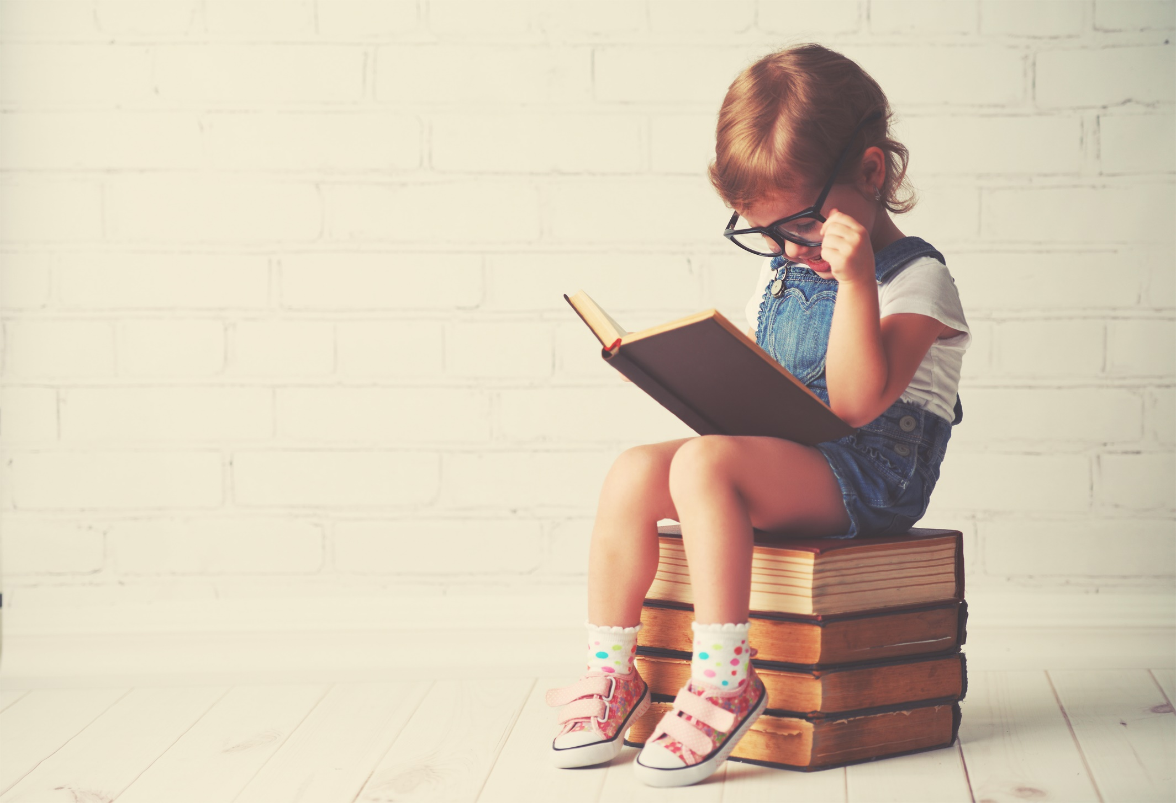
READING

Slide 13
a. Read about the festival. Write ONE WORD for each blank.
The Laughing Festival
You should come and join us (0) __________ the Laughing Festival.
It (1) __________ take place on the second Sunday of October, in Hidakagawa, Japan. We will laugh (2) __________ have a great day. It started many years ago. People say that (3) __________ goddess was very sad and wouldn’t leave the
Nyu Shrine. The people of the nearby village wanted to make her happy, so
they laughed all together. Their laughter made her feel better and she came
(4) __________ of the shrine. We will have a parade (5) __________ the town to
the shrine. At the shrine we will all laugh as loud as we can. It will cheer up the goddess and bring us good luck! Please come and join us. The louder we laugh,
the more luck we will get!
at
will
and
a
out
from

Slide 14
Read the article and choose the best word (A, B, or C) for each space.
Robert Jones, March 12 DAY OF THE DEAD
Day of the Dead is a special festival in Mexico and other (0) ________ in Latin America.
It lasts two (1) ________ from November 1st to November 2nd. Although you may think that it is similar to Halloween, the two (2) ________ are very different. On Halloween, people wear costumes to scare ghosts away. On the Day of the Dead, people welcome
the ghosts of their dead family members home. One of the (3) ________ of this festival is making offrendas for the dead. An offrenda is like a collection of (4) ________ for the dead. It includes flowers, candies, foods, and drinks. People add photos and beautiful paper cut-outs to their offrendas. These cut-outs are called papel picado. People believe the offrendas will (5) ________ the dead the way home. Day of the Dead is a day of joy
and love.
Extra Practice
WB, page 69
countries
days
festivals
traditions
gifts
show
0. A. cities B. groups C. countries
1. A. days B. weeks C. months
2. A. festivals B. places C. vacations
3. A. harvests B. traditions C. parties
4. A. shopping B. gifts C. donations
5. A. look B. listen C. show

Slide 15
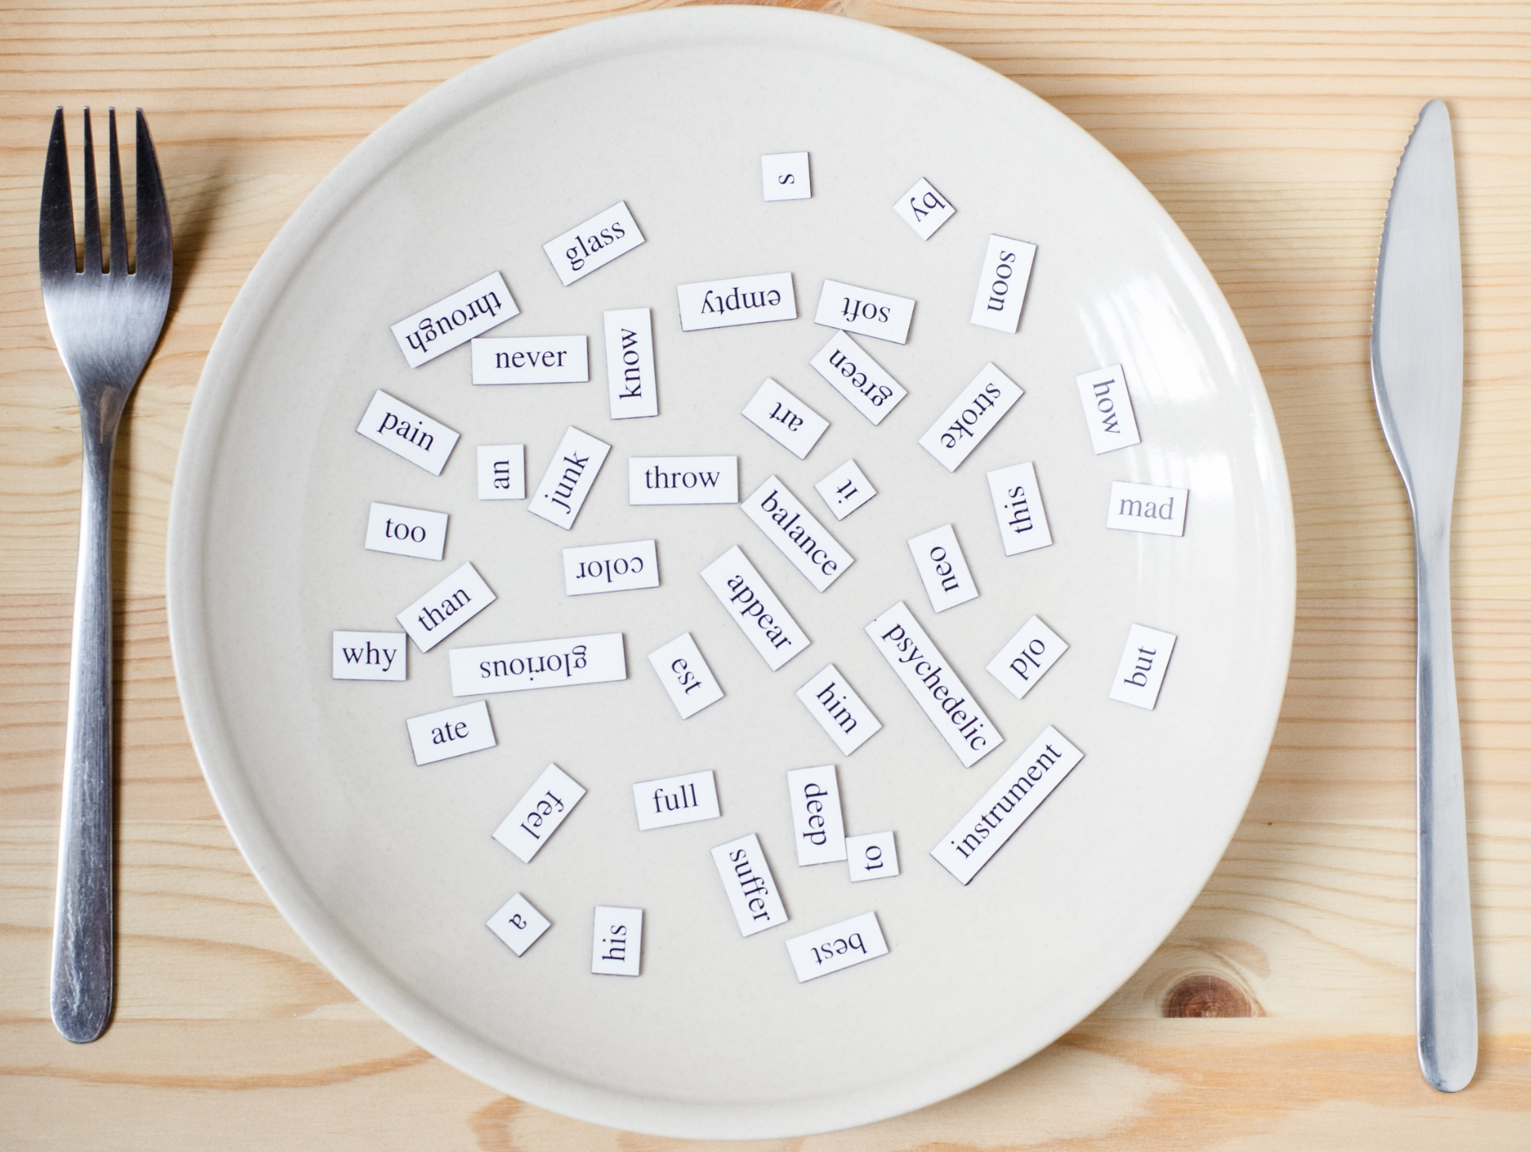
VOCABULARY

Slide 16
a. say that you hope somebody will be happy, lucky, etc.
b. a way of doing something that a group of people usually do
c. give something and receive something in return
d. a small box made of thin paper with a candle inside
e. People take part in this event and try to win by being better, faster, etc., than others.
f. 12 o'clock at night
g. a piece of art made by shaping clay, stone, metal, etc.
h. a large outdoor fire
1. lantern
2. midnight
3. competition
4. exchange
5. sculpture
6. bonfire
7. tradition
8. wish

Slide 17
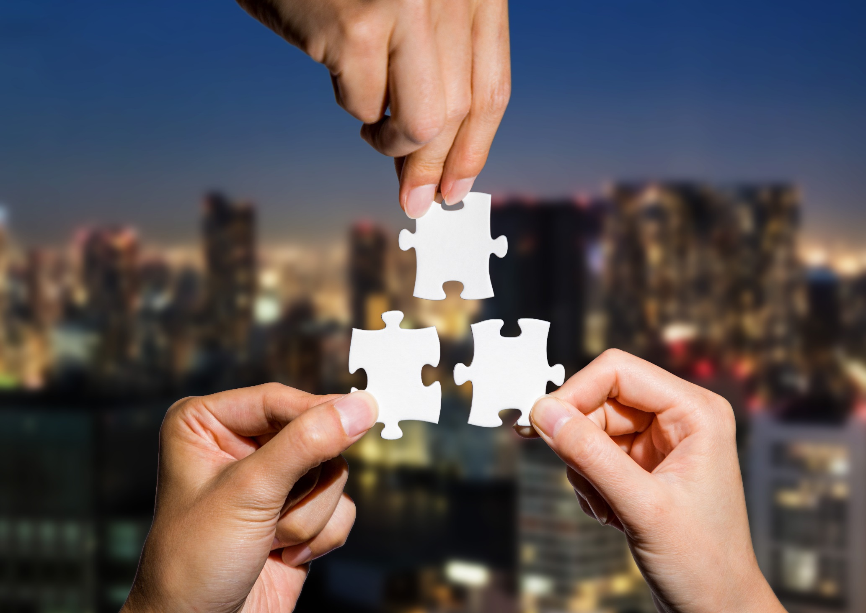
GRAMMAR

Slide 18
1. next Lantern Festival/begin/November 19th. _______________________________________________
2. there/be/party/after/festival/8 p.m. _______________________________________________
3. Groovy Groo/not participate/festival/this year. _______________________________________________
4. You/not be/disappointed with/Festival of Lights. _______________________________________________
5. G Start/perform/the opening night? _______________________________________________
The next Lantern Festival will begin on November 19th.
There will be a party after the festival at 8 p.m.
Groovy Groo won't /will not participate in the festival this year.
You won't/will not be disappointed with the Festival of Lights.
Will G Start perform on the opening night?

Slide 19
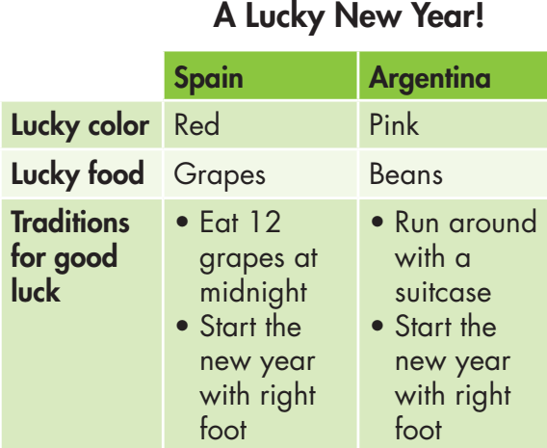
The lucky color in Spain is different from that in Argentina.
________________________ grapes.
That’s _________________________.
Spanish people eat ______________
_________________ for good luck. That’s _________________________.
People in Argentina start __________
_______________________ Spanish people, for good luck.
The lucky food in Spain is
different from Argentina.
12 grapes
at midnight
different from Argentina.
the new
year with their right foot, like

Slide 20

PRONUNCIATION

Slide 21
a. Circle the word that has the underlined part pronounced differently from the others.
1. A. fight B. wish C. midnight D. bonfire
2. A. lantern B. race C. exchange D. celebrate
3. A. tradition B. festival C. greeting D. competition
b. Circle the word that differs from the other three in the position of primary stress in each of the following questions.
4. A. Cambodian B. European C. Australian D. Canadian
5. A. festival B. opening C. tradition D. celebrate
6. A. concert B. exchange C. ticket D. music

Slide 22

CONSOLIDATION

Slide 23
What can you remember about the Hùng King festival?
Read about the festival. Write ONE WORD for each blank.
The Hùng Kings Festival
The Hùng Kings Festival takes place all over Vietnam. It _________ in the spring and _________ a few weeks. On these days, people remember the Hùng Kings. The Hùng Kings are the _________ kings of the nation. During the festival, people _________ colorful, traditional clothes and _________ at temples.
It is a fun and relaxing time for families.
happens
lasts
first
wear
pray

Slide 24
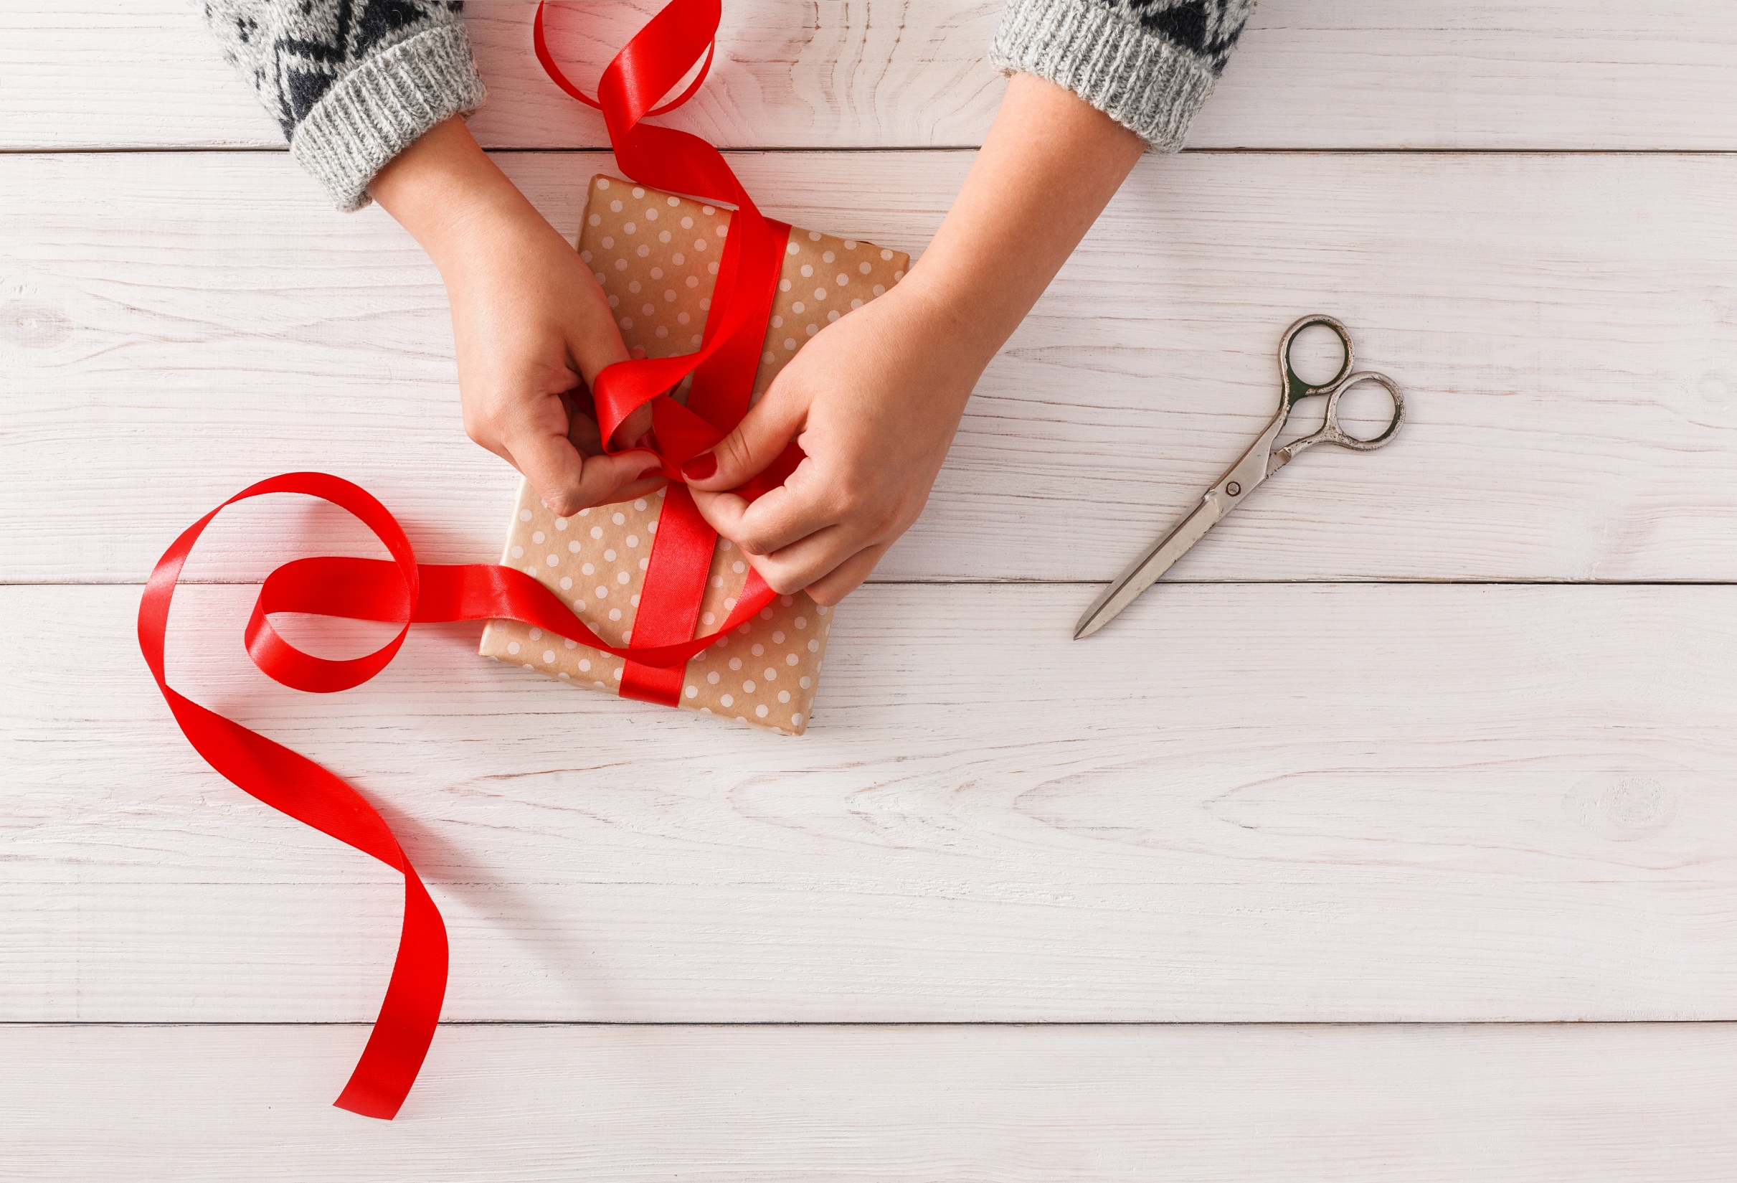
WRAP-UP

Slide 25
Today’s lesson
Reviewing the vocabulary and grammar points in Unit 8.
Practicing Listening, Speaking and Reading skills.

Slide 26
Homework
Review all the vocabularies and grammar points in the unit.
Finish the Listening exercise in the WB, page 69.
Play the consolidation games in Tiếng Anh 7 i-Learn Smart World DHA App on www.eduhome.com.vn
Prepare Unit 9 (page 68, SB).

Slide 27

Lesson 3
Stay positive and have a nice day!

