Slide 1


Lesson 2: A closer look 1
(1,2,3,4)

Slide 2
Chèn Video clip về Têt.
Tạo đường link đó.

Slide 3






Vocabulary
Pronunciation
/s/ and /ʃ/
Write the words / phrases in the box under the pictures.
Listen and repeat the words.
Match the verbs with the nouns.
Complete the sentences with the words in the box.

Slide 4
I. Objectives:
1. Cognitions:
By the end of the lesson student can:
Extend and practice vocabulary related to “Tet”: things, activities, practices.
To introduce topic of the lesson Our Tet holiday”
To teach/ introduce how to combine a verb with a noun.
Ss also learn how to pronounce the sounds /s/ and /∫/ correctly.
+ Vocabulary:
- To use the words related to the topic Tet holiday in Viet Nam.
- To pronounce the sounds /s/ and /∫/ correctly.
+ Grammar: Simple present tense

Slide 5
2. Skills:
Listening + Reading and Speaking
3. Attitude:
- To educate the love and preservation of traditional customs and traditions. Having a good behavior toward the adult and the elderly people on Tet holiday.
- To collaborate and build enthusiasm and effectiveness in pair work and teamwork.
Extend Ss’ serious learning attitudes; love learning English, energetically and actively participate in learning activities.

Slide 6
II. Teaching aids/materials
1. Google meet/ zalo group (Discussion)
2. Quizizz/ Zalo, Meet (Contents/ products creation tools)
3. https://padlet.com/dashboard/ - Zalo group (Assignment and submission tools)
4. https://forms.google.com / Azota.vn / Quizizz (Startup activity creation/ assessment tools)
5. Zoom/ Google meet (Virtual classroom)
6. Textbook : Global success

Slide 7
*Vocabulary:
-to wish: mong ước
-have fun (adj): vui
-furniture: nội thất, đồ đạc
-special food: thức ăn ngon
-relative: họ hàng
-spring: mùa xuân

Slide 8


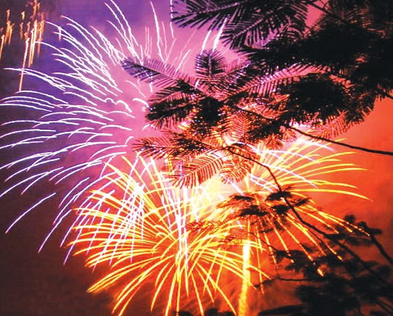
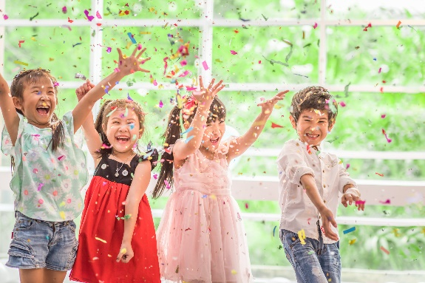
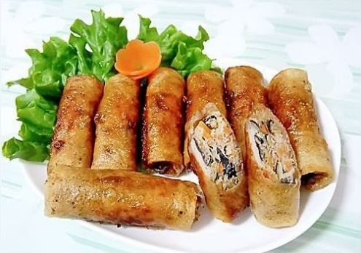
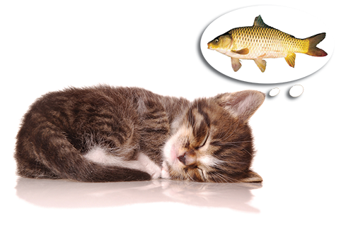
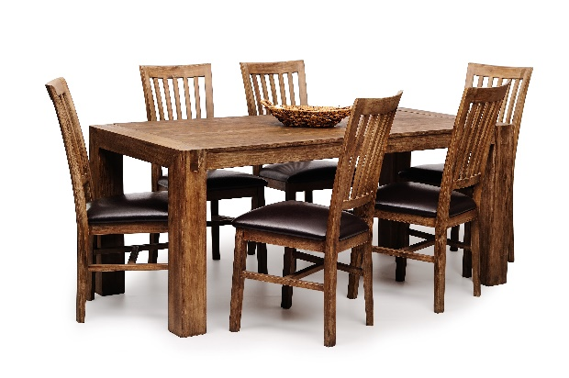
Write the words / phrases in the box under the pictures.
Thiết kế trò chơi trên Kahoot hay cái khác.
Tạo đường link đó.
wish
fun
fireworks
special food
furniture
1. fireworks
2. special food
3. fun
1.
2.
3.
4.
4. wish
5. furniture
5.

Slide 9

Match the verbs with the nouns.
Verbs
Nouns
a. a wish
1. have
f. fun
e. relatives
2. visit
b. fireworks
d. lucky money
3. give
c. the furniture
4. make
d. lucky money
a. a wish
5. clean
e. relatives
c. the furniture
f. fun
6. watch
b. fireworks

Slide 10
Match the verbs with the nouns.
Verbs
Nouns
a. a wish
1. have
f. fun
e. relatives
2. visit
b. fireworks
d. lucky money
3. give
c. the furniture
4. make
d. lucky money
a. a wish
5. clean
e. relatives
c. the furniture
f. fun
6. watch
b. fireworks

Slide 11

Circle the best option A, B or C to complete the sentences.
In Viet Nam, we__________ Tet in January or February.
A. celebrate B. make C. join
2. At Tet, we decorate our houses with __________ flowers.
A. rose B. peach C. lotus
3. Children should help their parents to______ their houses.
A. move B. make C. clean
4. People do a lot of __________before Tet.
A. shop B. shopping C. shops
5. My mother usually cooks special __________ during Tet.
A. food B. meat C. cake
Thiết kế trò chơi trên Kahoot hay cái khác.
Tạo đường link đó.

Slide 12
Chèn Video clip về cachs phát âm .
Tạo đường link đó.
/s/ and /ʃ/
Pronunciation
/s/ and /ʃ/

Slide 13


Listen and repeat the words.
shopping
special
rice
spring
wish
celebrate

Slide 14
HOMEWORK:
/s/ and /ʃ/
Learn by heart new words pronoun
Copy the answer into their notebook
Prepare next lesson: Unit 6: A Closer Look 2, Exercise 1,2,4
Focus more on Should/ Shouldn’t and some/ any for amount.

Slide 15







