Slide 1

Unit 1: Free time
Lesson 1.3: Pronunciation & Speaking
Page 6

Slide 2



Lesson 1.3
LESSON OUTLINE
Consolidation

Slide 3
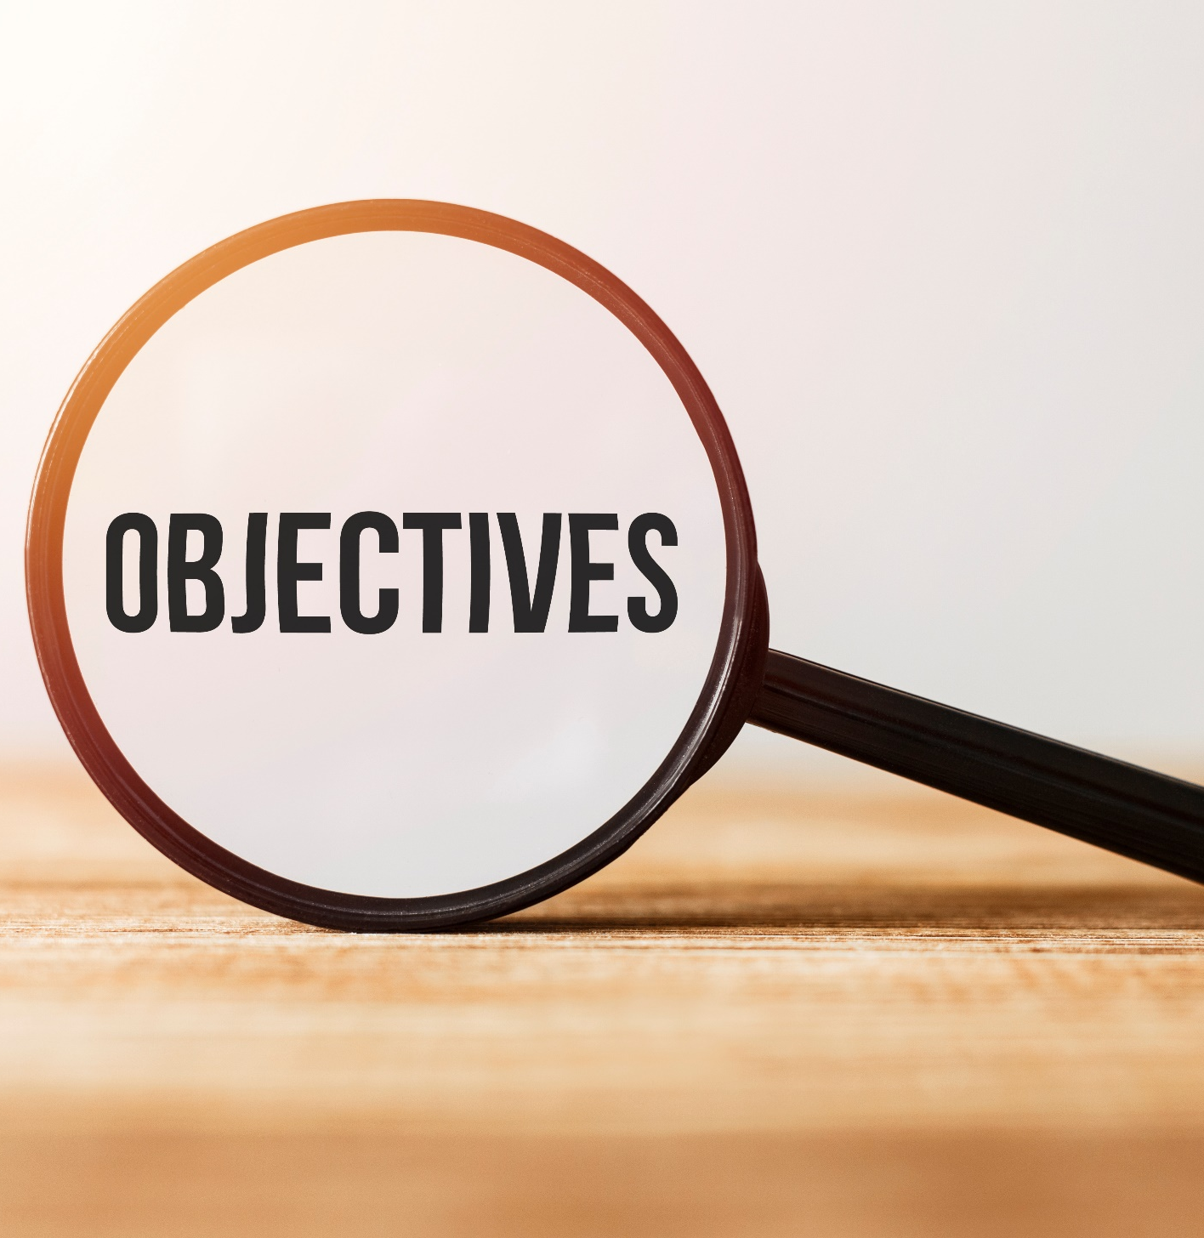
By the end of this lesson, students will be able to…
- pronounce the sound /eɪ/ correctly.
- ask and answer about free time activities, using time expressions of the Simple Present.
- conduct a survey about hobbies.

Slide 4
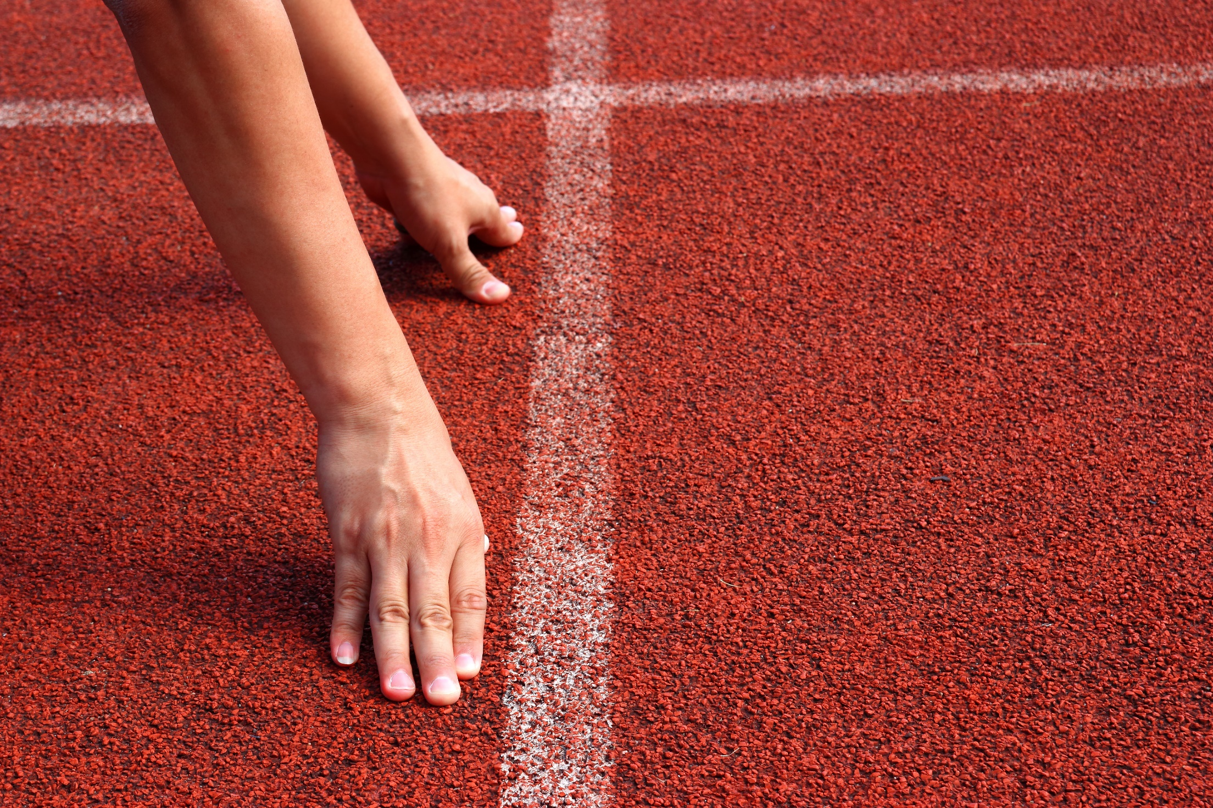
WARM UP

Slide 5

Work in pairs.
Choose the word whose main stress is placed
differently from the others.
A. mystery B. balcony C. adventure D. fantasy
2. A. dinner B. kitchen C. laundry D. garage
3. A. dangerous B. exciting C. mountainous D. beautiful
/ˈmɪstəri/
/ˈbælkəni/
/ədˈventʃər/
/ˈfæntəsi/
/ˈdɪnər/
/ˈkɪtʃən/
/ˈlɔːndri/
/ɡəˈrɑːʒ/
/ˈdeɪndʒərəs/
/ɪkˈsaɪtɪŋ/
/ˈmaʊntənəs/
/ˈbjuːtəfl/

Slide 6
Work in pairs.
Choose the word whose underlined part is
pronounced differently from that of the other words.
A. center B. city C. soccer D. icing
2. A. bowling B. timing C. tonight D. Friday
3. A. drama B. garage C. villa D. water
/ˈsentər/
/ˈsɪti/
/ˈsɑːkə/
/ˈaɪsɪŋ/
/boʊlɪŋ/
/ˈtaɪmɪŋ/
/təˈnaɪt/
/ˈfraɪdeɪ/
/ˈdrɑːmə/
/ɡəˈrɑːʒ/
/ˈvɪlə/
/ˈwɑːtə/

Slide 7

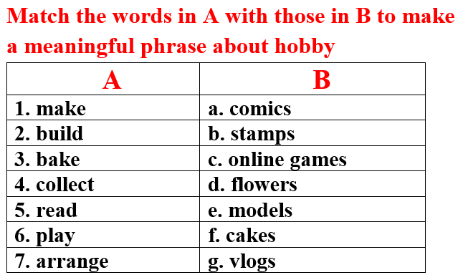
Work in pairs

Slide 8
Key answer

Slide 9



Slide 10
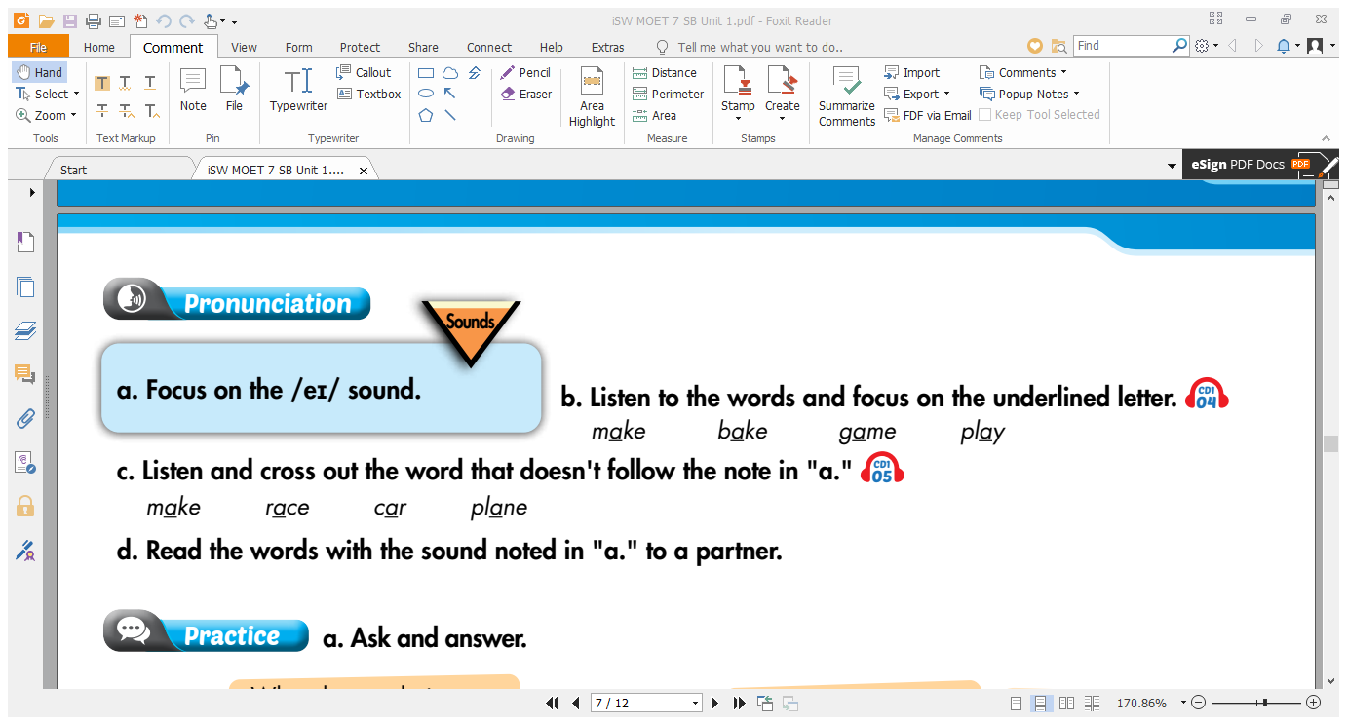

Unit 1

Slide 11
Unit 1

Slide 12
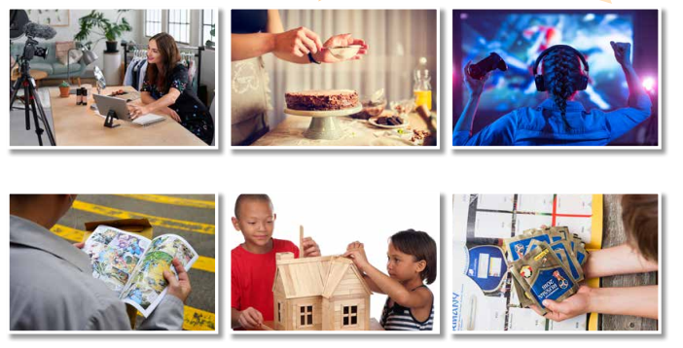
Unit 1
Look and name the pictures
make vlogs
bake cakes
play online games
read comics
build models
collect soccer stickers

Slide 13
Unit 1
A sample conversation
in your free time?
A: What do you do…………….….…
B: I ………………….
A: ……………do you arrange flowers?
B: I arrange flowers ………………..
arrange flowers.
How often
once a week.

Slide 14
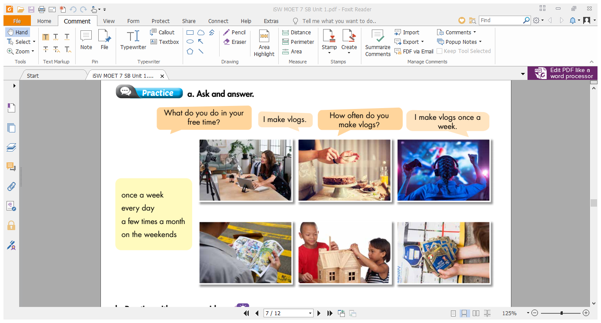
Unit 1
✓
✓
✓
✓
✓

Slide 15
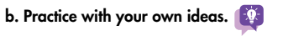
Unit 1
Suggested conversation
in your free time?
A: What do you do…………….….…
B: I …………………..
A: ……………do you arrange flowers?
B: I arrange flowers ………………..…or…………………………….. such as my family members’ birthday, Tet holiday or Christmas.
arrange flowers
How often
on the weekends
on some special occasions

Slide 16
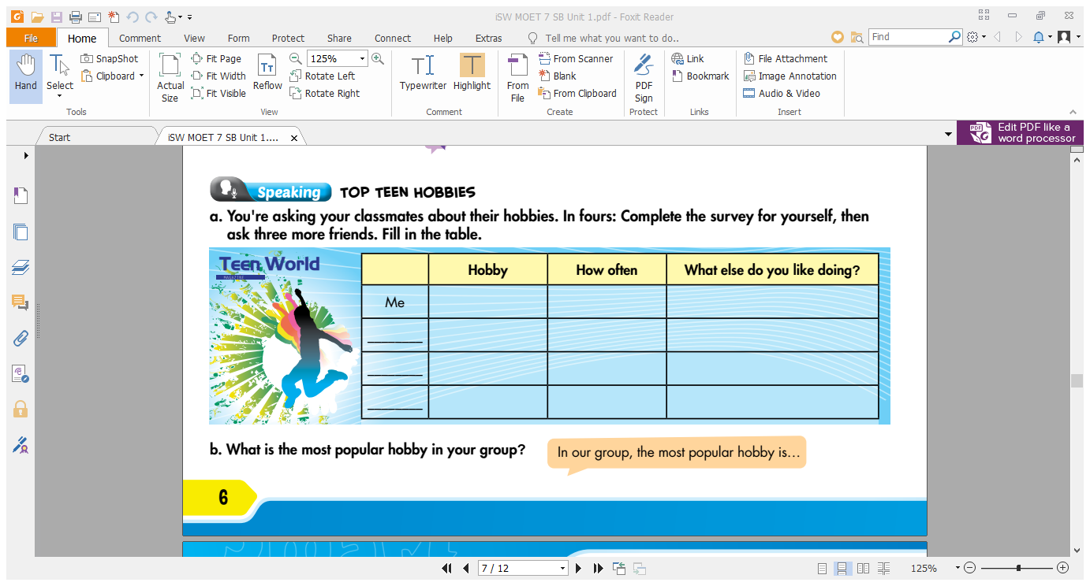
Unit 1
make vlogs
once a week
collect soccer stickers
B
?
?
?
C
?
?
?
D
?
?
?

Slide 17
STUDENT A
STUDENT B
What do you do in your free time?
I make vlogs.
How often do you make vlogs?
I make vlogs once a week.
What else do you like doing?
I also like collecting soccer stickers.

Slide 18
Work in groups
b. What is the most popular hobby in your group?
In our group, the most popular hobby is….

Slide 19

CONSOLIDATION

Slide 20
Write a paragraph about your hobby. You can begin with.
My hobby is/ hobbies are…..

Slide 21
Suggested paragraph
My hobby is baking cakes. I bake cakes when I have free time. I often spend one or two hours baking cakes. My mother is a good baker so she helps me a lot. In addition, I like making vlogs. I make vlog every week and it helps me make new friends. What about you? What do you do in your free time?

Slide 22
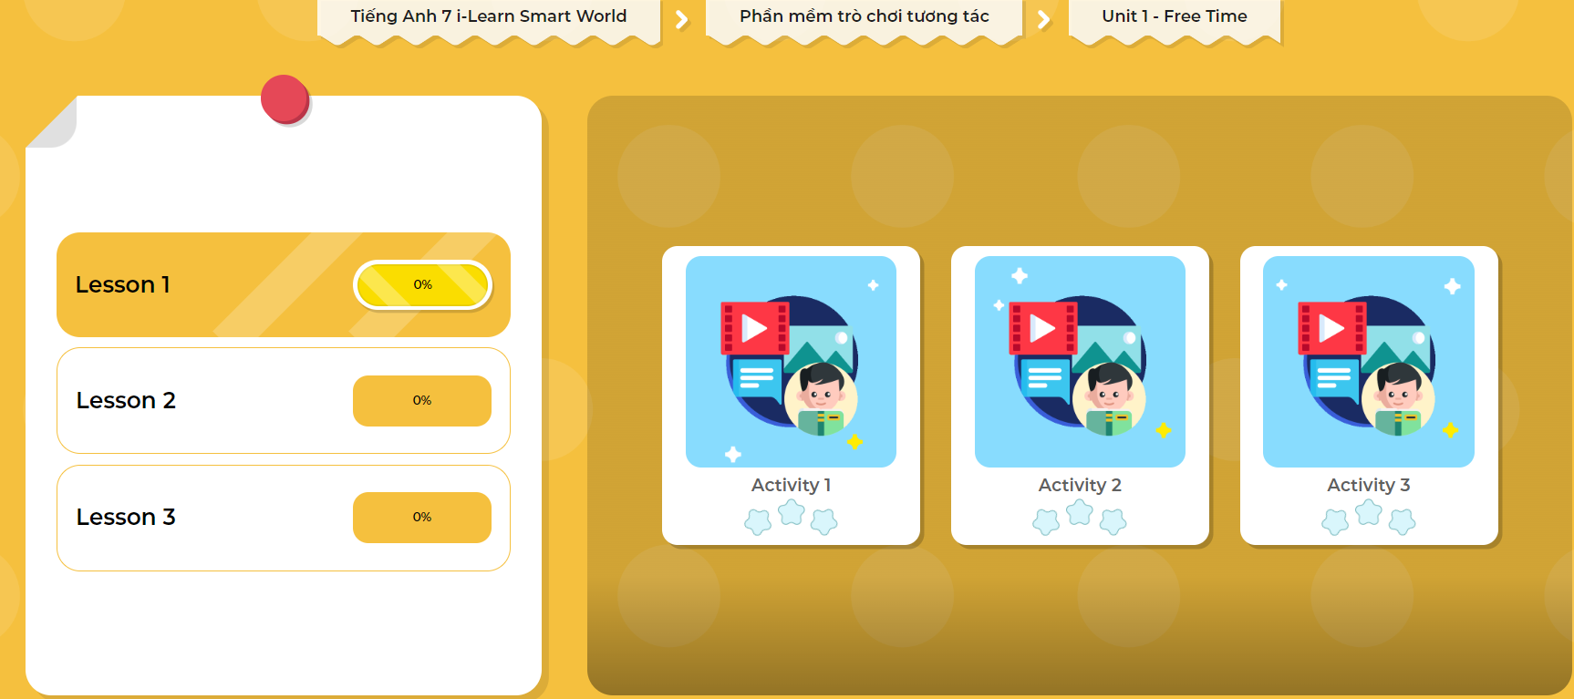
Extra Practice
DHA App
Let’s play!
Click here to play the game

Slide 23
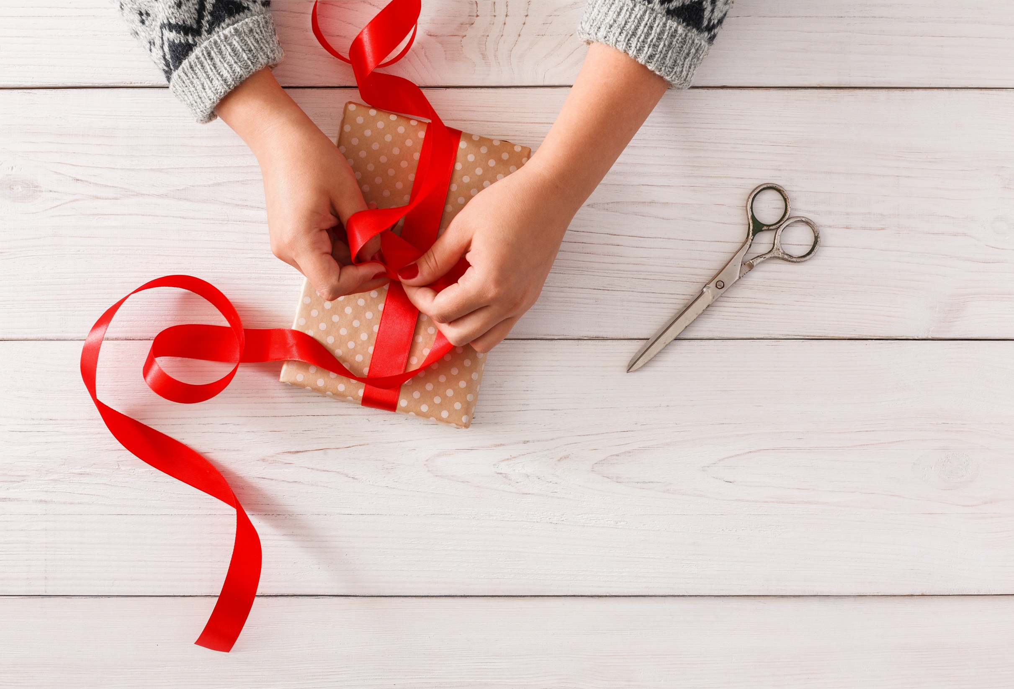
WRAP-UP

Slide 24
Today’s lesson
Speaking:
- talk about your hobby.
- practice pronouncing sound /ei/.

Slide 25
Homework
Make 2 sentences containing some words with the sound /eɪ/, then practice saying them.
Redo the writing exercise on page 3 WB (Writing).
Prepare Lesson 2 – New words and Listening (page 7 SB).
Play the consolidation games in Tiếng Anh 7 i-Learn Smart World DHA App on www.eduhome.com.vn

Slide 26

Lesson 3
Stay positive and have a nice day!

