Slide 1
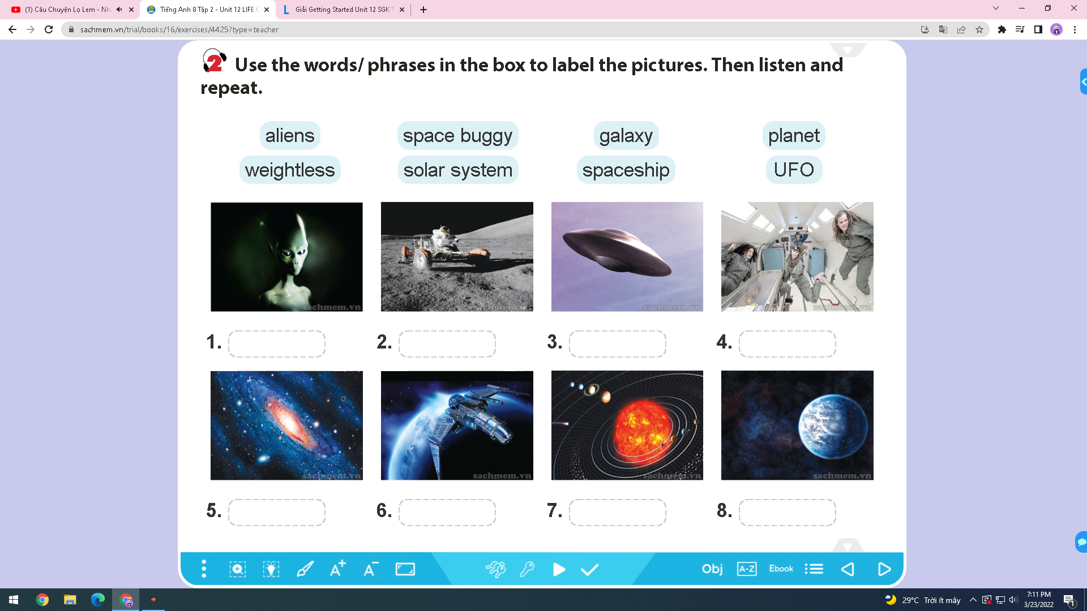
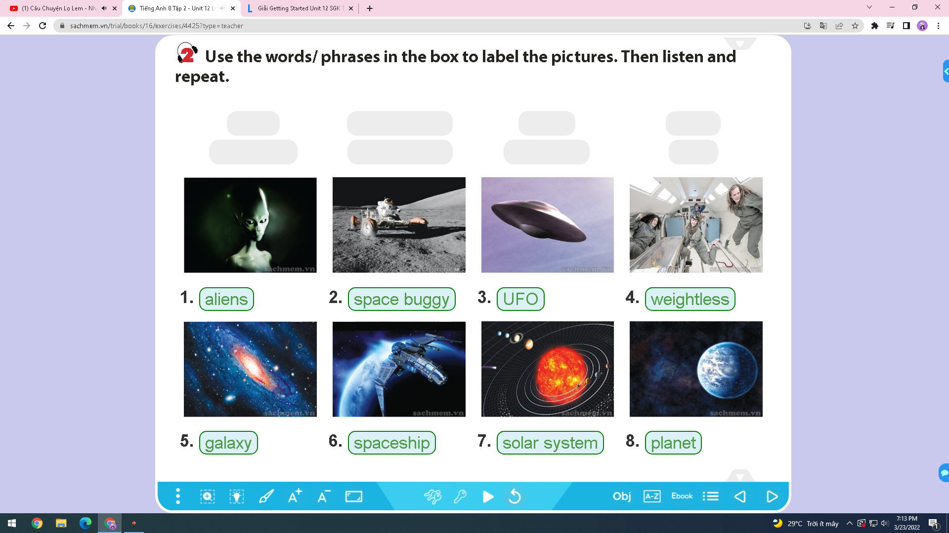
WARM UP

Slide 2
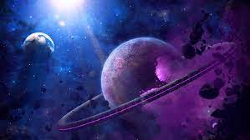
Unit 12​
Life on other planets
A closer look 1

Slide 3
Từ vựng
- Mercury: sao Thủy
- Venus: sao Kim
- Mars: sao Hỏa
- Jupiter: Sao Mộc
- Saturn: Sao Thổ
- Neptune: Sao Hải Vương
- goddess: thần
- thunder and lighting: sấm và chớp
- be named after: được đặt tên theo
- weightless - phi trọng lực
- waterless - hạn hán
- resourceful/ recourceless - nhiều tài nguyên/không có tài nguyên
- airless - thiếu không khí

Slide 4
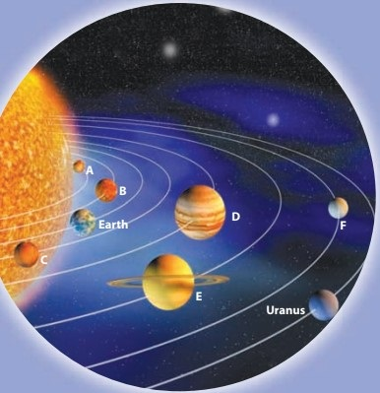
1. Use the names of the planets in the box to label the diagram of the solar system.
Mercury | Mars | Venus
Neptune | Saturn | Jupiter
A. Mercury | B. Venus
E. Saturn | C. Mars
F. Neptune | D. Jupiter

Slide 5
2. Now scan the passage and check your answers.
The planets in the solar system are named after the Roman Gods. Mercury is the smallest and closest planet to the Sun. It is named after the Roman God Mercury, who was the fast-flying messenger of the Gods, because it moves very fast. Venus is the second planet from the Sun. It is named after the Roman Goddess of love and beauty. Mars is the fourth planet from the Sun and the second smallest planet. It is named after the Roman God of war. The fifth planet from the Sun is Jupiter. It is also the largest planet. The Romans named the planet after the Roman God of thunder and lightning. Saturn is the sixth planet from the Sun and the second largest planet. It is named after the Roman God of agriculture. Neptune is the eighth planet from the Sun in the Solar System. It is named after the Roman God of the sea.

Slide 6
3. Write the names of the plannets that match the Roman Gods.
Neptune
1._________ | God of sea
2._________ | God of agriculture
3._________ | God of war
4._________ | God of thunder and lighting
5._________ | God of love and beauty
Saturn
Mars
Jupiter
Venus

Slide 7
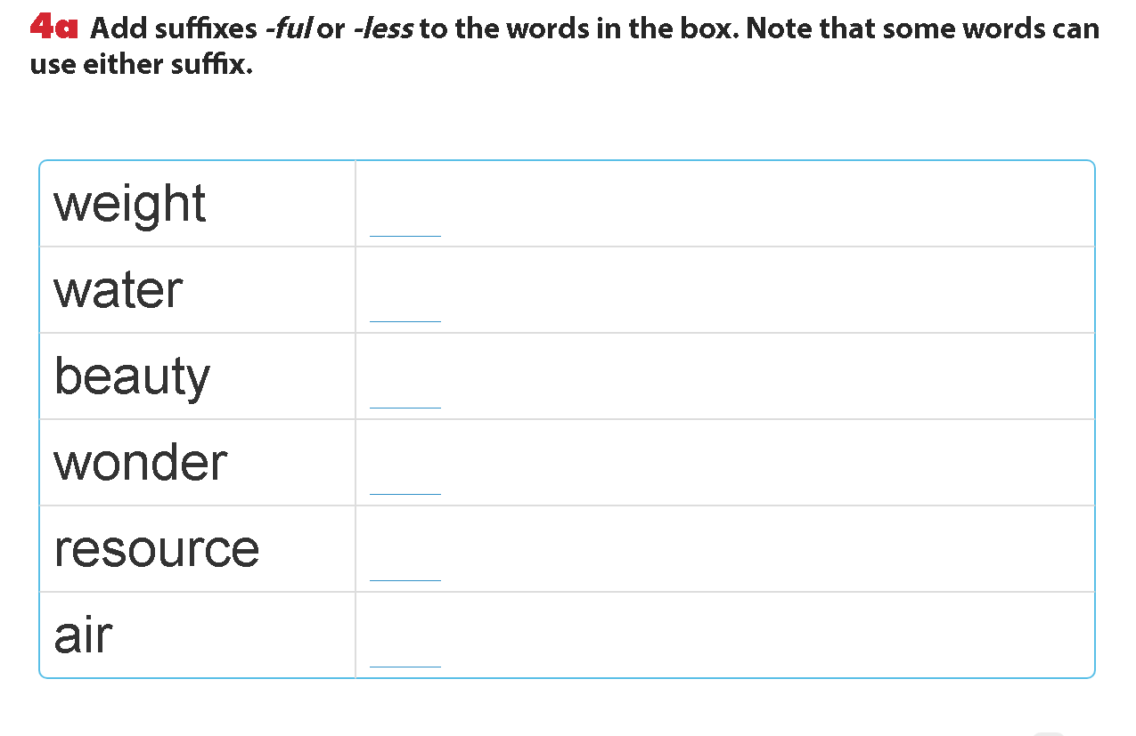
Weightless
Waterless
Beautiful
wonderful
Resourceful/ Resourceless
Airless

Slide 8
b. Now use the topic of space to make a sentence for each new word. Compare your sentences with a partner.
Example:
– Earth looks beautiful from space.
– Venus is a dry and waterless planet.

Slide 9
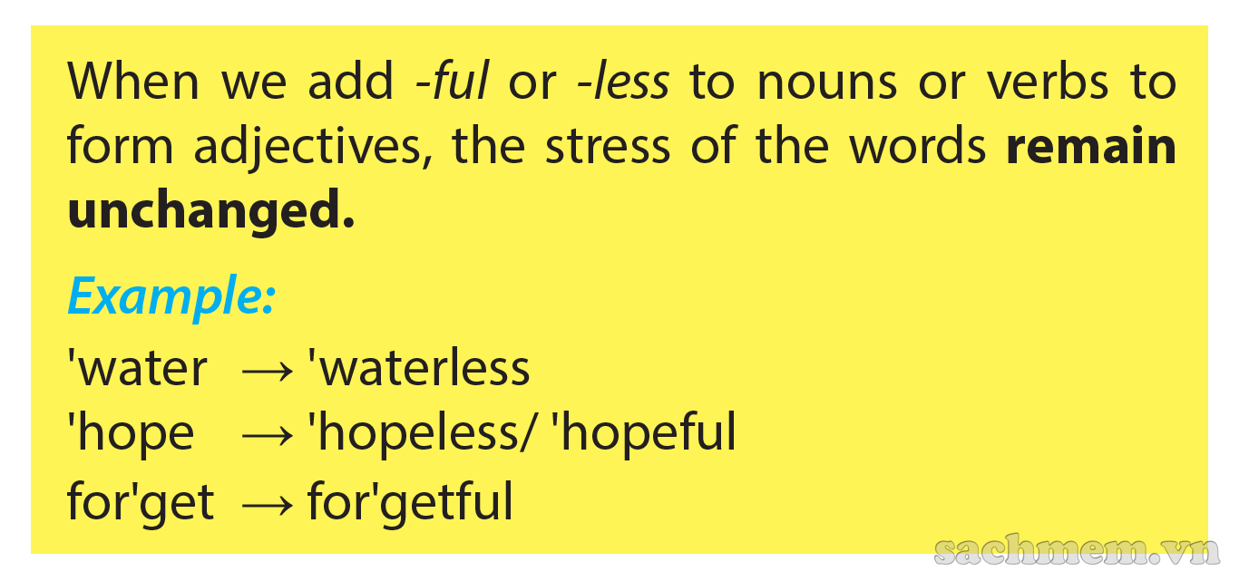

Slide 10
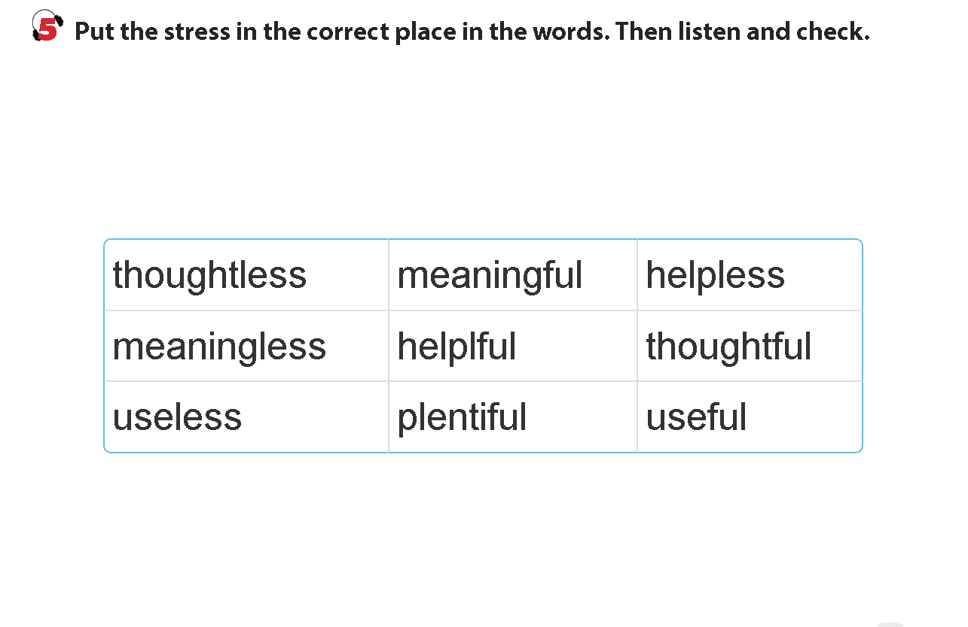
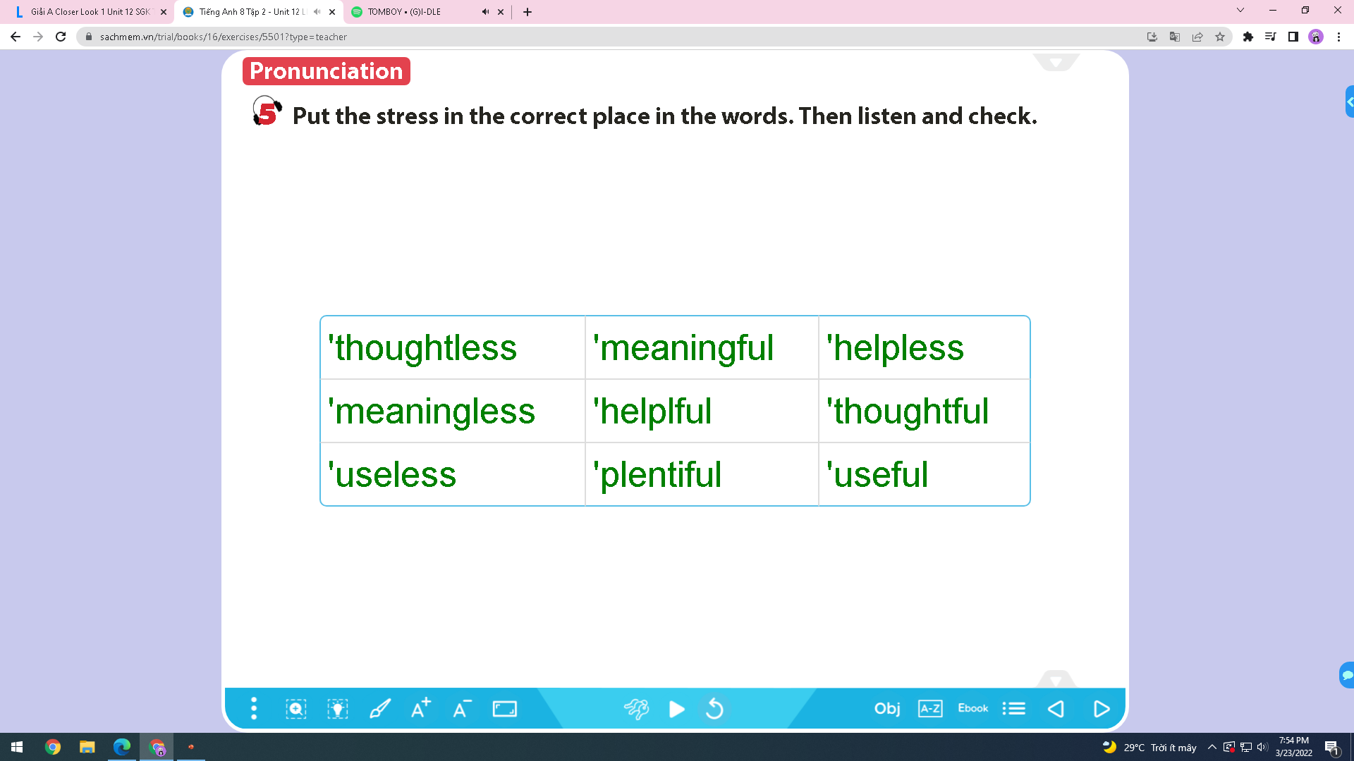

Slide 11
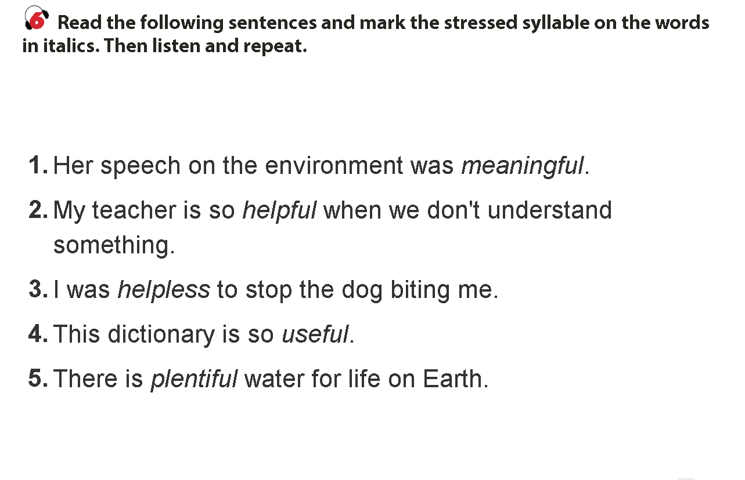
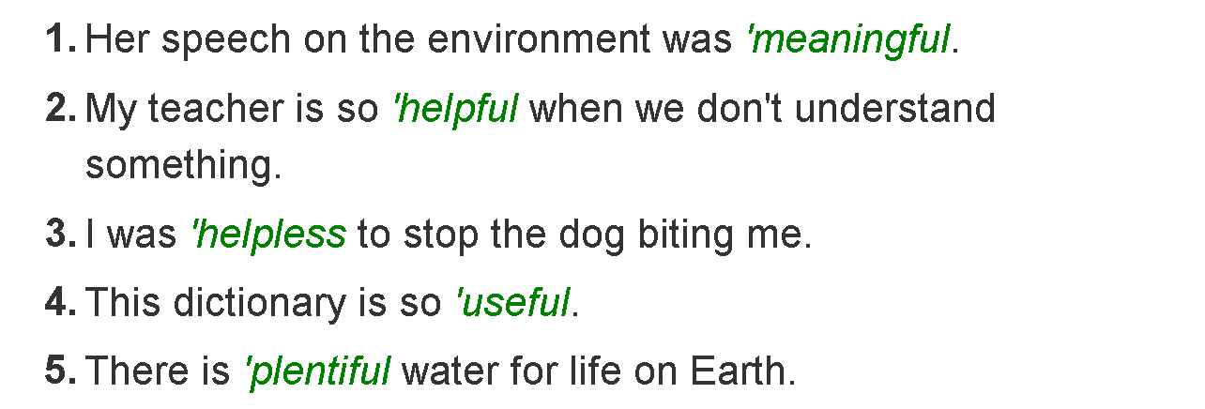

Slide 12
HOMEWORK

