Slide 1
THÔNG TIN CUỘC THI | BỘ GIÁO DỤC VÀ ĐÀO TẠO Cuộc thi thiết kế bài giảng điện tử
Tiêu đề bài dự thi | UNIT 2: MY HOUSE – A CLOSER LOOK 1
Môn/ Lớp | Tiếng Anh 6
Giấy phép học liệu mở: | CC BY/ CC BY- SA
Thông tin tác giả | Giáo viên: Ngô Thị Thu Hương
Email | thuhuongg2207@gmail.com
Đơn vị công tác | Trường THCS Bùi Quang Mại (Đông Anh, Hà Nội)
Tháng/ Năm | 10/ 2021

Slide 2








Welcome,
teachers and students!
Notes:
I’m so honored to introduce you many teachers coming to our class today, so I hope you guys will try your best to have a good lesson together as a gift for them
For warm – up,

Slide 3
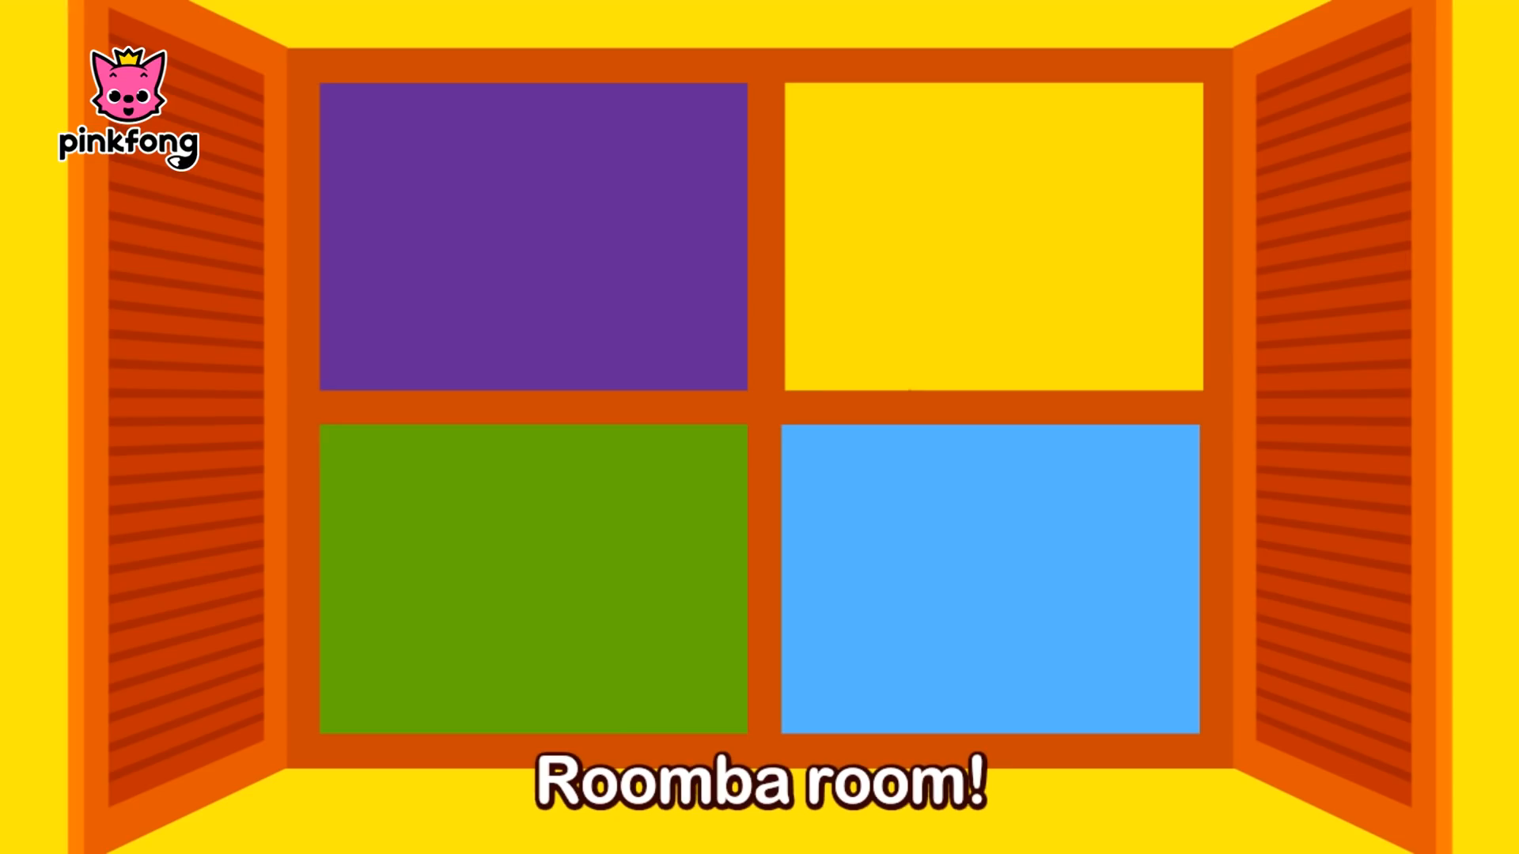
Warm – up

Slide 4

Tuesday, October 12th 2021
UNIT 2: MY HOUSE
Period 10: A closer look 1

Slide 5
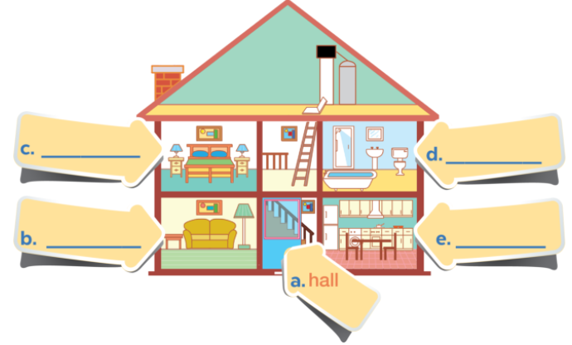
I. Vocabulary
bedroom
bathroom
living room
kitchen

Slide 6


Slide 7
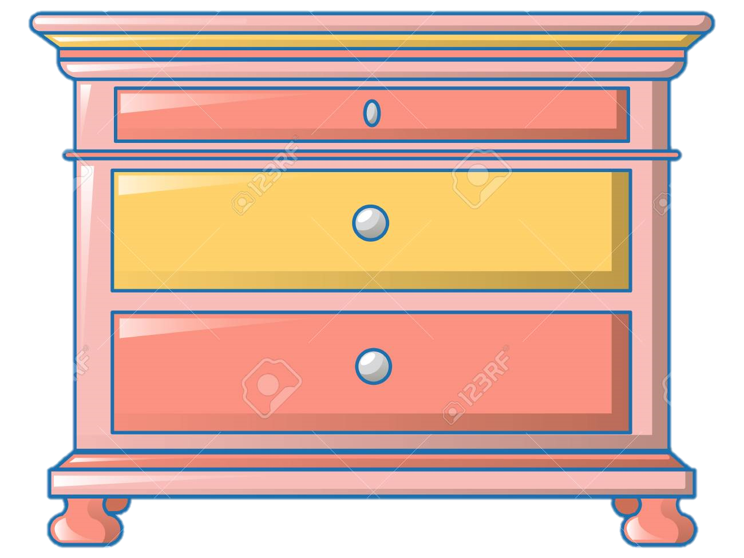

Chest of drawers /ˌtʃest əv ˈdrɔːrz/
Example: Mary buys a new chest of drawers.

Slide 8
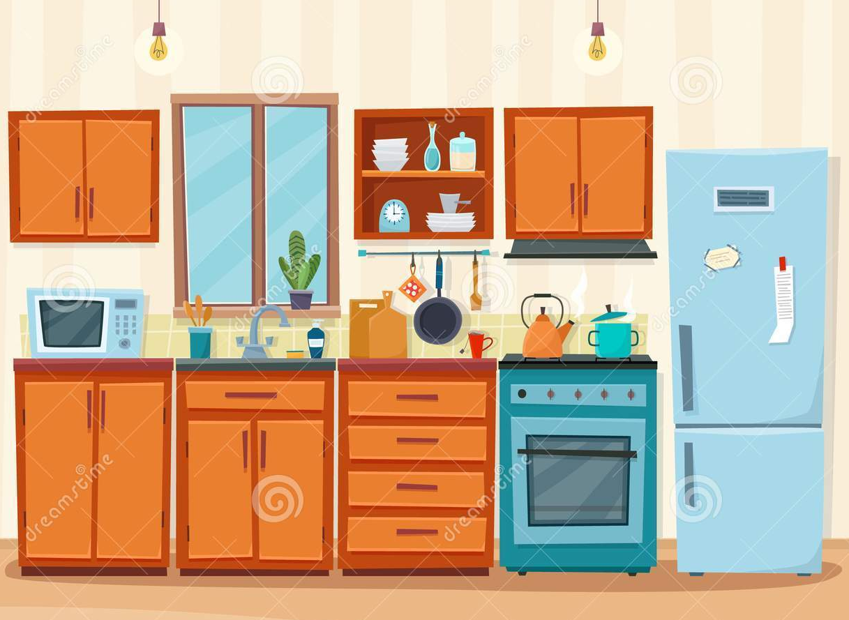
Cupboard /ˈkʌbərd/
Example: There are cupboards in the kitchen.

Slide 9

Shower /ˈʃaʊər/
Example: I take a shower every day.

Slide 10
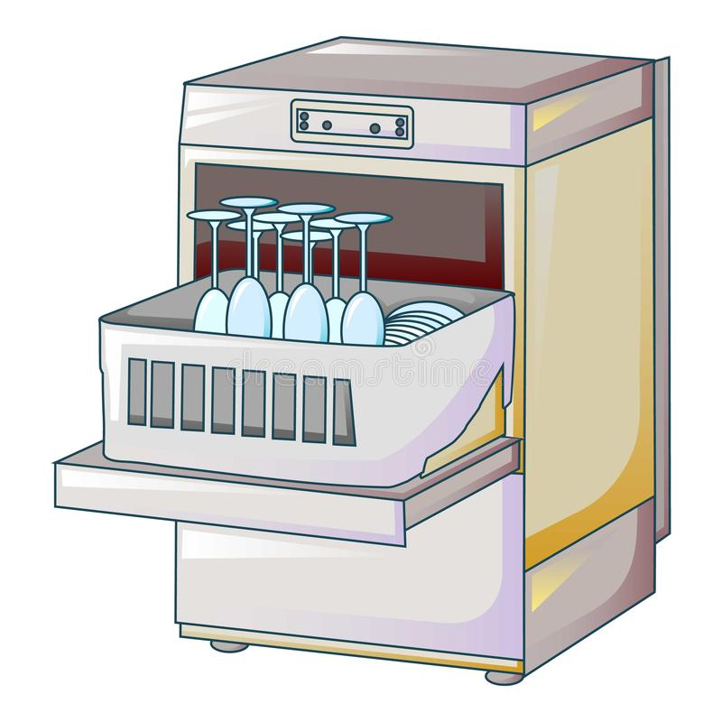
Dishwasher /ˈdɪʃwɔːʃər/
Example: The dishwasher is convenient.

Slide 11





PLAY

Slide 12

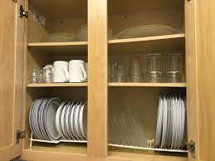



What’s this?
cupboard
hall
shower
sofa

Slide 13
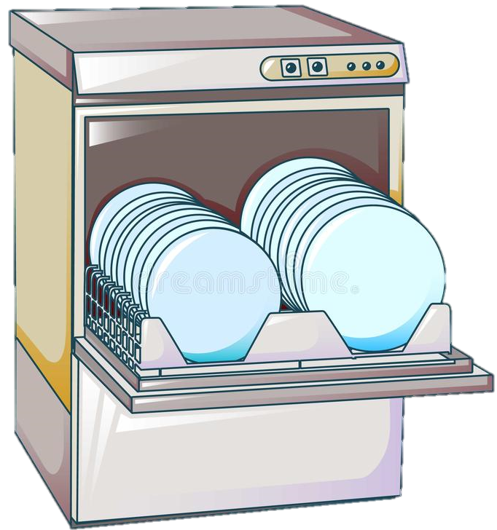
What’s this?
washing machine
dishes
washing dishes
dishwasher

Slide 14
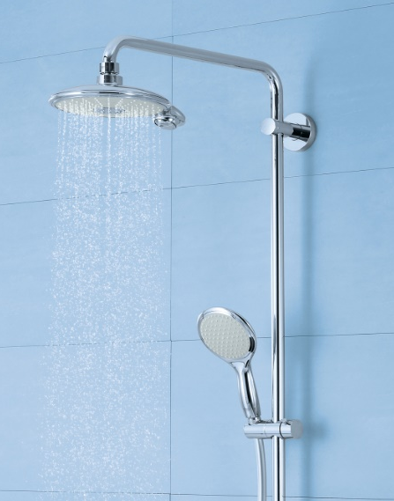
What’s this?
take
shower
kitchen
toilet

Slide 15
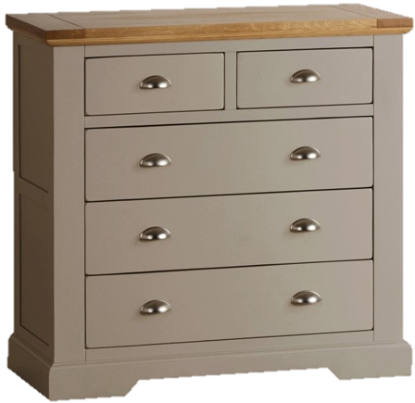
What’s this?
chest of drawers
cupboard
drawer
lamp

Slide 16
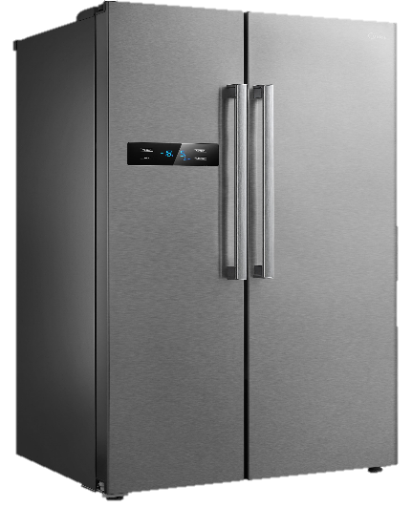
What’s this?
armchair
fridge
picture
lamp

Slide 17
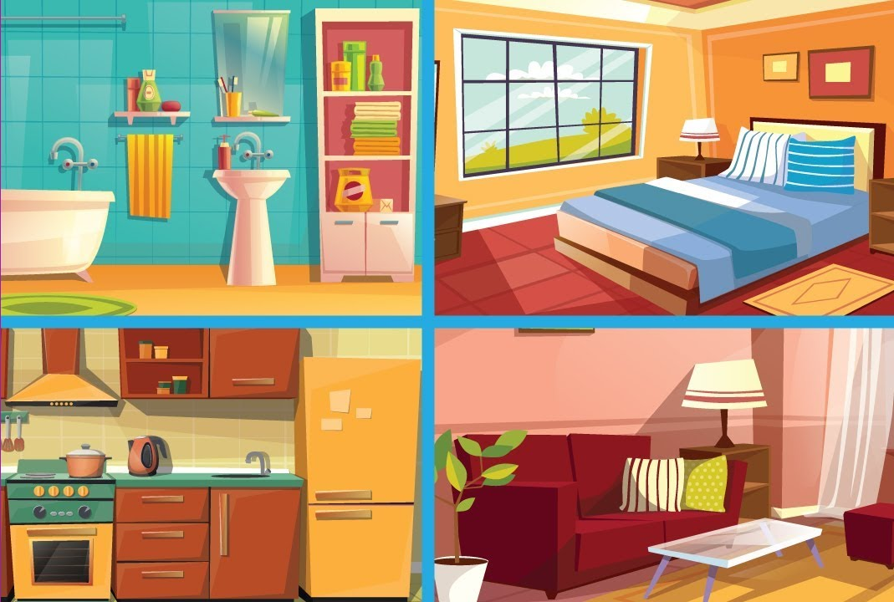
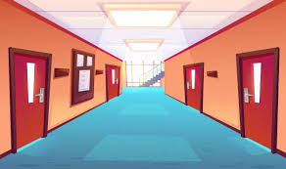

Slide 18
Exercise 2: Name the things in each room.
II. Practice
sofa, lamp, picture, sink, dishwasher, cupboard, chest of drawers, shower, toilet, fridge
Living room | Bedroom | Bathroom | Kitchen | Hall
sofa
chest of drawers
shower
sink
picture
lamp
lamp
sink
dishwasher
picture
picture
cupboard
toilet
fridge

Slide 19

Exercise 3: Work in pairs
A sofa and a television
1. What’s in your room?
Yes
2. Is it the living room?

Slide 20
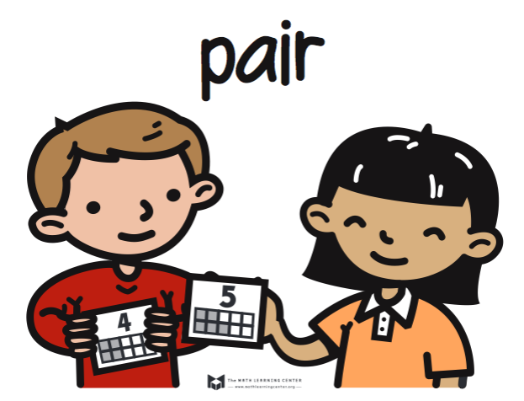
A lamp and a picture
1. What’s in your room?
Is it the bedroom?
Yes

Slide 21

1. What’s in your room?
A sink and a shower
Is it the bathroom?
Yes

Slide 22
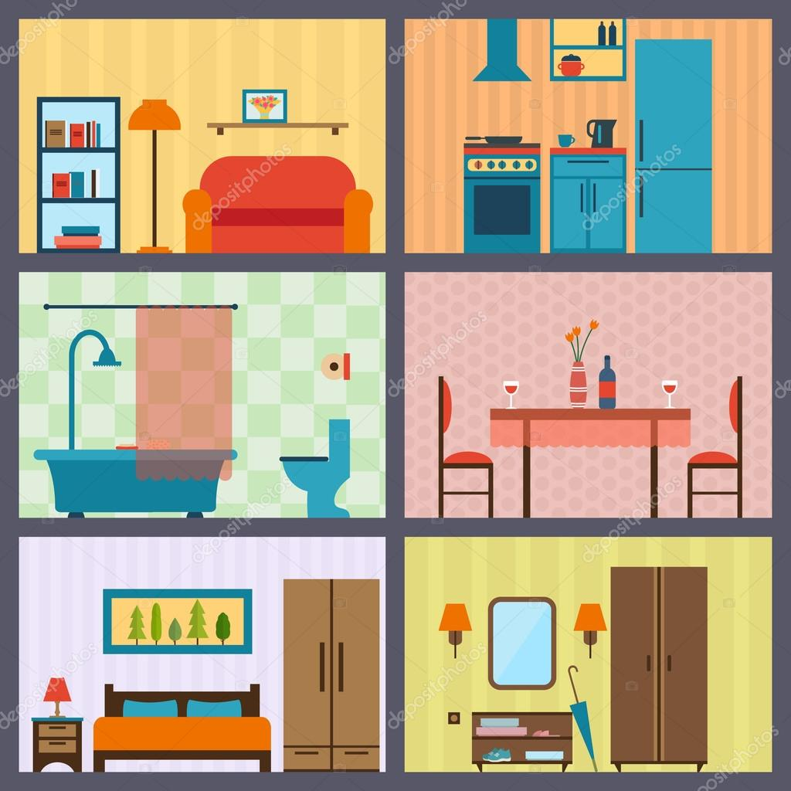

pictures
books
chairs
lamps

Slide 23
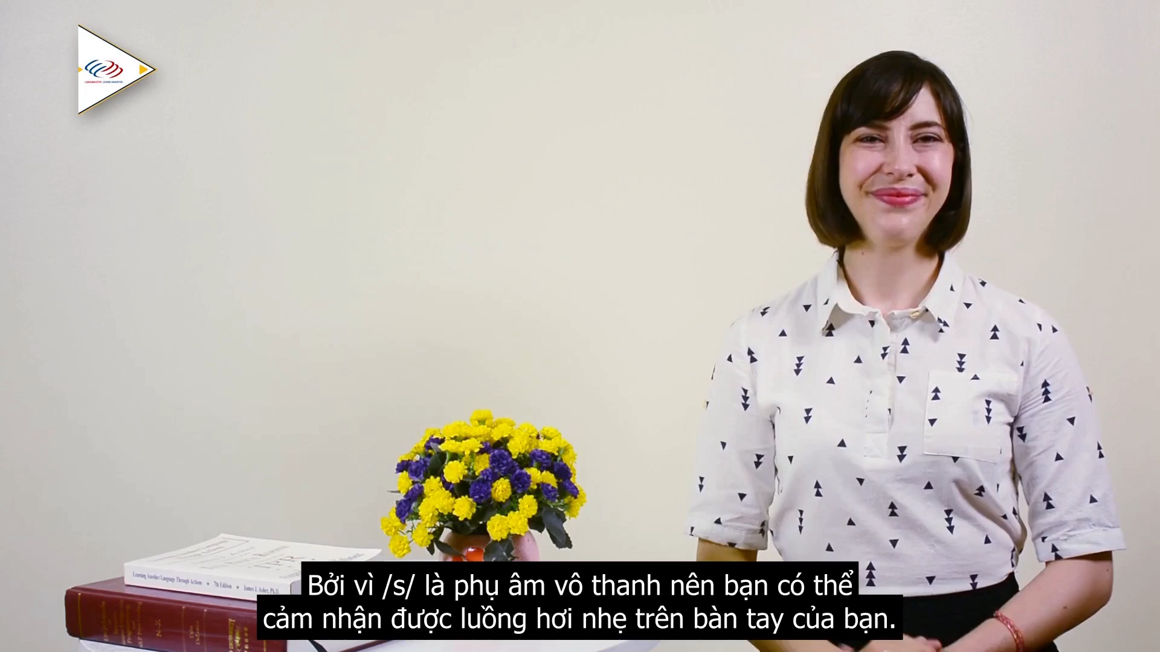
III. Pronunciation
Final sounds: /s/, /z/

Slide 24
Exercise 4: Listen and repeat these words
lamps
cupboards
sinks
sofas
flats
kitchens
toilets
rooms

Slide 25
Final sounds: /s/, /z/
Say /s/ when the word ends in a voiceless sound like: /p/, /t/, /k/, /f/, /θ/
Example:
Say /z/ when the word ends in a voiced sound like: /m/, /n/, /ŋ/, /l/, /b/, /d/, /g/, /v/, /ð/, /r/
Example:
books,
cups,
pens,
cupboards,
cats, …
dogs, …

Slide 26
Exercise 5: Listen, underline the final s in the words and pronounce them correctly
Mi: Mum, are you home?
Mum: Yes, honey. I’m in the kitchen. I’ve bought these new bowls and chopsticks.
Mi: They’re beautiful, Mum. Where did you buy them?
Mum: In the department store near our house. They have a lot of things for homes.
Mi: Don’t forget we need two lamps for my bedroom, Mum.
Mum: Let’s go there this weekend.
/z/
/s/
/z/
/z/
/s/

Slide 27
Put the words in the correct column
lamps, pictures, sinks, cupboards, toilets, sofas
/s/ | /z/
lamps
pictures
sinks
cupboards
toilets
sofas

Slide 28
UNIT 2: A CLOSER LOOK 1
Vocabulary
Pronunciation
Rooms in the house: bedroom, kitchen, …
Things in the rooms: sofa, sink, …
Final sounds /s/, /z/
/s/: cups,
books, …
/z/: tables, doors, …

Slide 29







IV. Homework
Learn by heart new words.
Tidy up your house, take a picture and write 5 sentences to describe things in a room of your house.
Do exercises in the part: “Vocabulary” and “Phonetics” (workbook)

Slide 30


Slide 31

Name:
Nationality: Vietnamese
School: Primary school
School address: Me Linh district,
Ha Noi city.
Class:

Slide 32
Hello. My name is Vy. I’m 9 years old. I’m from Viet Nam. I’m Vietnamese. I study at Thai hoa Secondery school. It’s a big school in Ba Vì district, Ha Noi city. I’m in class 6A.
How about you?
Thank you for listening. Good bye!

