Slide 1
WARM - UP
List all adjectives that describe a person's appearance and personality

Slide 2
Unit 3: My friends
Lesson 4: Communication

Slide 3


Everyday English
Asking about appearance and personality

Slide 4



Listen and read the dialogue between Linda and Mi. Pay attention to the highlighted.
…
Linda: What does your best friend look like?
Mi: She’s short with long black hair.
She has bright brown eyes.
Linda: What’s she like?
Mi: She’s very kind and creative.
…

Slide 5
a. Asking about appearance
What + do/ does + S + look like?
=> S + have/ has + (a/an) + adj + body part
Ex: What does your best friend look like?
=> She has blue eyes
b. Asking about personality
What + tobe + S + like?
=> S + tobe + adj
Ex: What is he like?
=> He is very kind and creative

Slide 6

Work with a classmate. Ask him / her about his / her best friend. Remember to use the two questions highlighted in 1.

Slide 7
Date of birth and personality

Slide 8

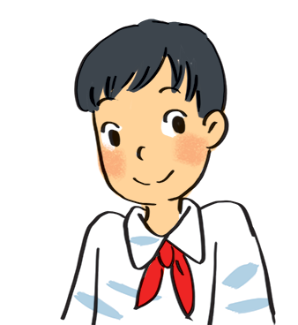
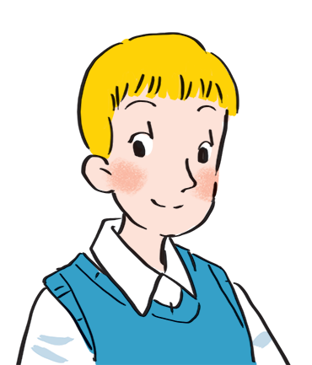
Read about these students in 4Teen magazine. Use one or two adjectives to describe them.
clever
I live in Da Nang. At home, I can do my homework without my parents’ help. At school, I like speaking English. I’m going to an English club now.
hard-working
I come from Cambridge. In my free time, I draw pictures and play the piano. I also help some old people near my house. I usually read to them at the weekend. Now I’m drawing in my garden.
creative
kind
Notes:
City landmarks phải ở trên mục 3

Slide 9

We may have different personalities because we have different birthdays.
Read the descriptions below. Do you think they match the friends in 3?
21/3 – 19/4 | confident, active
20/4 – 20/5 | loving, hard-working
21/5 – 21/6 | active, friendly
22/6 – 22/7 | caring, clever
23/7 – 22/8 | confident, creative
23/8 – 22/9 | careful, hard-working
23/9 – 23/10 | creative, friendly
24/10 – 21/11 | careful, funny
22/11 – 21/12 | clever, confident
22/12 – 19/1 | careful, hard-working
20/1 – 18/2 | friendly, clever
19/2 – 20/3 | kind, creative

Slide 10


Read the descriptions in 4.
Share your opinion with the class.
Example:
My birthday is …
It’s true that …
It isn’t true that …

Slide 11
Homework
- Learn by heart the grammar
- Prepare the next lesson ( Unit 3 - Skills 1)

