Slide 1


WELCOME TO OUR CLASS

Slide 2
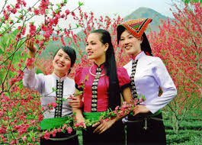
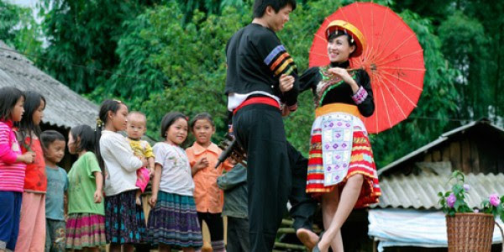
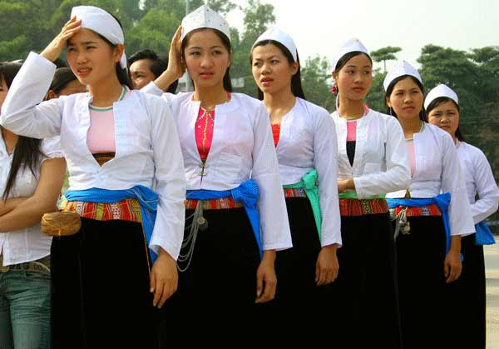
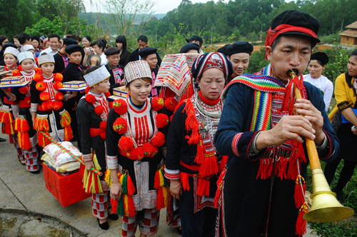
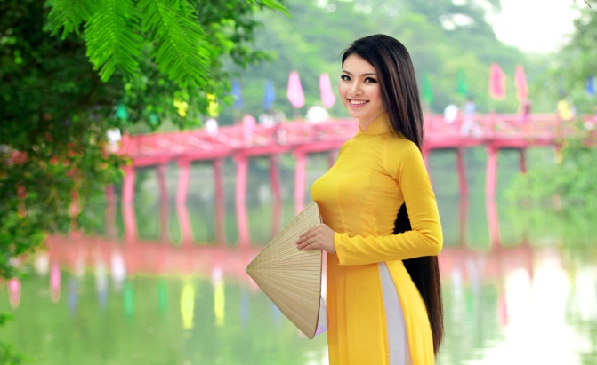
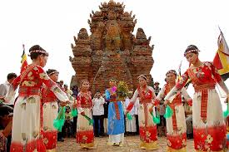
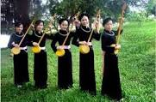
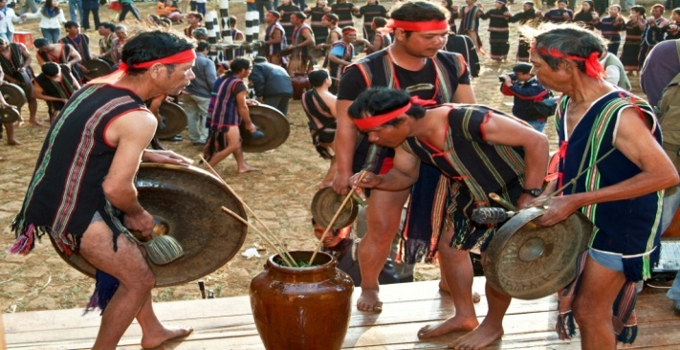
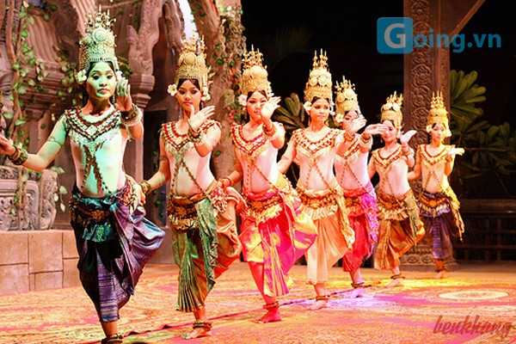
a.The Kinh c. The Tay e. The Khmer g.The Yao i.The Hre
b.The Thai d. The Cham f.The H’Mong h.The Muong
1
the Thai
2
the HMong
3
the Muong
ethnic groups
4
5
6
the Cham
the Yao
the Kinh
7
8
the Hre
9
the Khmer
the Tay

Slide 3
UNIT 3: PEOPLES OF VIET NAM
Lesson 1: Getting started

Slide 4
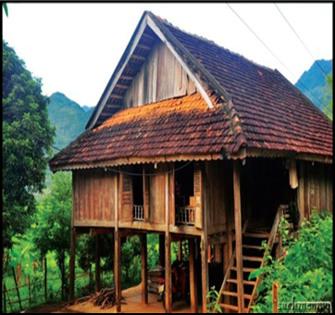
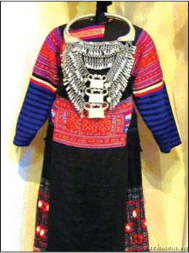
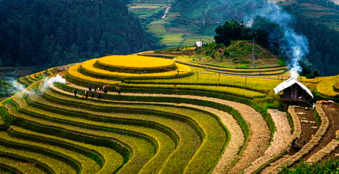
I. VOCABULARY
- terraced fields :
ruộng bậc thang
- awesome
= surprising, amazing
- costume (n):
trang phục
- stilt house :
nhà sàn

Slide 5
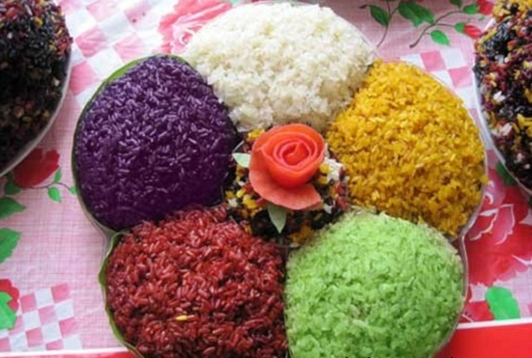
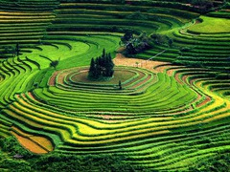
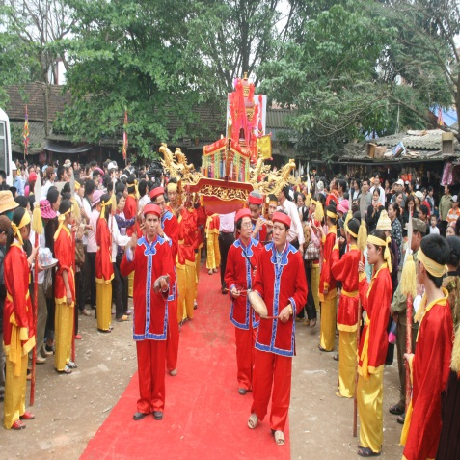
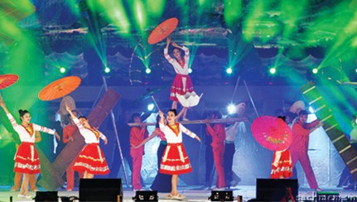
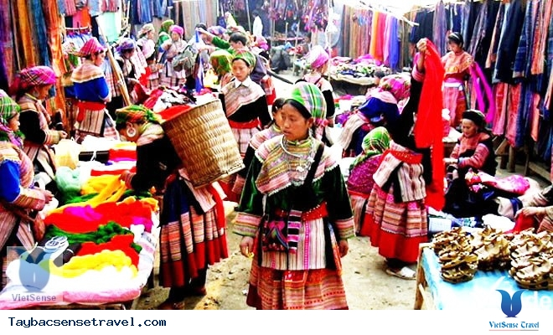
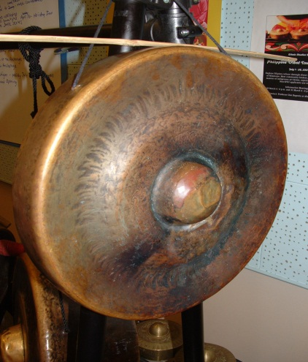
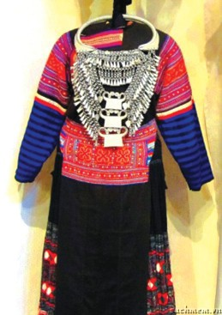
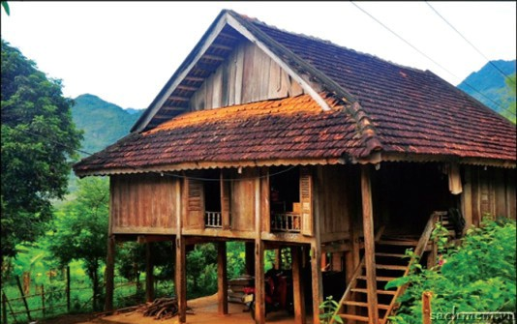
Use the words and phrases in the box to label each picture.
A. costume D. stilt house H. terraced fields
B. open-air market E. folk dance I. musical instrument
C. festival G. five- coloured sticky rice
five-coloured sticky rice
2.
terraced fields
3.
1.
festival
4.
folk dance
open – air market
stilt house
5.
musical instrument
8.
6.
7.
costume

Slide 6

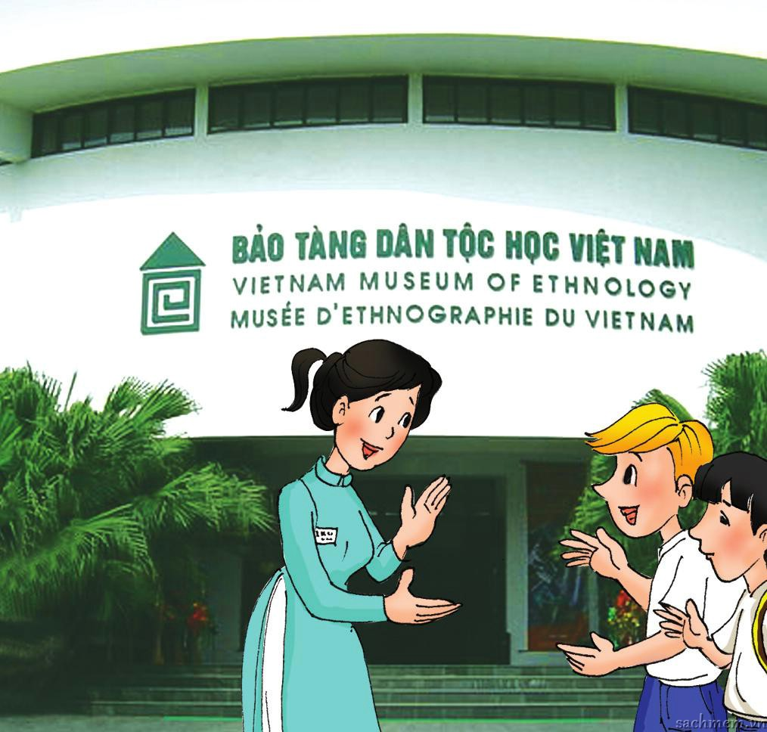
Nick
Duong
a guide

Slide 7

~~ At the Museum of Ethnology ~~
Duong & Nick: Good morning.
Guide: Good morning. Can I help you?
Nick: Yes, we’d like to know something about the cultural groups of Viet Nam.
Duong: Right. Is it true that there are 54 ethnic groups in our country?
Guide: Exactly.
Nick: How interesting! I’m curious about them now. Which group is the largest?
Guide: Well, the Viet (or Kinh) have the largest number of people, accounting for about 86% of the population. 53 others are called 'ethnic minority peoples’.
Nick: And where do they live?
Guide: All over the country. Some groups like the Tay, Hmong, Yao… live mostly in the mountainous regions in the north, and the Cham, Khmer, Ede… live in the Central Highlands and some southern provinces.
Nick: I see. And do they speak their own languages?
Guide: Yes, and they have their own ways of life, and customs and traditions.
Nick: That’s awesome! I’d like to find out more about them.
Guide: OK. I’ll show you round and tell you some interesting…

Slide 8
Find the opposite of these words in the conversation.
Duong & Nick: Good morning.
Guide: Good morning. Can I help you?
Nick: Yes, we’d like to know something about the cultural groups of Viet Nam.
Duong: Right. Is it true that there are 54 ethnic groups in our country?
Guide: Exactly.
Nick: How interesting! I’m curious about them now. Which group is the largest?
Guide: Well, the Viet (or Kinh) have the largest number of people, accounting for about 86% of the population. 53 others are called 'ethnic minority peoples’.
Nick: And where do they live?
Guide: All over the country. Some groups like the Tay, Hmong, Yao… live mostly in the mountainous regions in the north, and the Cham, Khmer, Ede… live in the Central Highlands and some southern provinces.
Nick: I see. And do they speak their own languages?
Guide: Yes, and they have their own ways of life, and customs and traditions.
Nick: That’s awesome! I’d like to find out more about them.
Guide: OK. I’ll show you round and tell you some interesting…

Slide 9
Listen and read.
a. Find the opposite of these words in the conversation.
boring ><
smallest ><
majority ><
northern ><
interesting
largest
minority
southern
minority, southern, largest, interesting

Slide 10
1b. Read the conversation again and choose the best answer
1. Where are Duong and Nick?
2. What do they want to know?
3. How many ethnic groups are there in Viet Nam?
4. Which ethnic groups has the largest population?
5. Do the ethnic minority peoples have their own customs and traditions?

Slide 11
1b. Read the conversation again and choose the best answer
1. Duong and Nick are in the Museum of .........
A. Ethnology B. Ethnic C. History
2. They want to know about the ...................of Viet Nam.
A. landscapes B. ethnic groups C. groups ethnic
3. There are ...................ethnic groups in Viet Nam.
A. 53 B. 86 C. 54
4. The ........................ has the largest population.
A. Kinh B. Thai C. Yao
5. Do the ethnic minority peoples have their own customs and traditions?
A. No information B. No, they don’t C. Yes, they do

Slide 12
~~ At the Museum of Ethnology ~~
Duong & Nick: Good morning.
Guide: Good morning. Can I help you?
Nick: Yes, we’d like to know something about the cultural groups of Viet Nam.
Duong: Right. Is it true that there are 54 ethnic groups in our country?
Guide: Exactly.
Nick: How interesting! I’m curious about them now. Which group is the largest?
Guide: Well, the Viet (or Kinh) have the largest number of people, accounting for about 86% of the population. 53 others are called 'ethnic minority peoples’.
Nick: And where do they live?
Guide: All over the country. Some groups like the Tay, Hmong, Yao… live mostly in the mountainous regions in the north, and the Cham, Khmer, Ede… live in the Central Highlands and some southern provinces.
Nick: I see. And do they speak their own languages?
Guide: Yes, and they have their own ways of life, and customs and traditions.
Nick: That’s awesome! I’d like to find out more about them.
Guide: OK. I’ll show you round and tell you some interesting…

Slide 13
1c.Can you find the following expressions in the conversation? Try to explain what they mean.
1. Exactly =>
2. How interesting! =>
3. I see =>
4. That’s awesome!=>
Được sử dụng như một câu trả lời, đồng ý với những gì đã nói, hoặc nhấn mạnh rằng điều đó là chính xác.
Được sử dụng để nhấn mạnh sự thú vị của vấn đề một cách mạnh mẽ và vấn đề đó làm ta phải chú ý.
Được sử dụng khi người nghe đã hiểu những gì người nói diễn tả.
Diễn tả sự ngạc nhiên, mang tính tích cực, được sử dụng để chỉ ra rằng vấn đề người nói trình bày là rất tuyệt vời.

Slide 14
* Grammar
How interesting!
How amazing!
How beautiful!
How peaceful!
How + adj/adv!

Slide 15
d. Work in pairs. Use facts from the conversation to make short role – plays using the expressions in c.
EX: A: Ss wear uniform to school everyday.
B: How exactly !
1. A: Some groups live in mountainous regions.
B: ________________________
How interesting!
2. A: Is it true that the Kinh speak Vietnamese?
B: _________________________
How exactly!
3. A: We got the scholarship to study in the U.S
B: _________________________
How amazing!

Slide 16

* People:
is used as the plural of ‘person’ to refer to men, women, and children.
* Peoples:
ethnic groups of people who belong to a particular country, race, or area.

Slide 17
3.Complete the following sentences with the words/phrases in the box.
A.heritage site B.stilt houses C.terraced fields D.member E.Ethnic F.festivals
1. In our country, it is against the law to discriminate against any __________ or religious group.
2. My Son in Quang Nam Province has been recognised by UNESCO as a world ____________.
3. ____________ have been popular among many of Viet Nam’s ethnic groups for a long time.
4. Lunar January is the time for important __________ in the whole country, especially in the north.
5. The exhibition building of the Museum of Ethnology was designed by the architect Ha Duc Linh, a __________ of the Tay ethnic group.
6. The _______________ of Sa Pa have entered in the Top 11 most beautiful terraces in the world, according to Touropia.
ethnic
heritage site
Stilt houses
festivals
member
terraced fields

Slide 18
4. GAME: QUICK QUIZ
Work in pairs. Ask and answer, using these cues.
Which/ smallest population?
______________________________________________
- The Odu group.
The Hmong/ own language?
______________________________________________
- Yes.
Where/ the Coho/ live?
______________________________________________
- Lam Dong Province.
What colour/ the Nung’s clothing?
______________________________________________
- Dark indigo.
Which/ larger population/ the Tay or the Thai?
__________________________________________________
- The Tay.
Whose arts/ displayed/ a museum/ Da Nang?
______________________________________________
- The Cham’s.
Which ethnic group has the smallest population?
Do the Hmong own have their language?
Where do the Coho live?
What colour is the Nung’s clothing?
Which group has a larger population, the Tay or the Thai?
Whose arts are displayed at a museum in Da Nang?

Slide 19
Note:-Vocabulary about Ethnology
-‘How + Adj/Adv to show a strong reaction to sth.
festival
costume
stilt house
open-air market
ETHNOLOGY
Folk dance
musical instrument
terraced fields
Five-colour sticky rice

Slide 20

HOMEWORK
1. Learn by heart:
+ Vocabulary about ethnology.
+ ‘How + Adj/Adv’ to show a strong reaction to sth.
2. Talking about ethnic groups.
3. Prepare for the next lesson: Unit 3 - A closer look 1

Slide 21


Slide 22





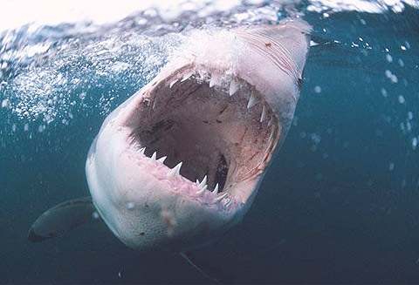
Shark attack
E T H N I C
stairs

