Slide 1

Unit 3: Music and Arts
Lesson 1.3: Pronunciation & Speaking
Page 22

Slide 2



Lesson 1.3
LESSON OUTLINE
Consolidation

Slide 3

By the end of this lesson, students will be able to…
talk about the music you like/don’t like.
practice pronouncing different sounds /s/, /z/ of "s" at the end of verbs.

Slide 4

WARM UP

Slide 5

Work in pairs.
Choose the word whose main stress is placed
differently from the others.
A. terrible B. favorite C. exciting D. classical
2. A. helpful B. selfish C. friendly D. amazed
3. A. glasses B. party C. swimming D. tonight
/ˈterəbəl/
/ˈfeɪvərət/
/ɪkˈsaɪtɪŋ/
/ˈklæsɪkəl/
/ˈhelpﬂ/
/ˈselfɪʃ/
/ˈfrendli/
/əˈmeɪzd/
/ˈɡlæsəz/
/ˈpɑ:rti/
/ˈswɪmɪŋ/
/təˈnaɪt/

Slide 6
Work in pairs.
Choose the word whose underlined part is
pronounced differently from that of the other words.
A. long B. short C. blond D. bored
2. A. love B. pop C. song D. rock
3. A. listening B. hospital C. evening D. designer
/lɔ:ŋ/
/ʃɔ:rt/
/blɒnd/
/bɔːrd/
/lʌv/
/pɑ:p/
/sɑ:ŋ/
/rɑːk/
/ˈlɪsənɪŋ/
/ˈhɒspɪtl/
/ˈi:vnɪŋ/
/dɪˈzaɪnə/

Slide 7

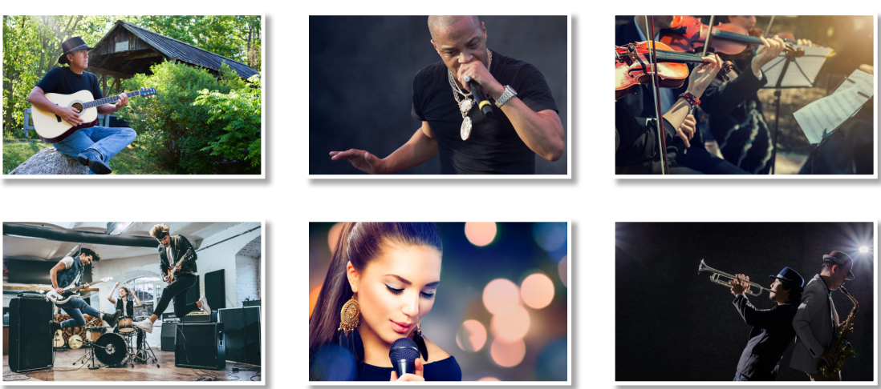
Work in pairs.
What can you see in each picture?

Slide 8



Slide 9
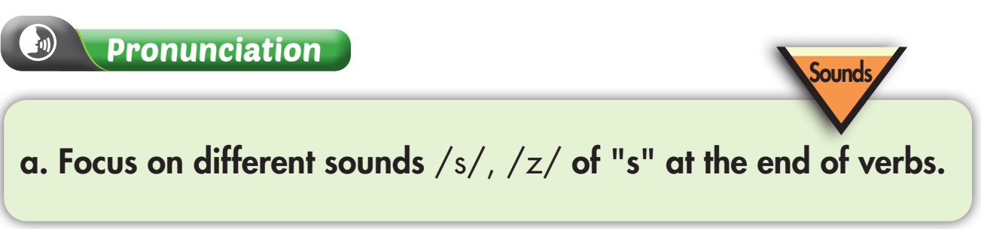
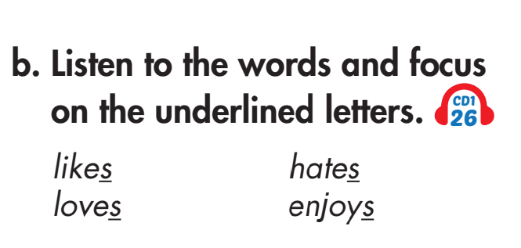


Slide 10
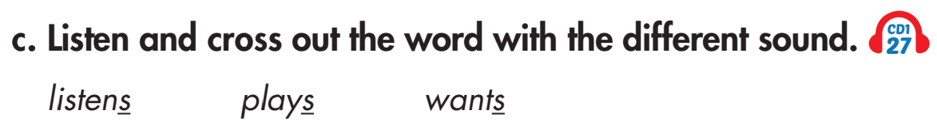

Slide 11
Extra Practice
Find 10 verbs related to the topic Music and Arts, add ‘s’ to each, then practice saying them with a partner.

Slide 12

Speaking

Slide 13

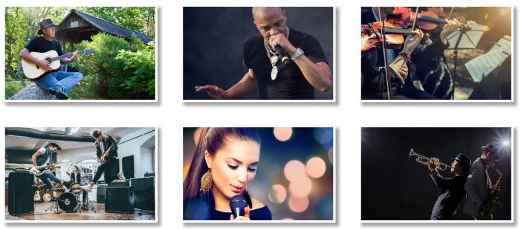
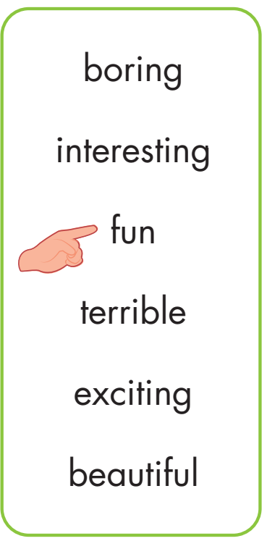
Point, ask, and answer. Then practice with your own idea.
Do you like country music?
Yes, I do. It's fun

Slide 14
Extra Practice
Try to extend your answers.
Do you like country music?
Yes, I do. I listen to music when I have free time, especially in the evening or when I’m sad. It's fun and I feel relaxed. What about you?

Slide 15
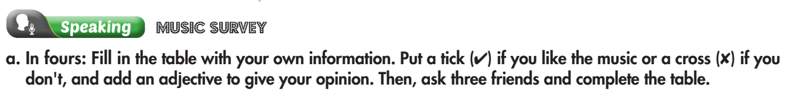

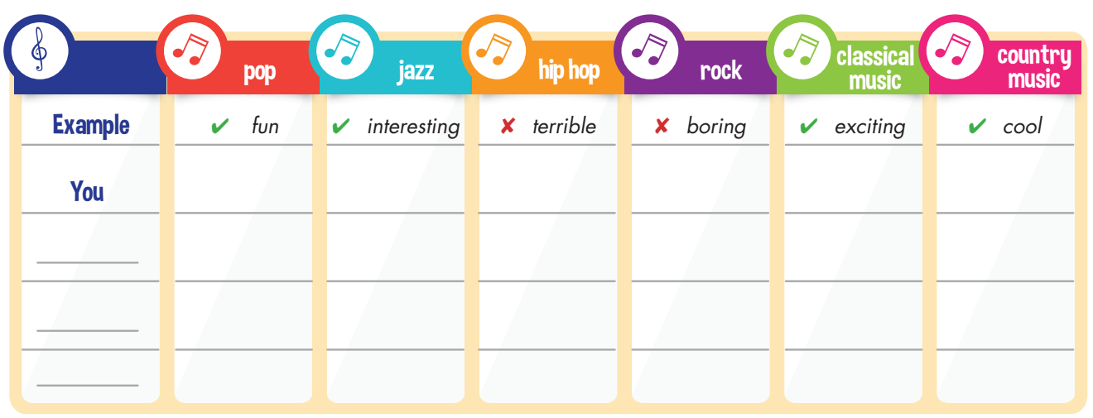
Work in groups

Slide 16
Teacher: What’s the most popular kind of music in your group?
Student: In our group, the most popular kind of music is pop.

Slide 17

CONSOLIDATION

Slide 18

WRAP-UP

Slide 19
Today’s lesson
talk about the music you like/don’t like.
practice pronouncing different sounds /s/, /z/ of "s" at the end of verbs.

Slide 20
Homework
Practice pronouncing sounds /s/, /z/ of "s" at the end of the verbs.
Do the writing exercise on page 57 WB.
Review the vocabulary and grammar notes in Tiếng Anh 7 i-Learn Smart World Notebook (pages 14 & 15).
Play the consolidation games in Tiếng Anh 7 i-Learn Smart World DHA App on www.eduhome.com.vn.
Prepare the next lesson (page 23 SB).

Slide 21

Lesson 3
Stay positive and have a nice day!

