Slide 1
Unit 4
MY NEIGHBORHOOD
LESSON 2 : A closer look 1

Slide 2
Name some places in your neigbourhood
hospital
tall building
clinic
school
museum
post office

Slide 3
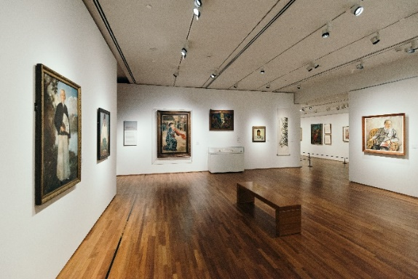
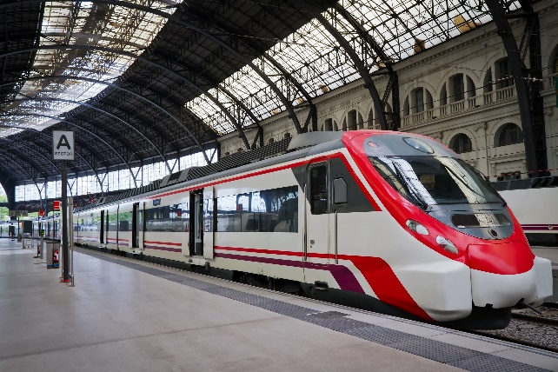
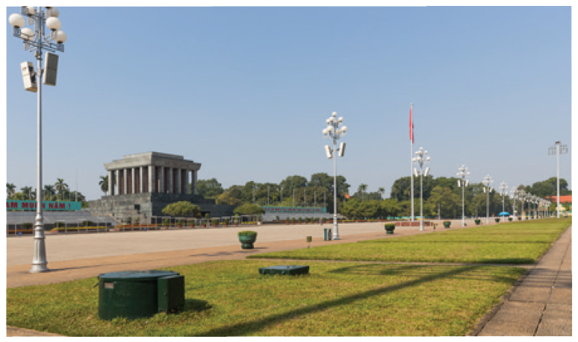
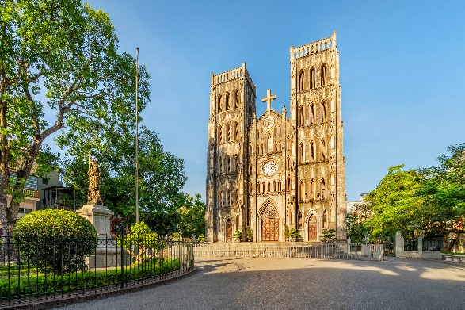
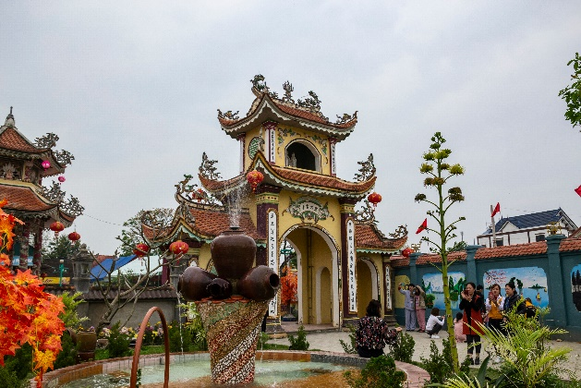

UNIT 4: MY NEIGHBOURHOOD
Lesson 2: A closer look 1
Vocabulary
- railway station (n)
: ga tàu
- square (n)
: quảng trường
- cathedral (n)
: nhà thờ lớn
- temple (n)
: đền, miếu
: triển lãm hội hoạ
- Art gallery (n)

Slide 4

1. Match the places below with the pictures.
Then listen, check and repeat the words.
a
b
b
a
1. square
2. art gallery
3. catherdral
4. temple
4. temple
4. temple
5. railway station
5. railway station
5. railway station
c
d
e
1. square
3. catherdral
2. art gallery
Name some other places in your neighbourhood.

Slide 5
2. Work in pairs. Ask and answer questions about
where you live.
Example:
A: Is there a/an square in your neighborhood ?
B: Yes, there is./ No, there isn’t
- cathedral (n)
- railway station (n)
- square (n)
- art gallery (n)
- temple (n)
- market (n)
- badminton club (n)

Slide 6
3. Work in groups. Ask and answer about your neighbourhood. You can use the adjectives below.
Example:
A: Is your neighbourhood quiet?
B: Yes, it is. / No, it’s noisy.
noisy | crowded | peaceful | quiet
modern | beautiful | busy | boring

Slide 7
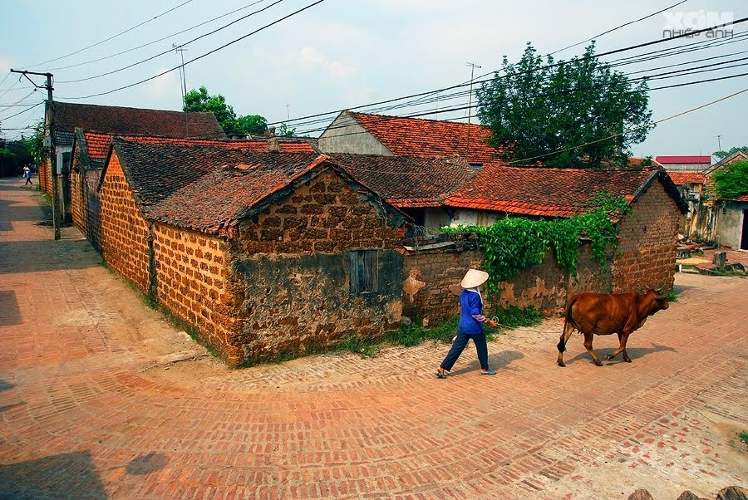
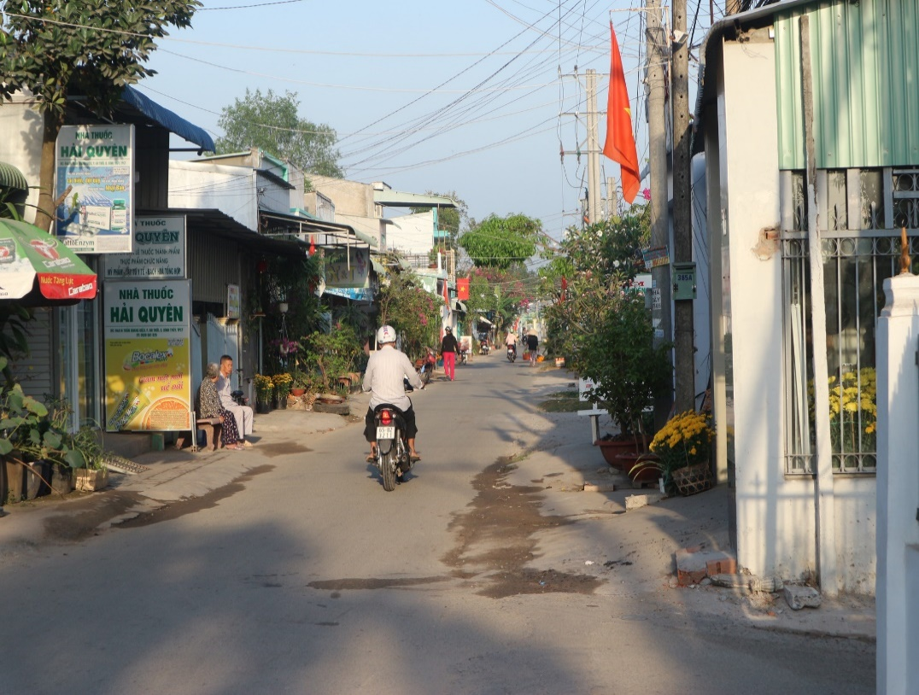
The neighborhood
You
I
quiet
noisy
≠
new
old
OPPOSITES

Slide 8

3. Work in pairs. Ask and answer questions about your neighbourhood. You can use the adjective below.
Example:
A: Is your neighbourhood crowded ?
B: No, it isn’t.
A: Is it peaceful ?
B: Yes, it is
1. noisy/No ; quiet/ Yes
2. boring/No ; beautiful/ Yes
3. busy/ No ; modern/ Yes

Slide 9
II. Pronunciation: Cách phát âm
/i:/
Teacher, tea, clean, convenient
/ɪ/
Quick, city, review

Slide 10


Listen and repeat the words. Pay attention to the sounds /ɪ/ and /i:/.
clean
expensive
clean
exciting
expensive
noisy
exciting
noisy
peaceful
convenient
cheap
convenient
cheap
friendly
peaceful
friendly
Now, in pairs put the words in the correct column.
/ɪ/ | /i:/
noisy
convenient
expensive
cheap
exciting
peaceful
friendly
clean

Slide 11

Listen and practise the chant. Notice the sounds /ɪ/ and /i:/.
MY NEIGHBOURHOOD
My city is very noisy.
There are lots of trees growing. The people here are busy.
It’s a lively place to live in.
My village is very pretty.
There are lots of places to see.
The people here are friendly.
It’s a fantastic place to be.

Slide 12

6. Listen and practice with the chant
My city is very busy
There are lots of buildings growing
The people here are funny
It’s a lovely place to live in.
My village is very pretty.
There are lots of places to see.
The people here are friendly.
It’s a fantastic place to be.

Slide 13
I. Vocabulary:
II. Pronunciation:
Home Asignment:
- Learn by heart the vocabulary in box 1 and box 2
- Practice the sounds: /i:/ and /I/ and find more words with the sounds above
- Prepare for the lesson: A closer look 2
- Workbook

