Slide 1
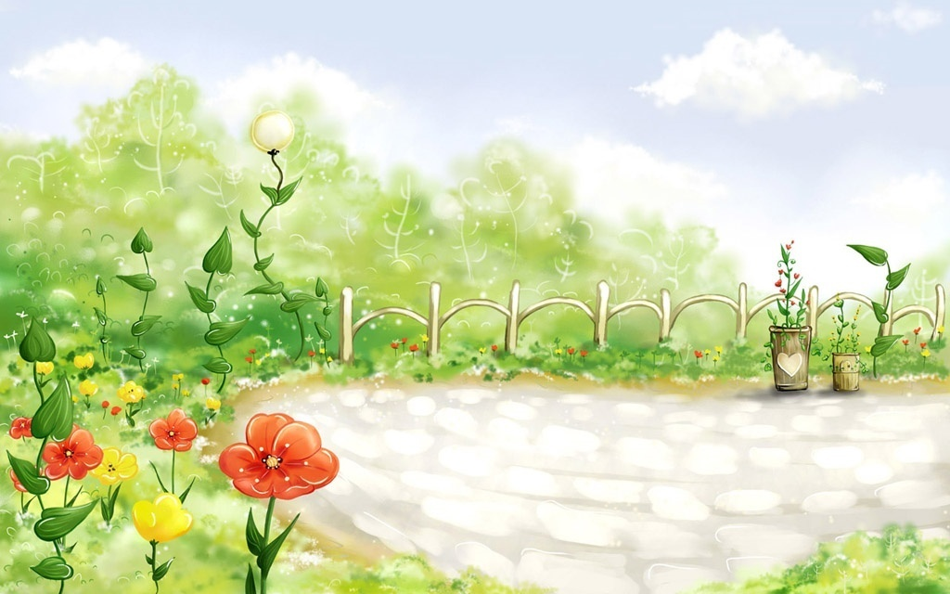



NGUYEN VIET XUAN SCHOOL
ENGLISH 6
Welcome the Teachers to our class
Notes:
1

Slide 3

Guessing and matching

Slide 4
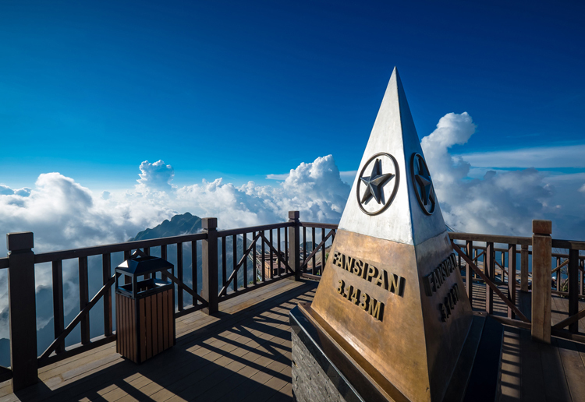
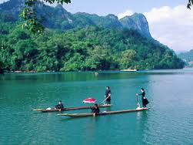
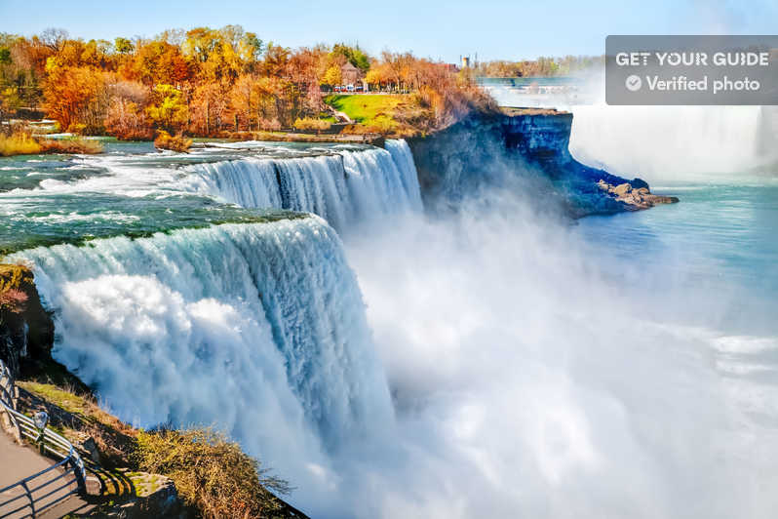
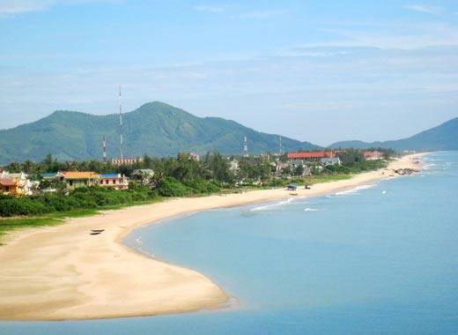
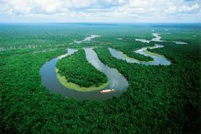
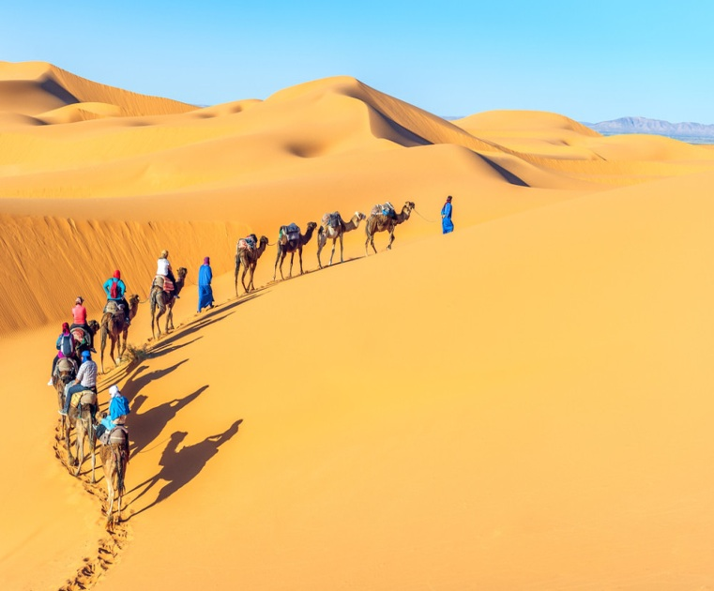
1
2
3
4
5
6
A. Ba Be Lake
B. The Amazon river
C. Tra Co Beach
D. The Sahara desert
E. Mount Fanxipan
F. Niagara Fall

Slide 5
E.Mount Fanxipan
A. Ba Be Lake
F. Niagara Fall
1
2
3
C. Tra Co Beach
B. The Amazon river
D. The Sahara desert
4
5
6

Slide 6

Monday, December 6 ^{th},2021
Unit 5
NATURAL WONDERS
OF VIETNAM
Lesson 3: A closer look 2

Slide 7








Grammar
Countable and uncountable nouns
Modal verb: must / mustn’t
Is the underlined noun countable or uncountable? Write C (countable) or U (uncountable).
Fill each blank with must or mustn’t.
Choose the correct option for each sentence.
Read the classroom rules below. Write some more rules for you and your classmates.
Fill each blank with a, any, some, much or many.

Slide 8

*Vocabulary:
countable (adj): đếm được
uncountable (adj): không đếm được
tired (adj) : mệt
- a few : 1 ít, 1 vài (danh từ đếm được)
a little : 1 ít, 1 vài (danh từ không đếm được)
empty (adj) : rỗng
allow (v) : cho phép
truth (n) : sự thật

Slide 9
Grammar
Countable and uncountable nouns
- Countable nouns are for the people and things we can count using numbers. Countable nouns can be singular: a rock, an island ..., or plural: rocks, islands ...
- Uncountable nouns are for the things that we cannot count with numbers. They usually do not have a plural form: cream, chocolate ...

Slide 10
Grammar
Countable and uncountable nouns
- .......………are for the people and things we ………….using numbers. Countable nouns can be …………: a rock, an island…,or ..…….: rocks, islands ...
Countable nouns
can count
singular
plural
- ..….……………… are for the things that we …………… with numbers. They usually do not have a plural form: cream, chocolate ...
Uncountable nouns
cannot count

Slide 11


Is the underlined noun countable or uncountable? Write C (countable) or U (uncountable).
1.
The children are very tired after a day of fun.
C
2.
Be careful! The water is deep.
U
3.
My mother uses real butter in the cakes she bakes.
U
4.
Remember to bring the necessary travel items.
C
5.
How about meeting in the canteen for some tea?
Sue. What time?
U

Slide 12

Grammar
Countable and uncountable nouns
We use some, many, a few with countable nouns.
We use some, much, a little with uncountable nouns.
We use some with countable/ uncountable nouns (+).
We use any with countable/ uncountable nouns (-)/(?).

Slide 13

Choose the correct option for each sentence.
1.
I have questions to ask you.
A.
a few
B.
a little
2.
Australia is very nice. It has natural wonders.
A.
much
B.
many
3.
This is a difficult lesson, so only students can understand it.
A.
a few
B.
many
4.
It is a very dry area. There isn’t rain in summer.
A.
a little
B.
much
5.
We’ve got very time before our train leaves.
We must hurry up!
A.
little
B.
much

Slide 14

Fill each blank with a, any, some, much or many.
many
1.
How books are there in your bag?
any
2.
There isn’t milk in the fridge.
It’s empty.
much
3.
How sugar do you need for your tea, Mum?
We need to buy new furniture for the house.
4.
some
5.
There is
a
big cave in this area.
big cave in this area.

Slide 15
Grammar
Modal verb: must / mustn’t

Slide 16
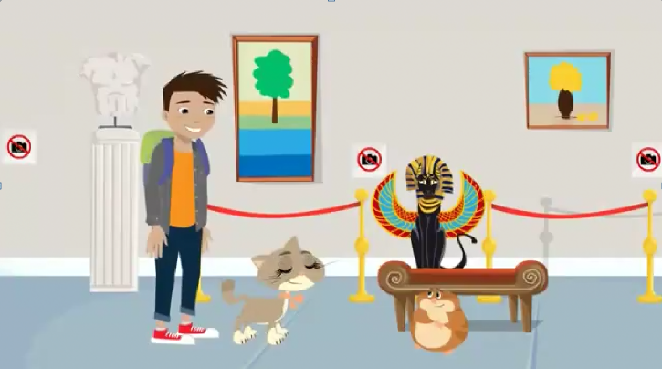
Watch the video about what you must/ mustn’t do in the museum.

Slide 17
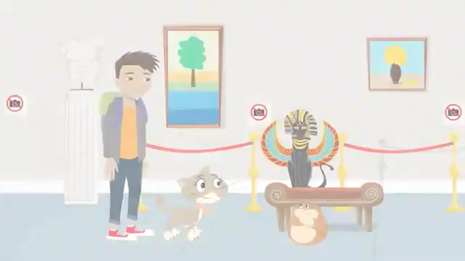

Slide 18

Form and usage of “must / mustn’t”

Slide 19
Grammar
Modal verb: must / mustn’t
- We use must to say that something is very necessary or very important.
- We use mustn’t to say that doing something is not allowed.
I | must | V(bare infinitive).
We/ You/ They
He / She / It
I | mustn’t
We/ You/ They
He / She / It

Slide 20

Fill each blank with must or mustn’t.
must
1.
You leave the hotel room before 12 o’clock.
mustn’t
2.
You make lots of noise in the museum.
3.
My mum says you
always tell the truth.
must
mustn’t
4.
You know you go to bed with your shoes on.
5.
I want to speak English better.
I
must
practice more.

Slide 21

Read the classroom rules below. Write some more rules for you and your classmates.
1.
We must arrive on time.
2.
We mustn’t pick flowers in the school garden.
3.
We must .
4.
We mustn’t .
5.
.

Slide 22
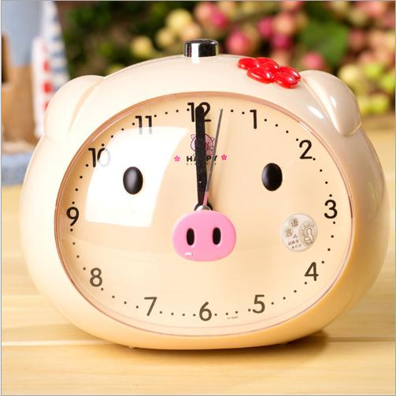
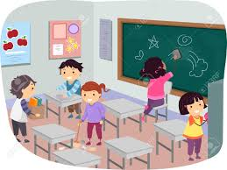

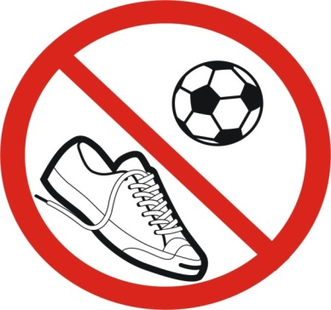

Look at the rules of classroom. Complete the sentences, by using must or mustn’t
must
1.We ………arrive on time.
2. We …….. clean the floor and the board.
3. We………….talk in class.
4. We …………play football in class.
5.We .…… put the garbage in the waste basket.
must
mustn’t
mustn’t
must

Slide 23
L
U
C
K
Y
N
U
M
B
E
R
1
2
3
4
5
6

Slide 24
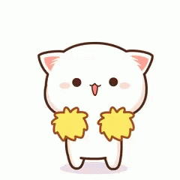
Put the words in the correct order
is/ Tuan Chau island / than bigger / Phu Quoc/ island
→ Phu Quoc island is bigger than Tuan Chau island .

Slide 25

must
DO
HOMEWORK
mustn’t
DO
HOMEWORK
We must do our homework.

Slide 26

must
mustn’t
We mustn’t eat and drink in class.

Slide 27

mustn’t
must
We mustn’t step on the flowers.

Slide 28

L
U
C
K
Y

Slide 29

L
U
C
K
Y

Slide 30

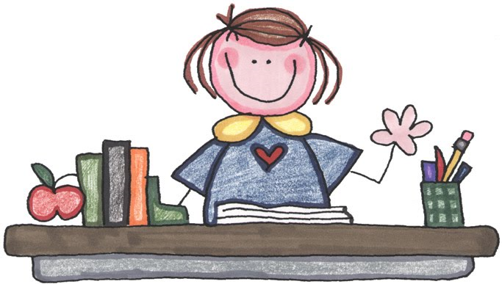
Review Countale nouns, Uncountable nouns and “must/ mustn’t”
Prepare the next lesson: “Communication” on page 53: torch, waterproof coat,diverse

Slide 31



