Slide 1




Welcome to English Class
Let’s learn English !

Slide 2
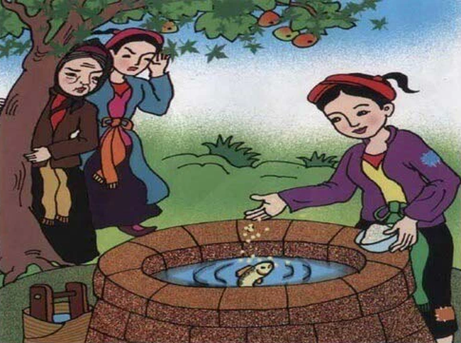
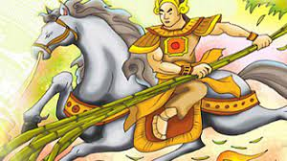
Warm up:
Tam and Cam
Saint Giong

Slide 3
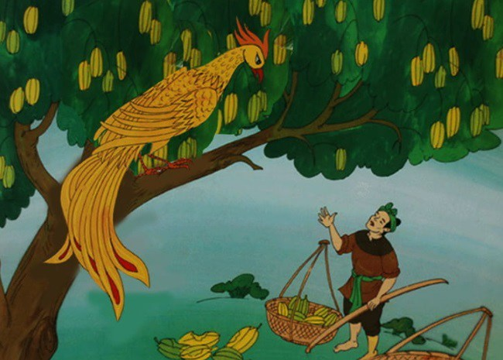
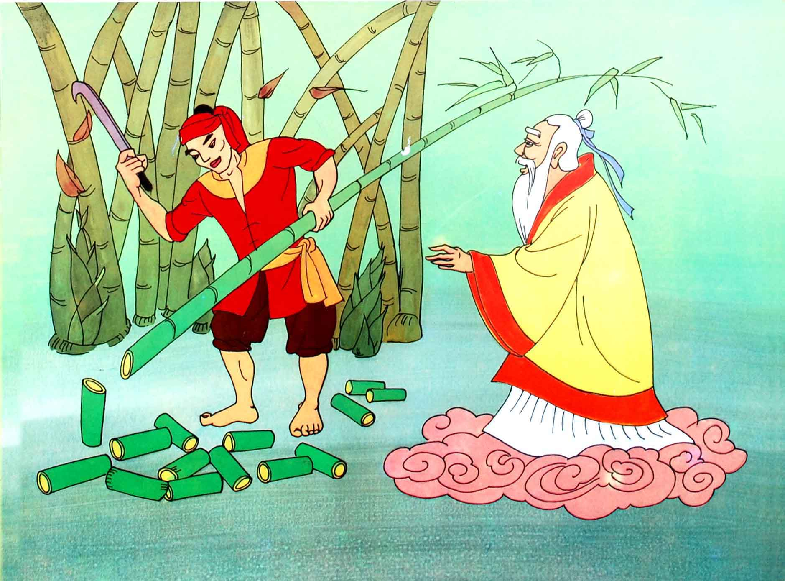
The starfruit tree
The hundred –knot Bamboo Tree

Slide 4
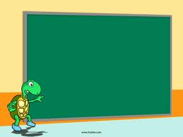
Unit 6: FOLK TALES
Lesson 4: Skills 1

Slide 5
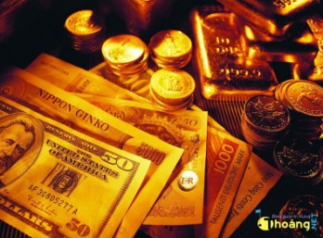
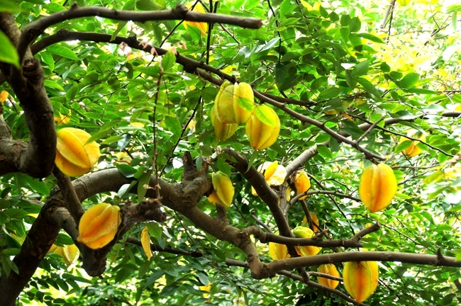
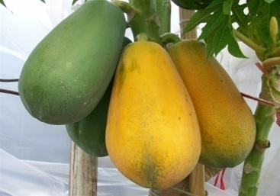
Gia tài,của cải
Startfuit tree
ripe

Slide 6
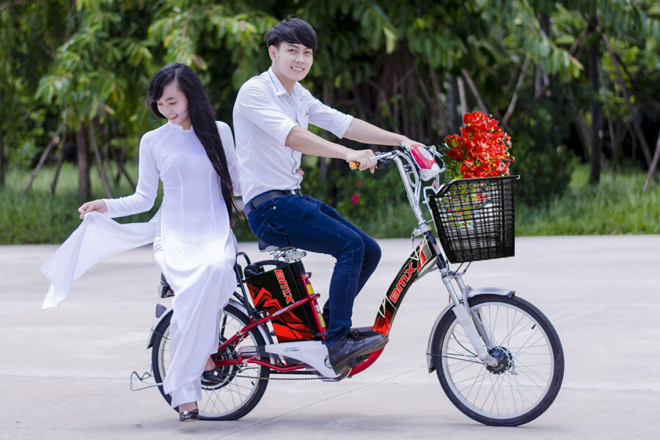
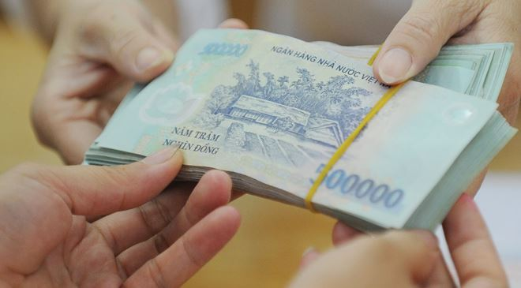
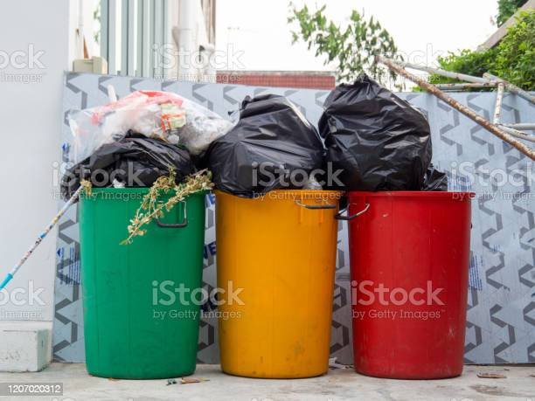
load
repay
filled

Slide 7
I Vocabulary
1 ‘fortune /ˈfɔːtʃuːn/(n): của cải
2 ‘starfuit /ˈstɑː fruːt/ tree (n) cây khế
3 ripe /raɪp/(adj) chín
4 load /ləʊd/ (v) chở
5 re’pay /rɪˈpeɪ/ (v) trả lại
6 filled /fɪld/ (v) chứa đầy

Slide 8
II. Reading
1. Read the fable The Starfruit Tree. Then find the following words and underline them in the story.
fortune - starfruit tree - ripe- filled - load - repay
Once upon a time, there was a rich man living in a village. When he died, he left his two sons a fortune. But the elder brother gave his brother only a starfruit tree. When the fruit was ripe, an eagle came and ate the fruit. The younger brother begged the eagle not to. The eagle promised to repay him in gold and told him to make a bag to carry it. The eagle took him on its back to a place of gold. There, he filled the bag with gold. When he got home he was rich. The elder brother was surprised, so he asked his brother to explain. After hearing the story, he offered to swap his fortune for the starfruit tree, and his kind brother accepted. When the eagle came, the elder brother asked it to take him to the place of gold. The greedy brother filled a very large bag and all his pockets with gold. On the way home, because the load was too heavy, the eagle got tired and dropped him into the sea.

Slide 9
2. Read the story again and answer the questions.
1. What did the older brother give his younger brother?
2. What did the eagle promise to the younger brother?
3. What did the elder brother do when he found out how his younger brother became rich?
4. What did the elder brother do when he got to the place of gold?
5. What happened to the elder brother in the end?
ANSWERS:
1. He gave his younger brother only a starfruit tree.
2. The eagle promised to repay him in gold.
3. He offered to swap his fortune for his brother’s starfruit tree.
4. He filled a very large bag and all his pockets with gold.
5. He was dropped (by the eagle) into the sea.

Slide 10
3. Now complete the details of the fable.
Main characters | Character 1: The younger brother. He is kind and honest. Character 2: The elder brother. He is (1)________. Characters 3: The eagle. It is grateful. A. Generous B. good C. greedy
Plot: beginning | Once upon a (2) ________ , there was a rich man living in a village. A. Week B. time C. day
Plot: middle | The man left his two sons a (3) ________ but the elder brother gave his brother only a starfruit tree. An eagle came and ate the fruit. It repaid the younger brother by taking him to a place of (4) ________ . He brought home some gold and became very rich. The elder brother (5) ________ his fortune for his brother’s tree. The eagle helped the elder brother take gold. 3. A. house B. fortune C. book 4. A. Trees B. Mountains C. gold 5. A. swapped B. took away C. bought
Plot: end | As the eagle was flying back, the load was too heavy. The eagle got tired and (6) ________ the elder brother into the sea. 6. A. saved B. dropped C. Brought
C. greedy
B. time
B. fortune
C. gold
A. swapped
dropped

Slide 11
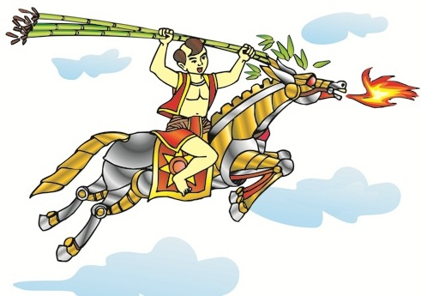
4. Read the story summaries below. Decide which story you would like to read.
III. Speaking
Title: Saint Giong
Genre: legend
Main characters: Thanh Giong
Plot: Thanh Giong lived in the village
of Phu Dong. He was already three
years old, but he couldn’t sit up or say
any words. However, when the enemy
invaded his country, he helped Emperor
Hung Vuong the Sixth defeat the enemy
and save the country. He flew to heaven
and became a Saint.

Slide 12

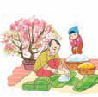
Title: Chung Cakes, Day Cakes
Genre: folk tale
Main characters: Prince Tiet Lieu,
his wife, and Emperor Hung Vuong
Plot: Emperor Hung Vuong announced
that the prince who made the most
delicious food would become the new
emperor. Prince Tiet Lieu and his wife
pleased the emperor by creating two
types of rice cakes that represented
Heaven and Earth. Emperor Hung Vuong made Tiet Lieu the new emperor.
Title: The Tortoise and the Hare
Genre: fable
Main characters: a hare and a tortoise
Plot: The hare always boasted about how fast he could run. The tortoise challenged him to a race. The hare soon left the tortoise behind.
The hare believed that he would win,
and he stopped to take a nap. When
he woke up, he found that the tortoise
arrived before him

Slide 13
5. Work in pairs. Ask and answer questions about the stories.
Questions
1. Which story do you want to read? | Giong Saint.
2. What kind of story is it? | (It is ) legend.
3. Who is the main character in it? | Giong Saint (is the main character)
4. What is it about? | It’s about Giong Saint who helped Emperor Hung Vuong the Sixth defeat the enemy and save the country
….

Slide 14
GAME
WHO AM I?
I was a three years old child. Then I grew up to be came a giant and save our country from the An under Emperor Hung King The sixth.
Thanh Giong / Giong Saint

Slide 15

.
- Learn vocabulary by heart and rewrite them in sentences.
- Redo the exercise in your notebook.
- Prepare for SKILLS 2

Slide 16


