Slide 1
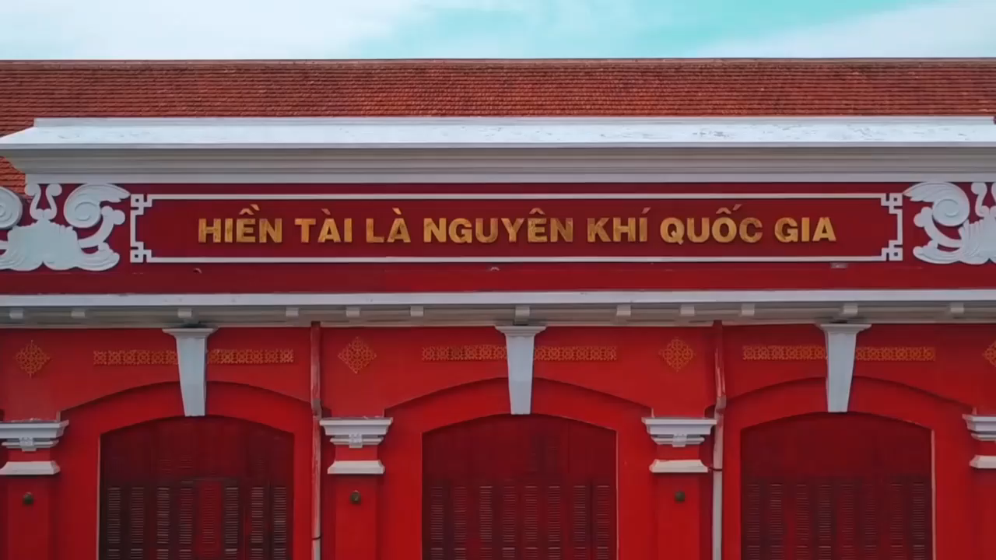
What can you see in the video?

Slide 2
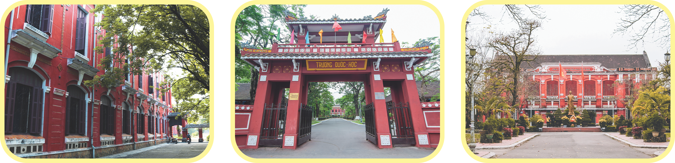
Quoc Hoc - Hue
What do you know about Quoc Hoc - Hue?

Slide 3
UNIT 2:
A VISIT TO A SCHOOL
LESSON 5: SKILLS 1

Slide 4
OBJECTIVES
01
02
READING
develop reading skill about a famous school
SPEAKING
develop speaking skill: talking about one’s school

Slide 5
01
READING
Page 66

Slide 6



NEW WORDS
found (v)
/faʊnd/
thành lập

Slide 7

NEW WORDS
well-known (adj)
/ˌwel ˈnəʊn/
nổi tiếng

Slide 8
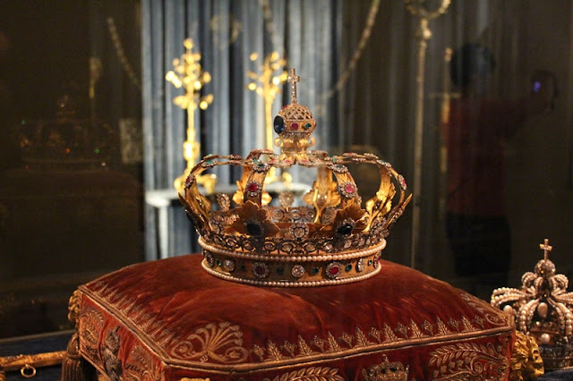
NEW WORDS
royal (adj)
/ˈrɔɪ.əl/
thuộc về hoàng gia

Slide 9

NEW WORDS
projector (n)
/prəˈdʒek.tər/
máy chiếu

Slide 10
NEW WORDS
New words | Pronunciation | Meaning
found | /faʊnd/ | thành lập
well-known | /ˌwelˈnəʊn/ | nổi tiếng
royal | /ˈrɔɪəl/ | thuộc về hoàng gia
projector | /prəˈdʒektər/ | máy chiếu

Slide 11
Ex 2. Read and answer
Quoc Hoc – Hue is one of the oldest schools in Viet Nam. It is on the bank of the Huong River, in Hue. It was founded in 1896. It used to be a school for children from rich and royal families. Well-known people such as Ho Chi Minh, Vo Nguyen Giap, Xuan Dieu studied there.
Nowadays, the school is for gifted students. They are intelligent and study hard. They have to pass an entrance exam to enter the school. The school has over 50 classrooms with TVs, projectors, and computers. It also has a swimming pool, a library, two English labs, four computer rooms, and many other modern facilities. The school is one of the largest and most beautiful schools in Viet Nam.
1. Where is Quoc Hoc – Hue?
2. Who were some of the well-known students of the school?
3. What are the students like?
4. How many English labs does it have?

Slide 12
Underline key words
Read silently and answer.
Quoc Hoc – Hue is one of the oldest schools in Viet Nam. It is on the bank of the Huong River, in Hue. It was founded in 1896. It used to be a school for children from rich and royal families. Well-known people such as Ho Chi Minh, Vo Nguyen Giap, Xuan Dieu studied there.
Nowadays, the school is for gifted students. They are intelligent and study hard. They have to pass an entrance exam to enter the school. The school has over 50 classrooms with TVs, projectors, and computers. It also has a swimming pool, a library, two English labs, four computer rooms, and many other modern facilities. The school is one of the largest and most beautiful schools in Viet Nam.
1. Where is Quoc Hoc – Hue?
2. Who were some of the well-known students of the school?
3. What are the students like?
4. How many English labs does it have?

Slide 13
Swap and check.
Quoc Hoc – Hue is one of the oldest schools in Viet Nam. It is on the bank of the Huong River, in Hue. It was founded in 1896. It used to be a school for children from rich and royal families. Well-known people such as Ho Chi Minh, Vo Nguyen Giap, Xuan Dieu studied there.
Nowadays, the school is for gifted students. They are intelligent and study hard. They have to pass an entrance exam to enter the school. The school has over 50 classrooms with TVs, projectors, and computers. It also has a swimming pool, a library, two English labs, four computer rooms, and many other modern facilities. The school is one of the largest and most beautiful schools in Viet Nam.
1. Where is Quoc Hoc – Hue?
 It’s on the bank of the Huong River, in Hue

Slide 14
Swap and check.
Quoc Hoc – Hue is one of the oldest schools in Viet Nam. It is on the bank of the Huong River, in Hue. It was founded in 1896. It used to be a school for children from rich and royal families. Well-known people such as Ho Chi Minh, Vo Nguyen Giap, Xuan Dieu studied there.
Nowadays, the school is for gifted students. They are intelligent and study hard. They have to pass an entrance exam to enter the school. The school has over 50 classrooms with TVs, projectors, and computers. It also has a swimming pool, a library, two English labs, four computer rooms, and many other modern facilities. The school is one of the largest and most beautiful schools in Viet Nam.
2. Who were some of the well-known students of the school?
 They were Ho Chi Minh,
Vo Nguyen Giap, Xuan Dieu.

Slide 15
Swap and check.
Quoc Hoc – Hue is one of the oldest schools in Viet Nam. It is on the bank of the Huong River, in Hue. It was founded in 1896. It used to be a school for children from rich and royal families. Well-known people such as Ho Chi Minh, Vo Nguyen Giap, Xuan Dieu studied there.
Nowadays, the school is for gifted students. They are intelligent and study hard. They have to pass an entrance exam to enter the school. The school has over 50 classrooms with TVs, projectors, and computers. It also has a swimming pool, a library, two English labs, four computer rooms, and many other modern facilities. The school is one of the largest and most beautiful schools in Viet Nam.
3. What are the students like?
 They are intelligent and study hard

Slide 16
Swap and check.
Quoc Hoc – Hue is one of the oldest schools in Viet Nam. It is on the bank of the Huong River, in Hue. It was founded in 1896. It used to be a school for children from rich and royal families. Well-known people such as Ho Chi Minh, Vo Nguyen Giap, Xuan Dieu studied there.
Nowadays, the school is for gifted students. They are intelligent and study hard. They have to pass an entrance exam to enter the school. The school has over 50 classrooms with TVs, projectors, and computers. It also has a swimming pool, a library, two English labs, four computer rooms, and many other modern facilities. The school is one of the largest and most beautiful schools in Viet Nam.
4. How many English labs does it have?
 It has two English labs.

Slide 17
02
SPEAKING
Page 66

Slide 18
Read again and complete the table.
Name | Quoc Hoc - Hue
Location
Students
School facilities

Slide 19
Read again and complete the table.
Name | Quoc Hoc - Hue
Location
Students
School facilities
On the bank of the Huong River, in Hue
Intelligent and hard-working
Over 50 classrooms (with TVs, projectors, computers), a swimming pool, a library, two English labs, four computer rooms, and many other modern facilities.
Report it to the class
Example:
The name of the school is Quoc Hoc – Hue

Slide 20

Ex 4. Work in pairs. Answer the questions with the information in the table.
Name | Hung Vuong Lower Secondary school
Location | 120, Hung Vuong Street
Students | Hard-working and intelligent
School facilities | 20 classrooms, one library, two computer rooms, one gym, one garden
1. What is the full name of the school?
2. Where is it?
3. What are the students like?
4. What facilities does the school have?

Slide 21
Ex 5. Work in groups. Tell about your school.
Leader?
Idea thinkers?
Work in groups of 6.
Drawers?
Presenters?

Slide 22


Ex 5. Work in groups. Tell about your school.
Think about your school.
Draw and write some key words
5 minutes
Name
Location
Students and teachers
School facilities

Slide 23
Let’s present!
I’d like to talk about my school …

Slide 24
RECAP
READING
Read about a famous school
SPEAKING
Talking about one’s school

Slide 25
THANKS!
Do you have any questions?
Please keep this slide for attribution

