Slide 1


YEN SO SECONDARY SCHOOL
Warmly welcome to our class
Teacher : Nguyen Thi Huyen
Notes:
Hello everybo

Slide 2
WARM-UP

Slide 3

Unit
4
ETHNIC GROUPS OF VIET NAM
Unit
ETHNIC GROUPS OF VIET NAM
LESSON 7: LOOKING BACK & PROJECT
LESSON 3: A CLOSER LOOK 2
Vocabulary
Grammar
Project
Unit
HOBBIES

Slide 4

VOCABULARY

Slide 5
VOCABULARY
1
Match the words and phrases with the pictures.
1. weaving
2. folk dance
3. open fire
4. fishing
5. minority group

Slide 6
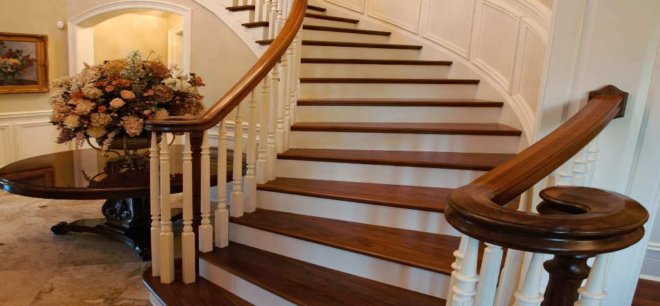
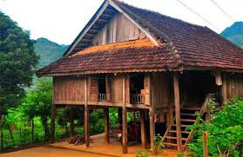
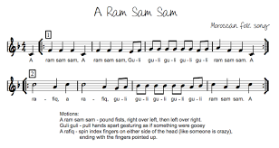

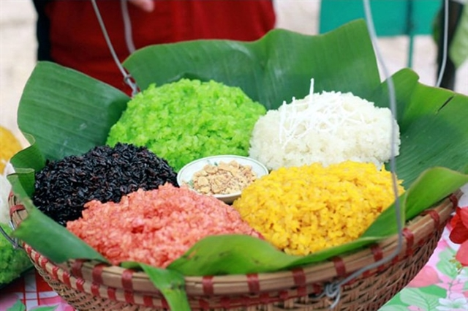
VOCABULARY
1
Match the words and phrases with the pictures.
folk songs
staircase
sticky rice
communal house
musical instrument

Slide 7
VOCABULARY
2
Complete the sentences with the word and phrases from the box.
folk songs
staircase
sticky rice
communal house
musical instruments
1. Minority groups have their own ______________ like the dan tinh, gong, t’rung.
2. The Kinh use _________ to make banh chung and banh tet.
3. For most minority groups like the Bahnar and Ede, the ______________, usually known as Rong house, is the heart of the village.
4. My grandmother taught me to sing many __________.
5. The ________of a Muong’s stilt house has an odd number of steps: 5, 7, or 9.

Slide 8
Grammar

Slide 9
GRAMMAR
3
Write questions from the clues.
you / attend / the Khmer’s Moon Worship Festival / last year /?
How many / ethnic minority groups / Viet Nam / ?
Where / the Hmong / live / ?
What / you / do / the Ede’s Harvest Festival / last October / ?
How old / minority children / when / they / start helping / the family / ?

Slide 10
Let’s visit
Ethnic groups
- The class will divide into 2 groups, each group will choose a thing, if:
+ You choose a lucky thing - you will get 2 stars and have another chance to choose other thing.
+ You choose a question, you will have to answer it and get 1 star If it is right.
+ You choose an unlucky thing, you will lose all your stars.
- The winner will get more stars. The loser will have to perform Chicken dance.

Slide 11
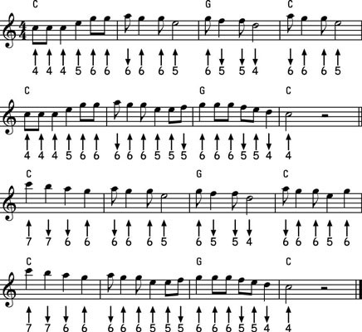
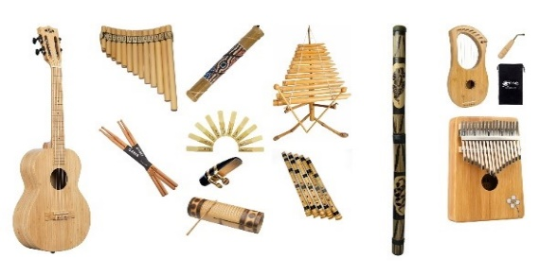
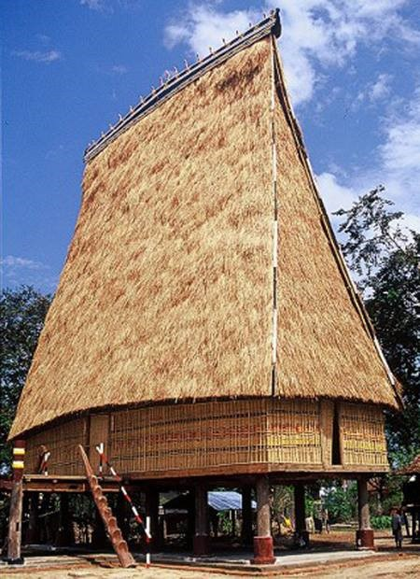

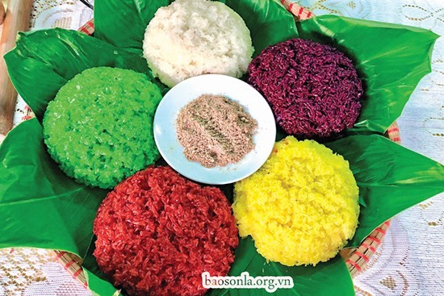
NEXT

Slide 12
1. you / attend / the Khmer’s Moon Worship Festival / last year / ?
Did you attend the Khmer’s Moon Worship Festival last year?

Slide 13
2.How many / ethnic minority groups / Viet Nam / ?
How many ethnic minority groups are there in Viet Nam?

Slide 14
3.Where / the Hmong / live / ?
Where do the Hmong live?

Slide 15
4. What / you / do / the Ede’s Harvest Festival / last October / ?
What did you do at the Ede’s Harvest Festival last October?

Slide 16
5. How old / minority children / when / they / start helping / the family / ?
How old are the minority children when they start helping the family?

Slide 17
I’d like to say.......................
YOU’RE
VERY LUCKY.

Slide 18

I’d like to say.......................
YOU’RE
UNLUCKY.

Slide 19
I’d like to say.......................
YOU’RE
VERY LUCKY.

Slide 20
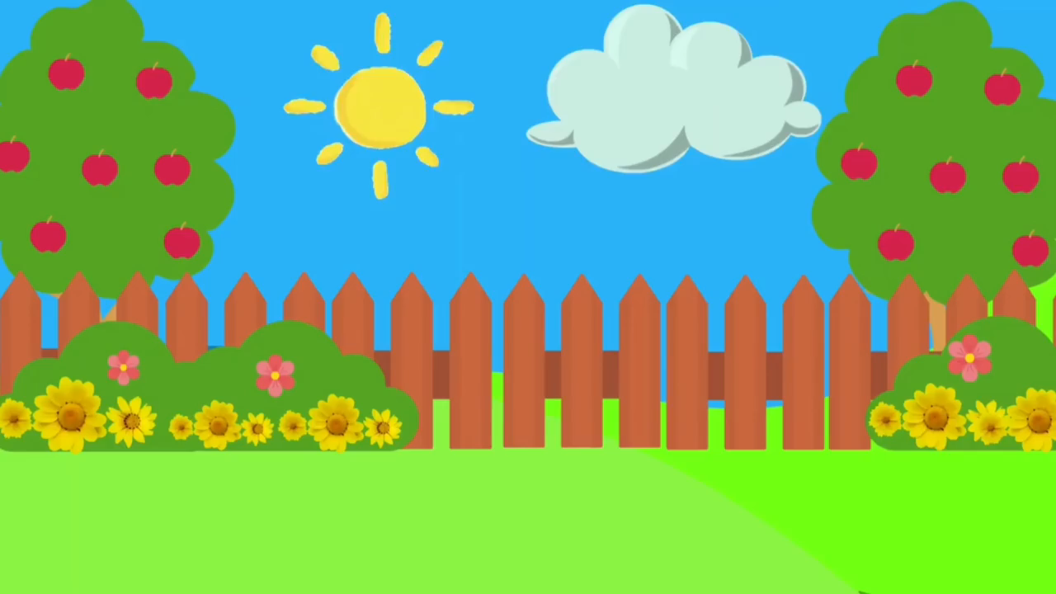

Slide 21
Did you attend the Khmer’s Moon Worship Festival last year?
How many ethnic minority groups are there in Viet Nam?
Where do the Hmong live?
What did you do at the Ede’s Harvest Festival last October?
How old are the minority children when they start helping the family?

Slide 22
GRAMMAR
4
There is one incorrect underlined word in each sentence. Circle and correct it.
 | Correct word
1. A big stilt houses stands on high posts.
2. The Lahu build their houses from wood and wild banana leave.
3. Much people in remote areas travel on foot.
4. Most minority women weave clothes and do houseworks.
5. In the mountains, there is not many land for growing crops.
house
leaves
Many
housework
much

Slide 23
Project

Slide 24

CONSOLIDATION
1
Wrap-up
In this lesson, you have:
revised more vocabulary items in the unit in different context.
revised Yes / No questions and Wh-questions.
revised the use of countable and uncountable nouns.
present your project about our ethnic groups.

Slide 25

CONSOLIDATION
2
Homework
Do exercises in the workbook.
Prepare for Unit 5 – Getting started.

