Slide 1

GAMES
Handicrafts
Brainstorming

Slide 2

traditional handicraft
drums
paintings
conical hats
marble sculptures
Handicrafts
Pottery
silk
lanterns
lacquerware

Slide 3

UNIT 1: LOCAL ENVIRONMENT
Lesson 2: A CLOSER LOOK 1

Slide 4
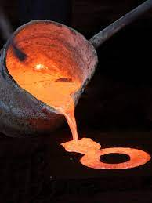
Cast /kɑːst/
đúc

Slide 5
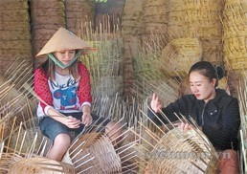
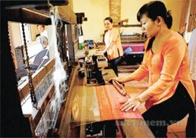
weave /wiːv/
Dệt, đan

Slide 6
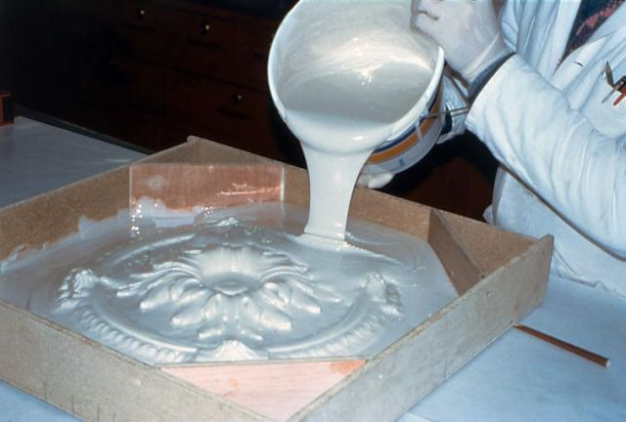
mould /məʊld/
đổ khuôn, tạo khuôn

Slide 7
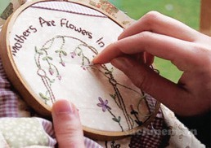
Embroider /ɪmˈbrɔɪ.dər/
thêu

Slide 8
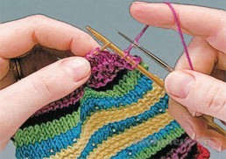
knit /nɪt/
đan

Slide 9
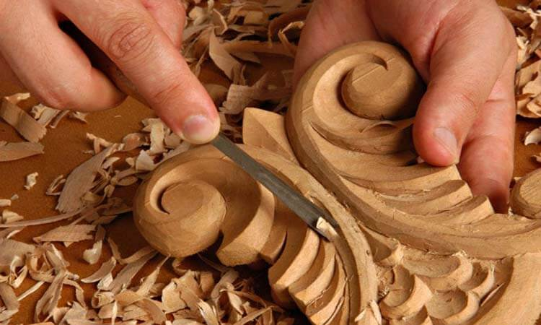
1. Write the verbs in the box under the pictures. ...
carve
cast
weave
embroider
knit
mould
cast
carve
embroider
weave
mould
weave
knit

Slide 10
mould
cast
đúc (đồng): tạo hình kim loại lỏng và nóng
đổ khuôn: định hình một chất mềm thành một vật thể cụ thể bằng cách đặt nó vào khuôn.

Slide 11
2a Match the verbs in column A with the group of nouns in column B
A | B
1. Carve | a. handkerchiefs, tablecloths, pictures
2. Cast | b. stone, wood, eggshells
3. Weave | c. clay, cheese, chocolate
4. Embroider | d. bronze, gold, iron
5. Knit | e. baskets, carpets, silk, cloth
6. Mould | f. sweaters, toys, hats

Slide 12
2a. Match the verbs in column A with ...
A | B
1. Carve
2. Cast
3. Weave
4. Embroider
5.Knit
6.Mould
b. stone, wood, eggshells
d. bronze, gold, iron
e. baskets, carpets, silk, cloth
a. handkerchiefs, tablecloths, pictures
f. sweaters, toys, hats
c. clay, cheese, chocolate

Slide 13
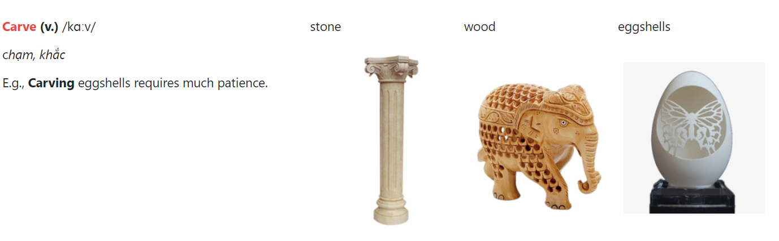
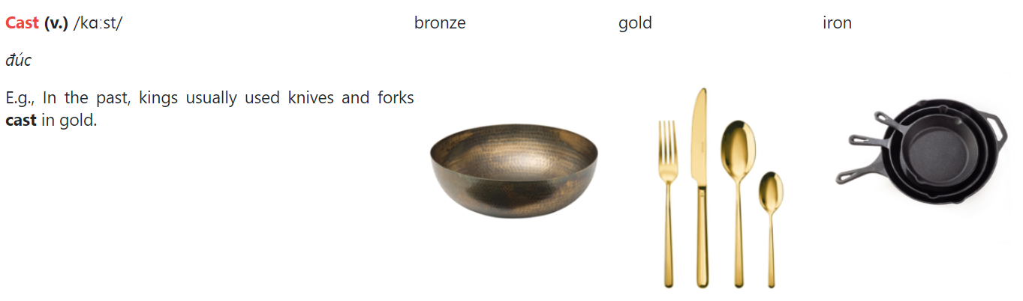

Slide 14
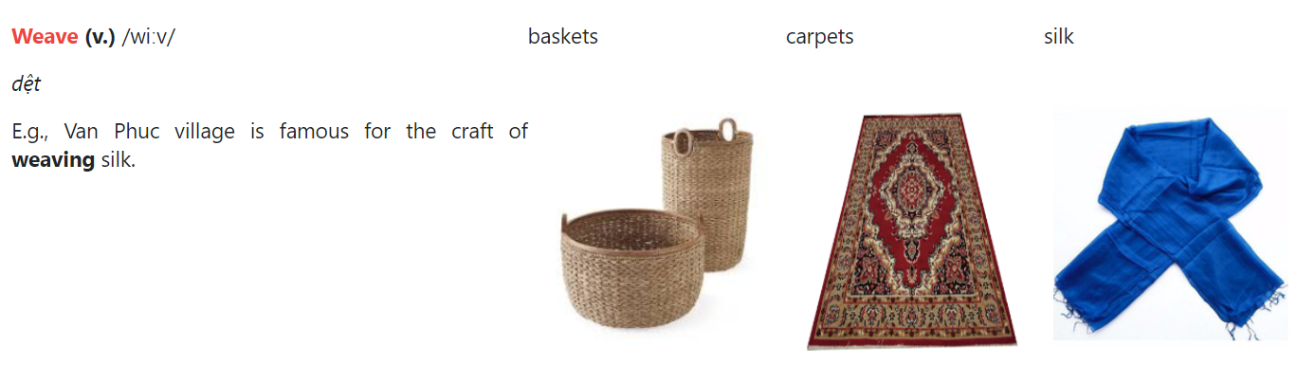
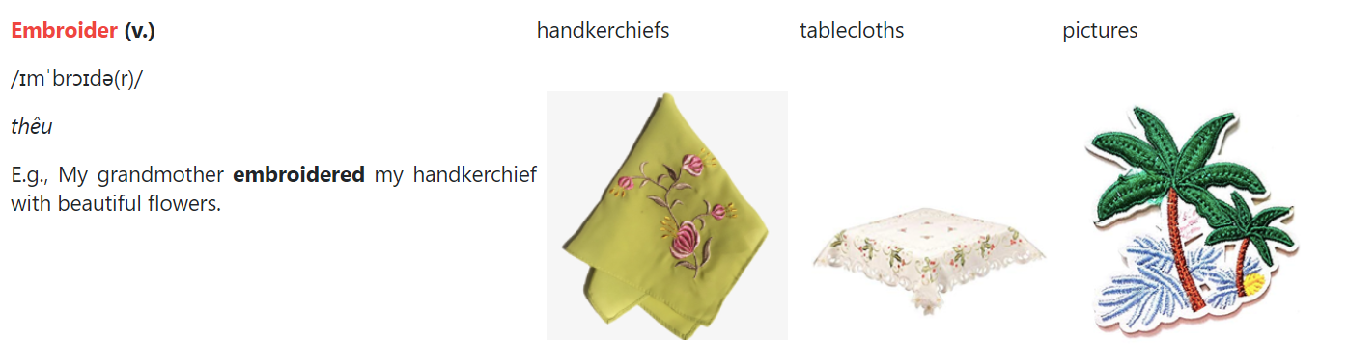

Slide 15
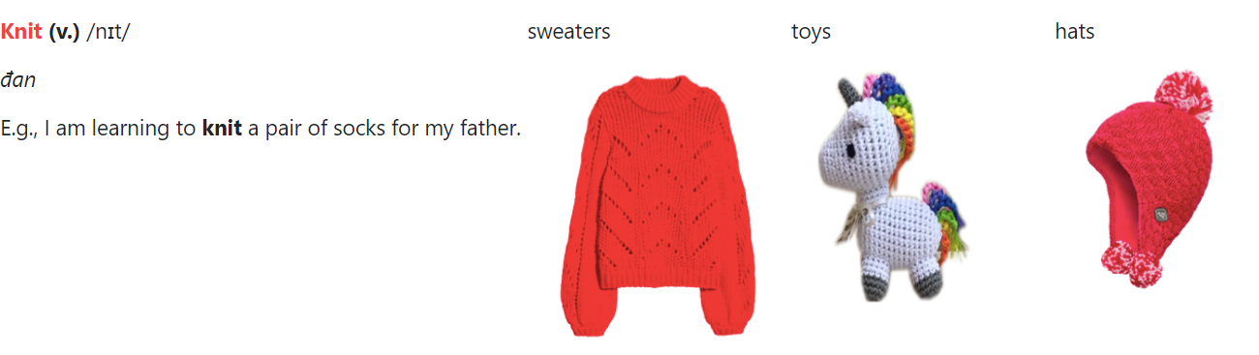
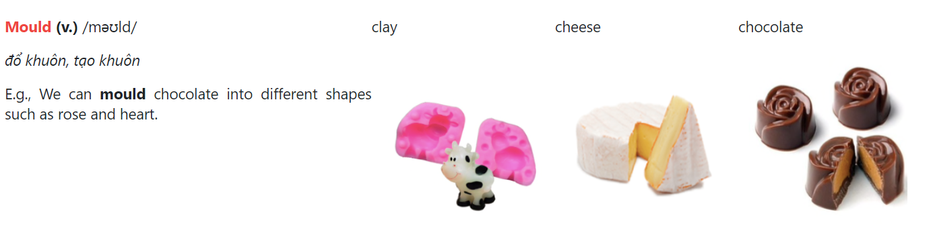

Slide 16

b. Now write the correct verb forms ...
Infinitive | Past tense | Past participle
1. to carve | I carved it. | It was carved.
2. to cast | I _________ it. | It was _________
3. to weave | I _________ it. | It was _________
4. to embroider | I __________ it. | It was _________
5. to knit | I _________ it. | It was _________
6. to mould | I _________ it. | It was _________
cast
cast
wove
woven
embroidered
embroidered
knitted
knitted
moulded
moulded

Slide 17
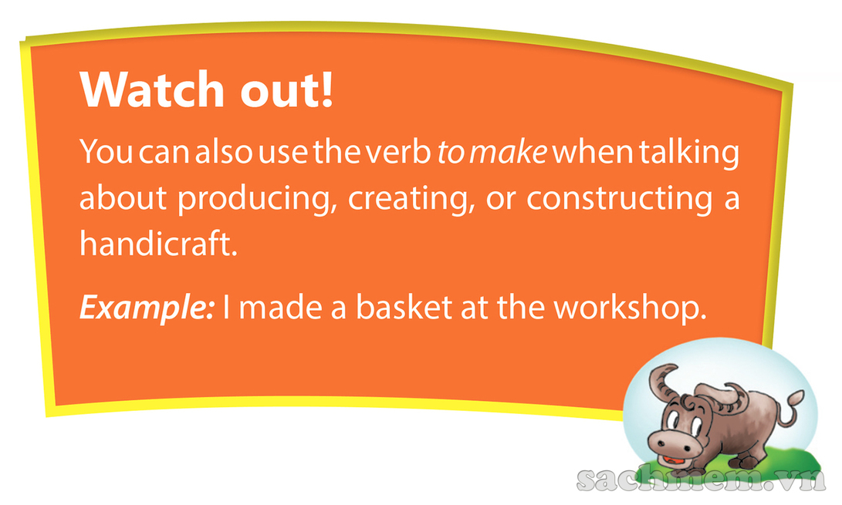

Slide 18
3. Complete the word web
Entertaining
- cinema
Educational
- library
Places of interest
Cultural
- Opera house
Historical
- building

Slide 19

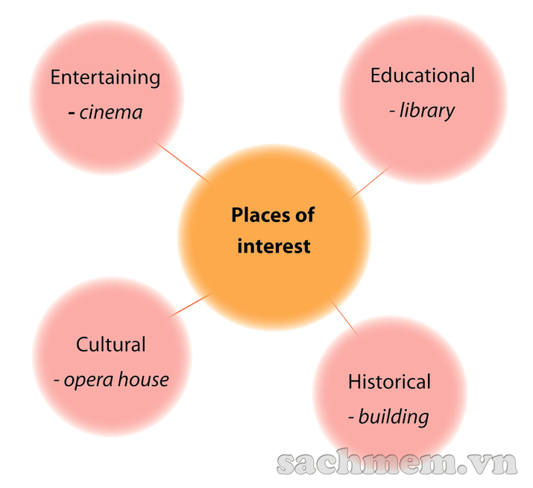
3. What are some places of interest in your area? …
- Entertaining: cinema, department store, restaurant, café, theatre, opera house, club, park, zoo...
- Cultural: opera house, museum, craft village, historical building, theatre, market, craft village...
- Educational: library, museum, theatre...
- Historical: building, temple, shopping district, market, beauty spot, craft village...

Slide 20
4. Complete the pasage by filling each blank …
Some people say that a place of interest is a place famous for its scenery or a well-known (1)________ site. I don’t think it has to be so limited. In my opinion, a place of interest is simply one that people like going to.
In my town, the park is a(n) (2)________ because many people love spending time there. Old people do (3)_______ and walk in the park. Children play games there while their parents sit and talk with each other. Another place of interest in my town is Hoa Binh market. It’s a(n) (4)________ market with a lot of things to see. I love to go there to buy food and clothes, and watch other people buying and selling. Foreign tourists also like this market because they can experience the (5)_________ of Vietnamese people, and buy woven cloth and other (6)___________ as souvenirs.
historical
attraction
exercise
traditional
culture
handicrafts

Slide 21
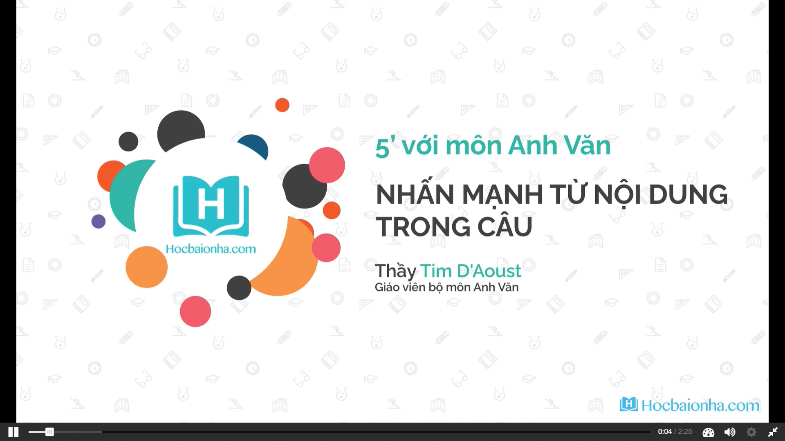
II. Pronunciation

Slide 22

5a. Listen and underline the words are louder and clearer
than the others
1. The craft village lies on the river bank.
2. This painting is embroidered.
3. What is this region famous for?
4. Drums aren’t made in my village.
5. A famous artisan carved this table beautifully.

Slide 23
5a. Answerkey
1. Which words are louder and clearer than the others?
1. The craft village lies on the river bank.
2. This painting is embroidered.
3. What is this region famous for?
4. Drums aren’t made in my village.
5. A famous artisan carved this table beautifully.
2. What kinds of words are they?
They are: nouns, verbs, adjective, adverbs, wh-question words, and negative auxiliaries.

Slide 24
3. Which words are not as loud and clear as the others
1. The craft village lies on the river bank.
2. This painting is embroidered.
3. What is this region famous for?
4. Drums aren’t made in my village.
5. A famous artisan carved this table beautifully.
4. What kinds of words are they?
They are: articles, prepositions, pronouns, and possessive adjectives.

Slide 25
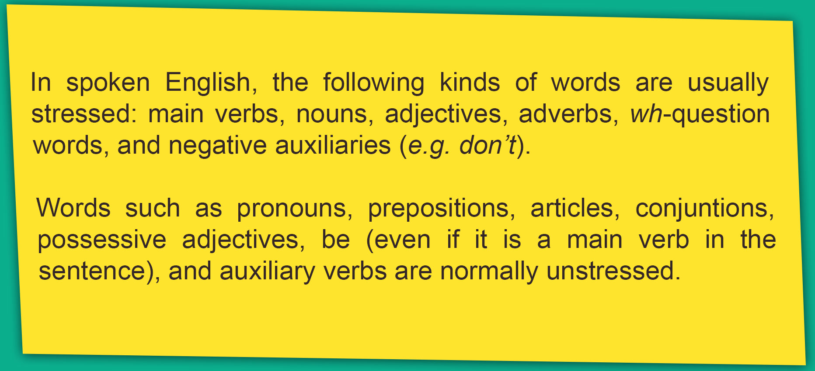
5b. Now listen, check, and repeat

Slide 26
Stress on content words in sentences (Trọng âm của từ trong câu)
Stressed:
Noun :house, teacher…
Verb : go, walk, …
Adj, adv : big, historic…
Wh: what, how…
Negative : isn’t, don’t…
Unstressed:
Article: a, an, the
Preposition : in , on, at…
Pronoun : I, you, we…
Possessive adj : his, her, my….
- Những loại từ sau thường được nhấn mạnh: động từ chính, danh từ, trạng từ, từ để hỏi, và trợ động từ nghi vấn (ví dụ như từ don’t).
- Những loại từ sau thường KHÔNG được nhấn mạnh: Những loại từ như đại từ, giới từ, liên từ, tính từ sở hữu, tobe và các trợ động từ

Slide 27
6. Underline the content word in the sentences.
1. The Arts Museum is a popular place of interest in my city.
2. This cinema attracts lots of youngsters.
3. The artisans mould clay to make traditional pots.
4. Where do you like going at weekend?
5. We shoudn’t destroy historical buildings.

Slide 28

6b. Now listen, check and repeat
1.The Arts Museum is a popular place of interest in my city.
2.This cinema attracts lots of youngsters.
3.The artisans mould clay to make traditional pots.
4.Where do you like going at weekends?
5.We shouldn’t destroy historical buildings.

