Slide 1
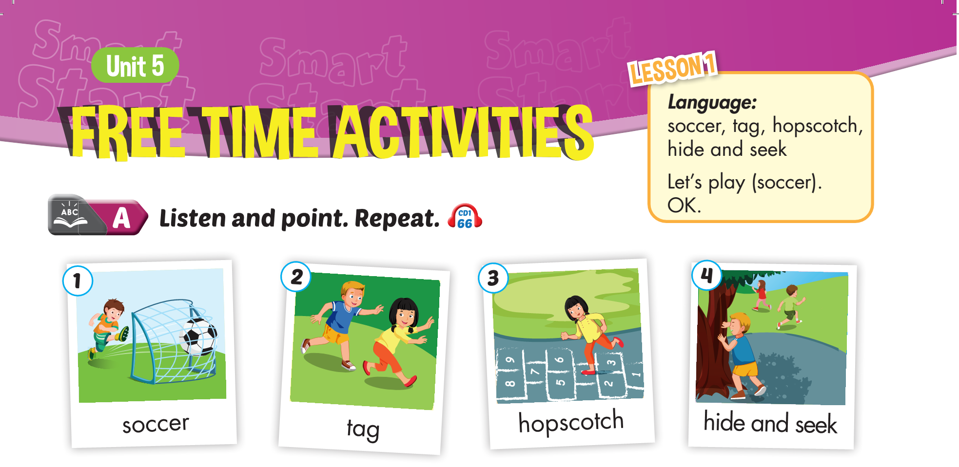


Slide 2
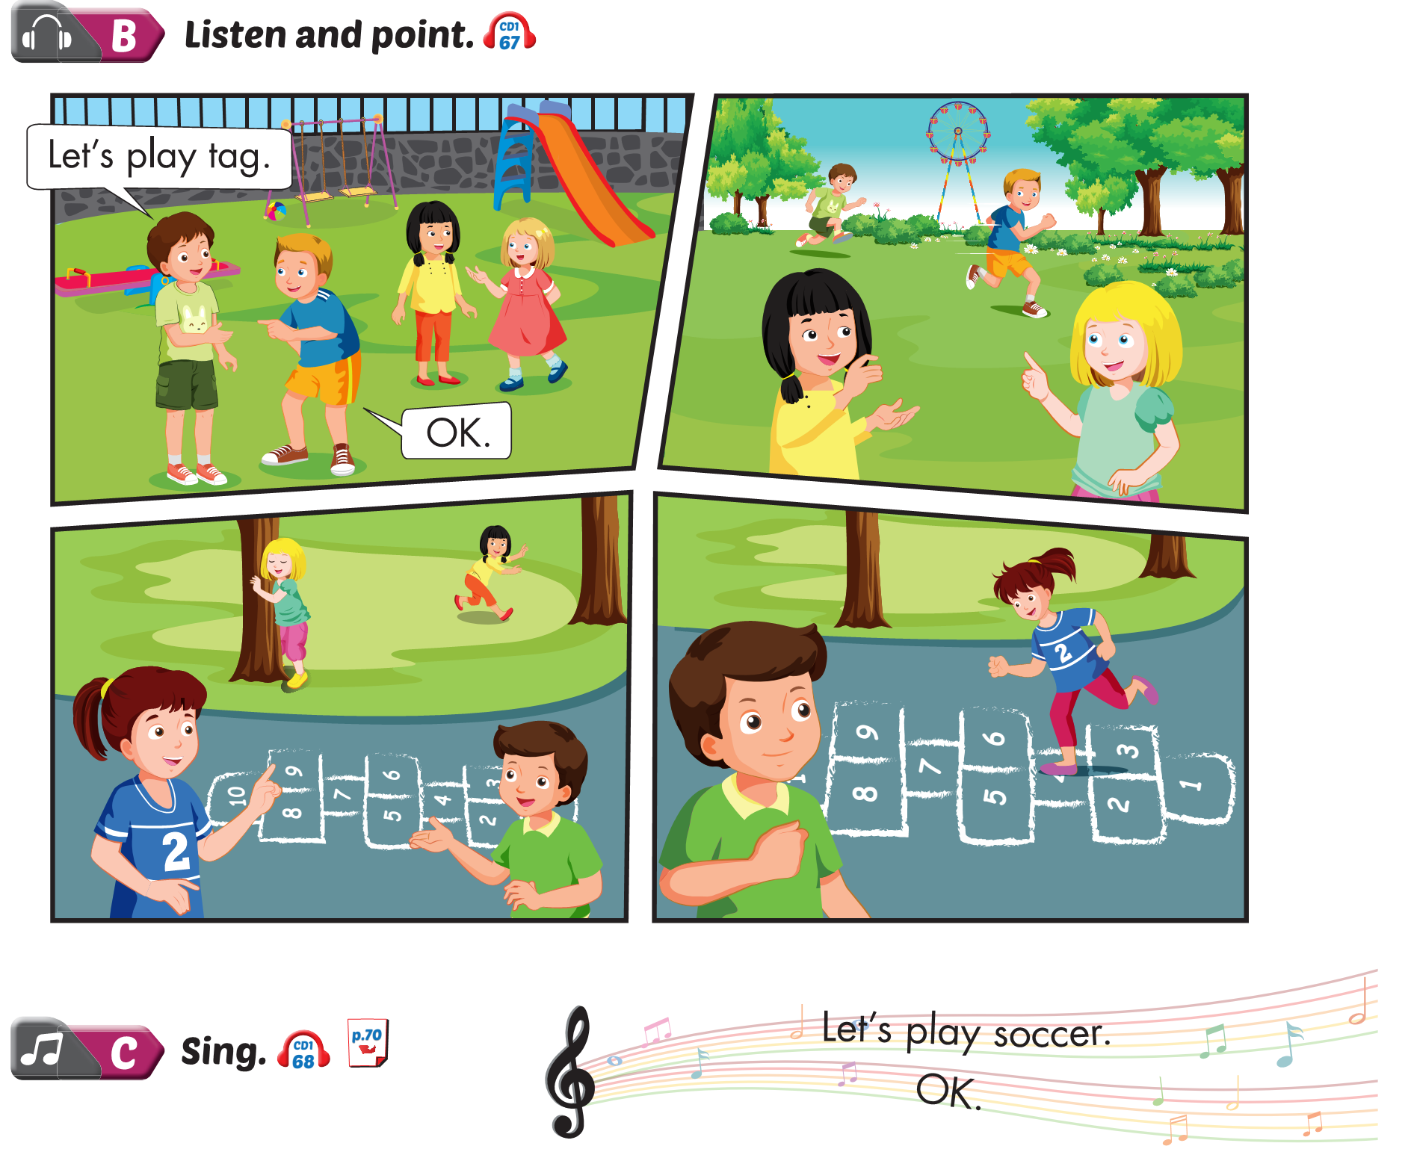
Lesson 1

Slide 3
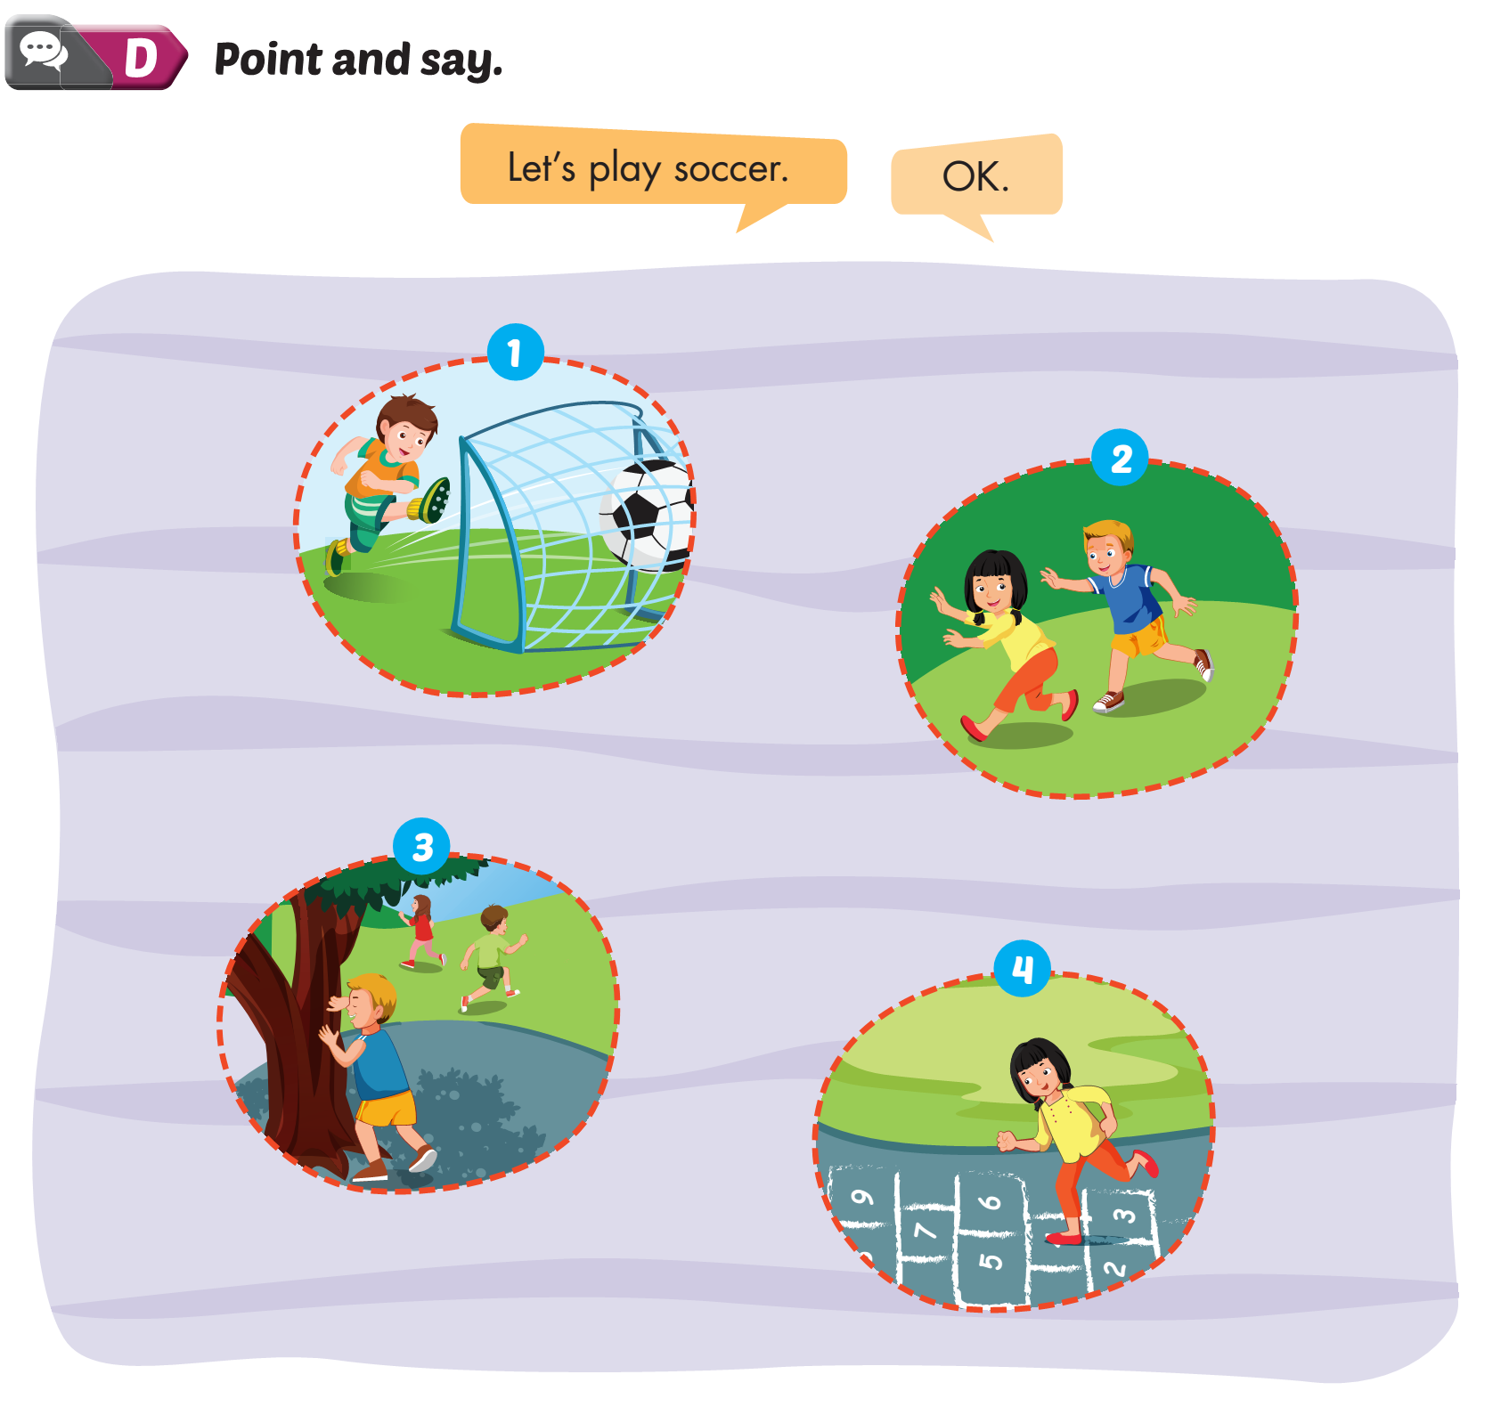
Lesson 1

Slide 4
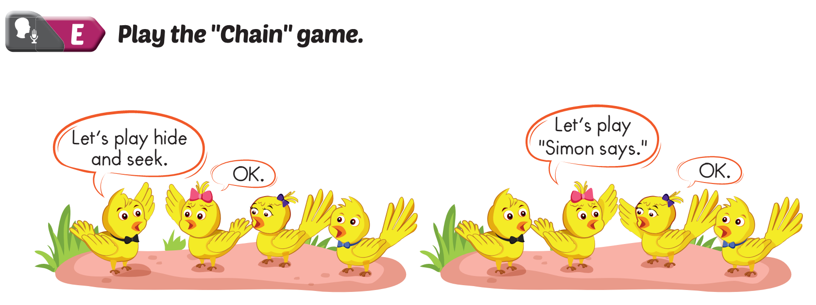
Lesson 1

Slide 5

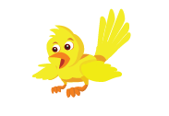

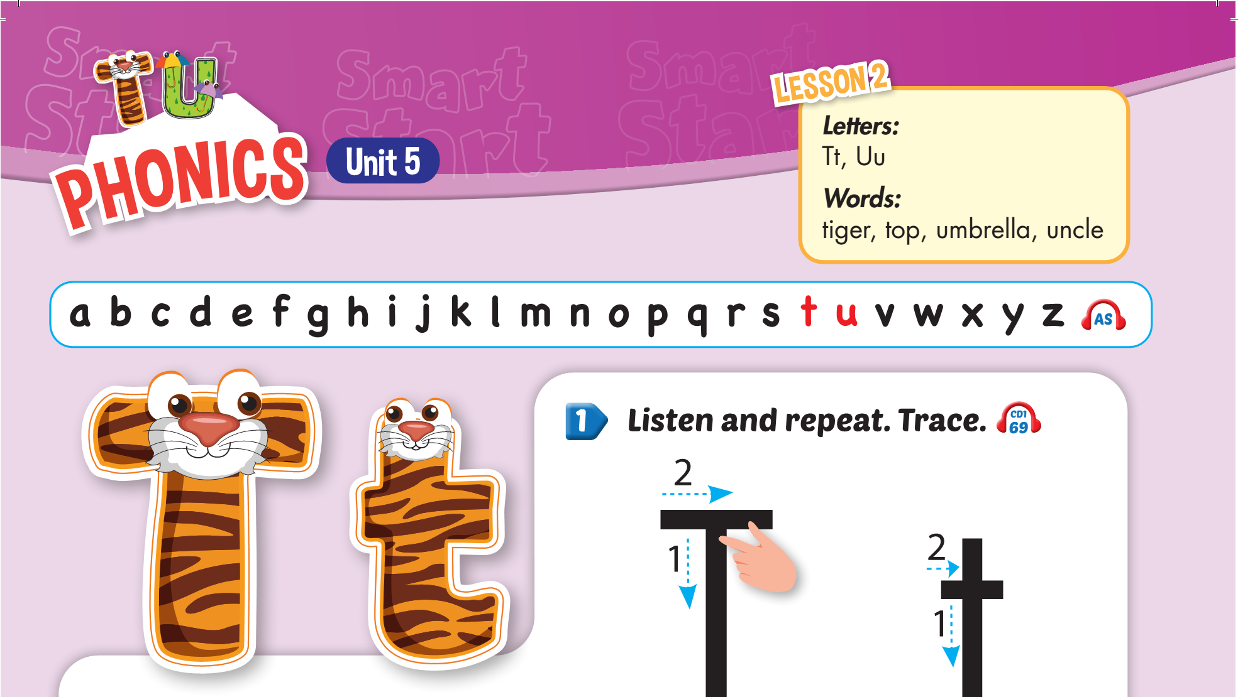
Lesson 2
Notes:
Click on the screen, a bird will fly in over the cats/dogs, and students will say I like... accordingly.

Slide 6
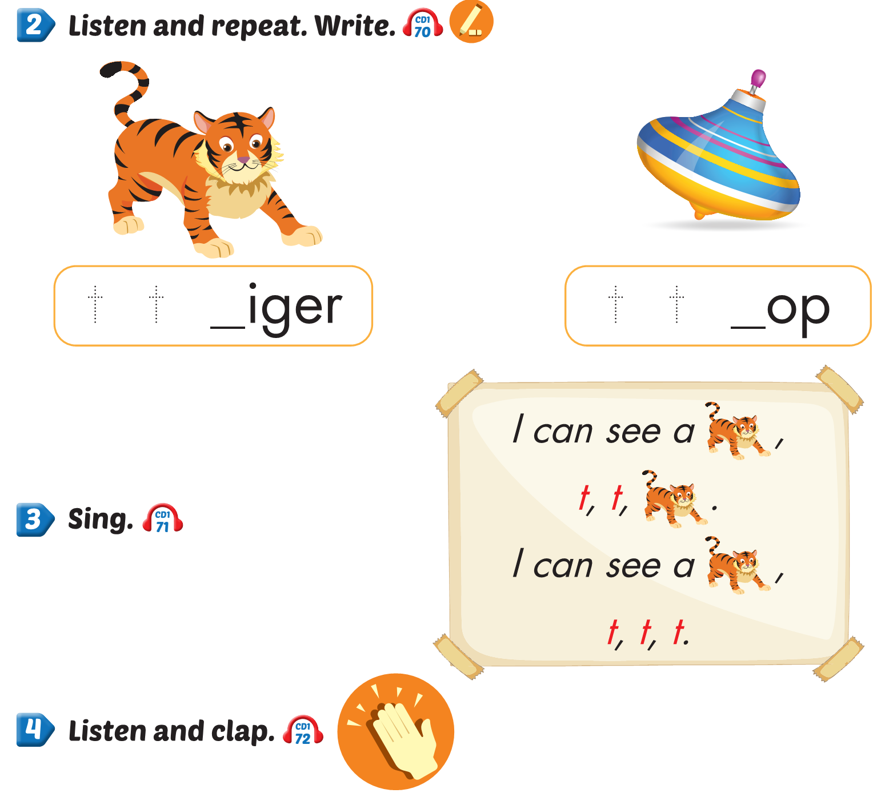
Lesson 2

Slide 7
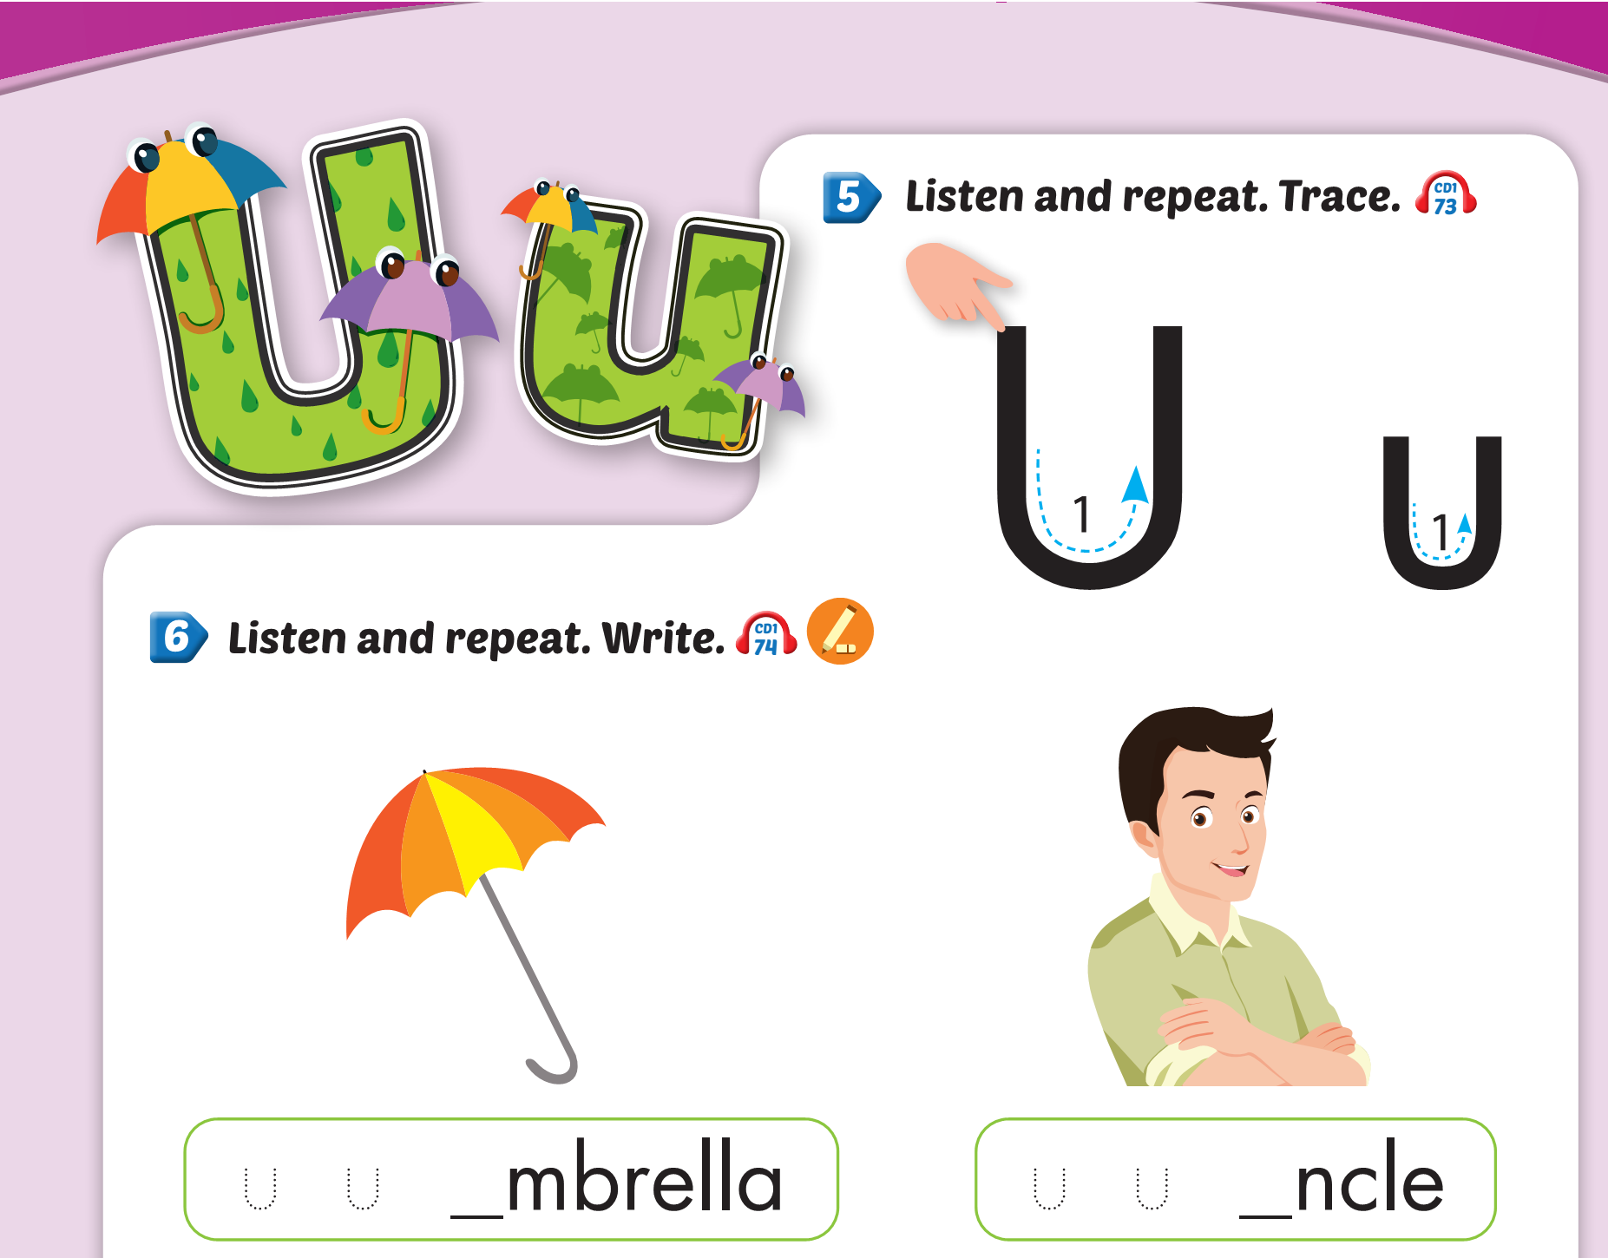
Lesson 2

Slide 8
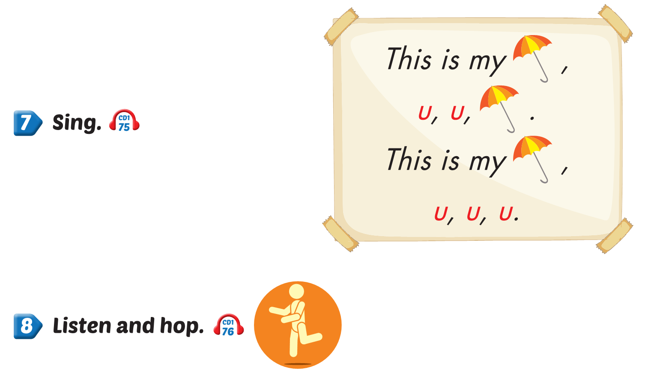
Lesson 2

Slide 9
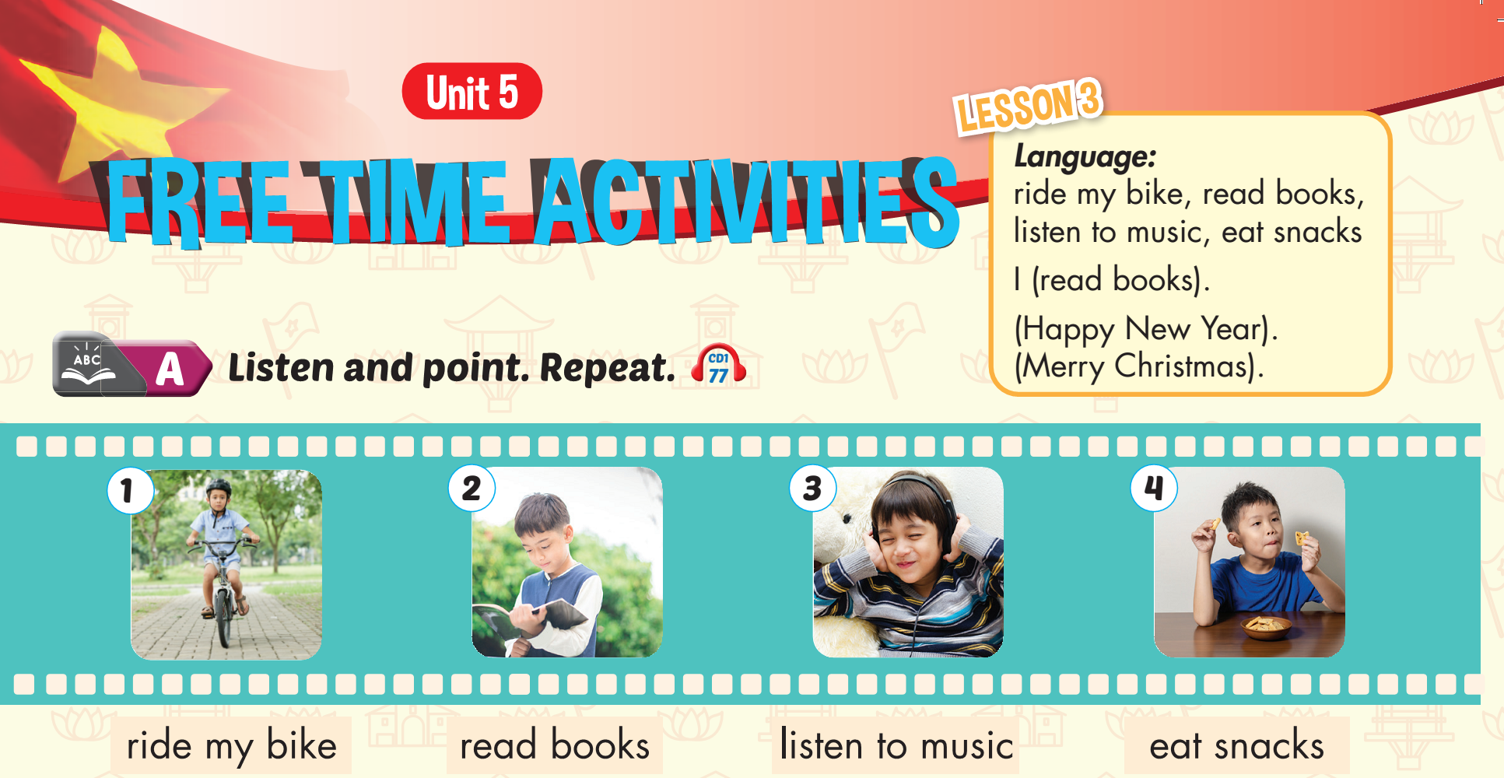

Slide 10
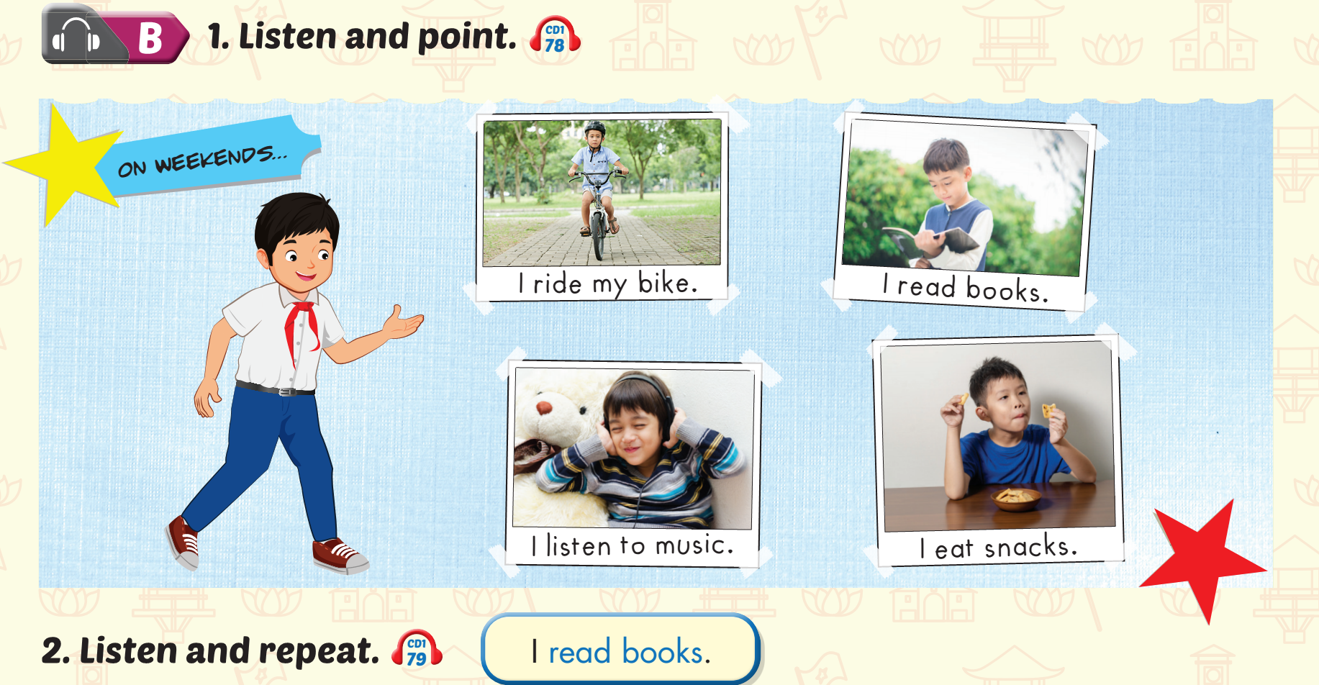
Lesson 3
Notes:
Click on a gift box to show the animal behind.

Slide 11

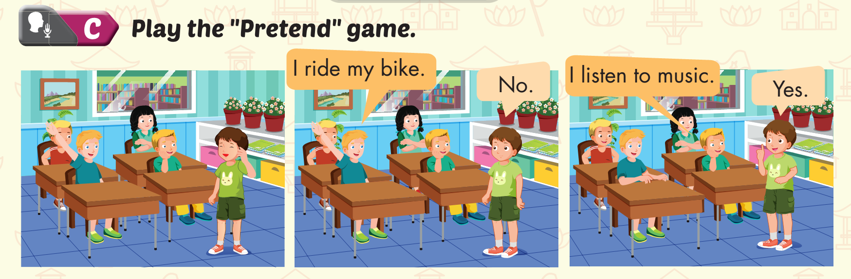
Lesson 3

Slide 12
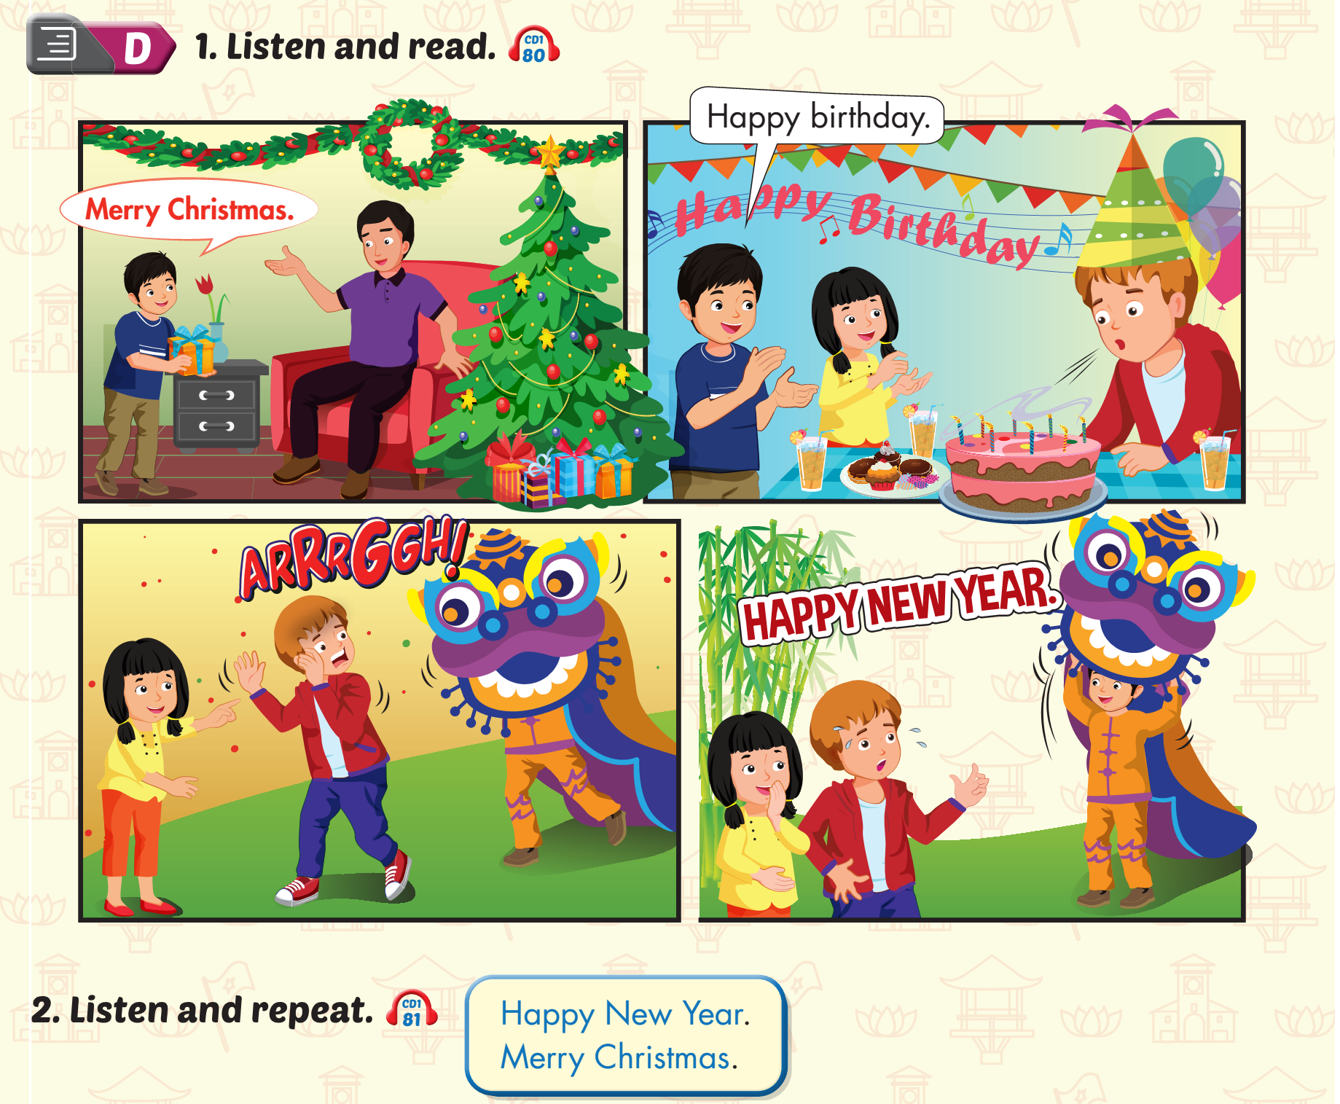
Lesson 3

Slide 13
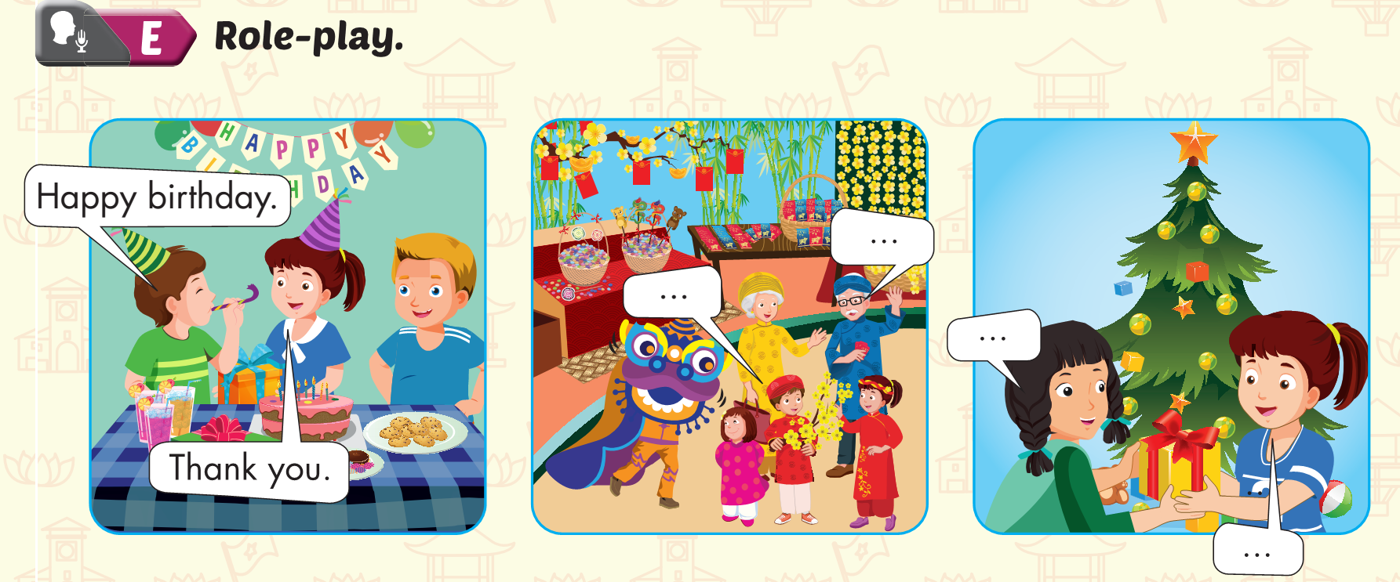
Lesson 3

